Slide 1
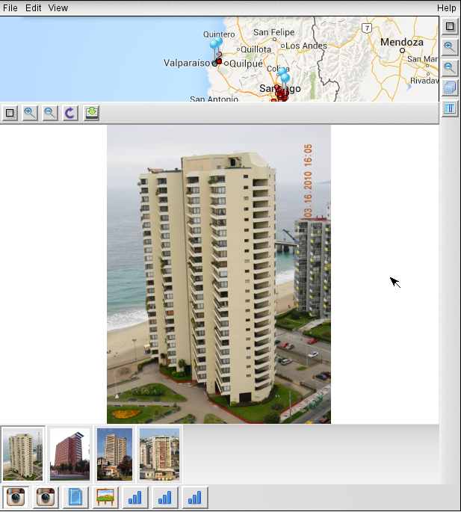
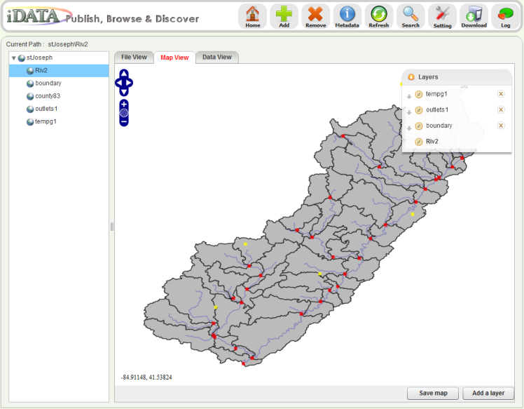
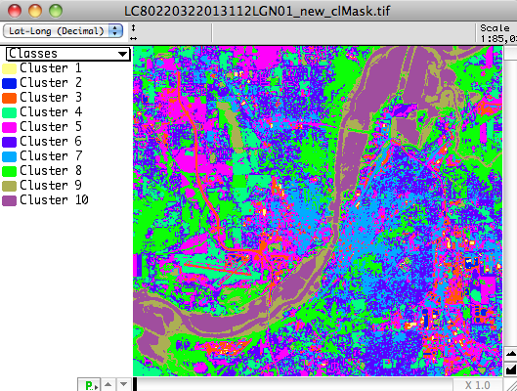
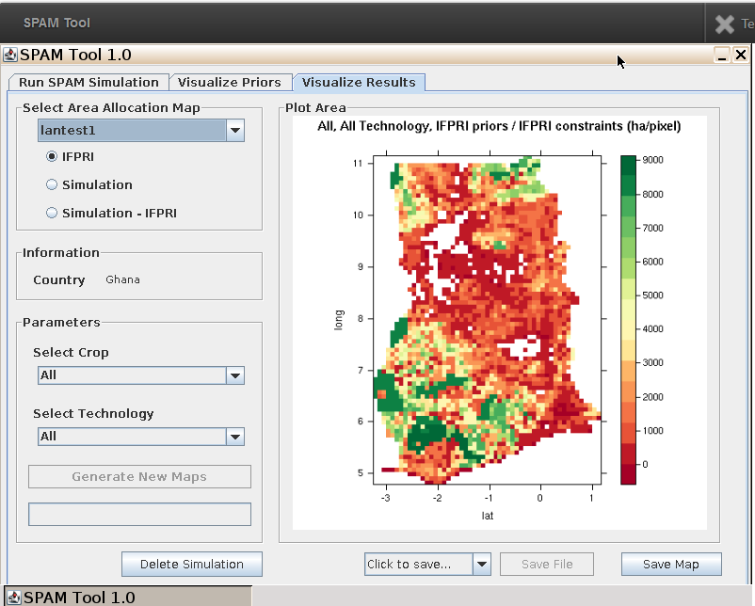
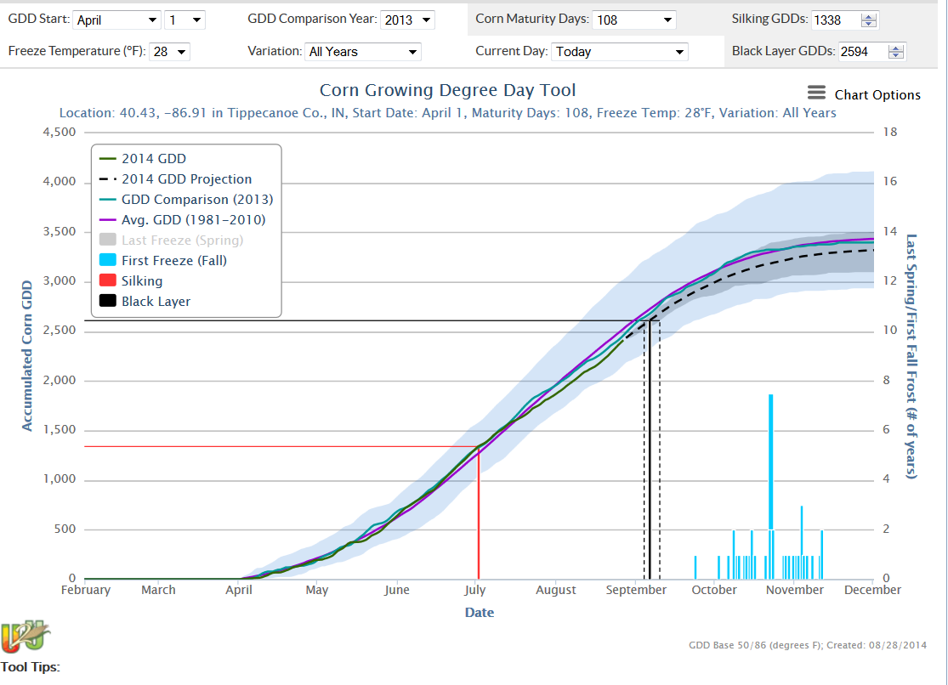
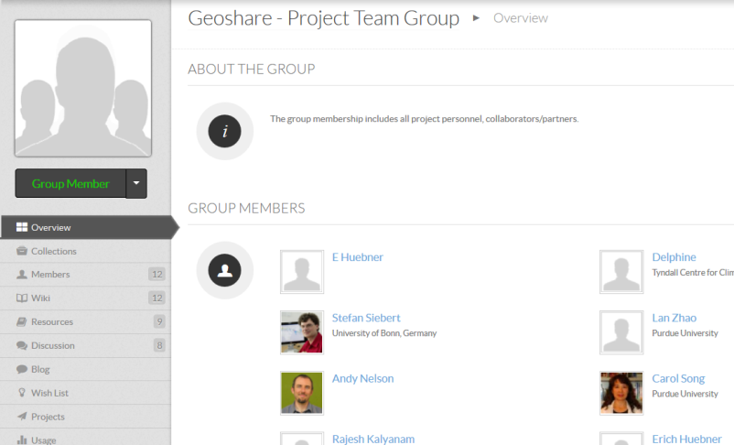
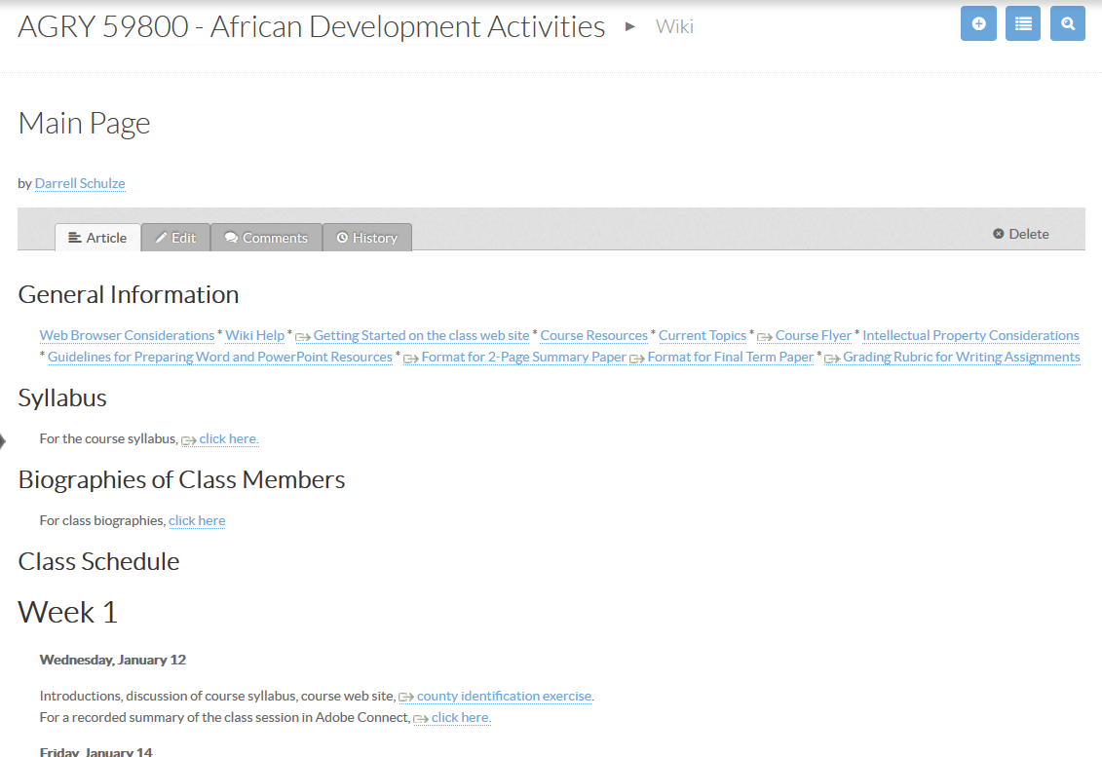
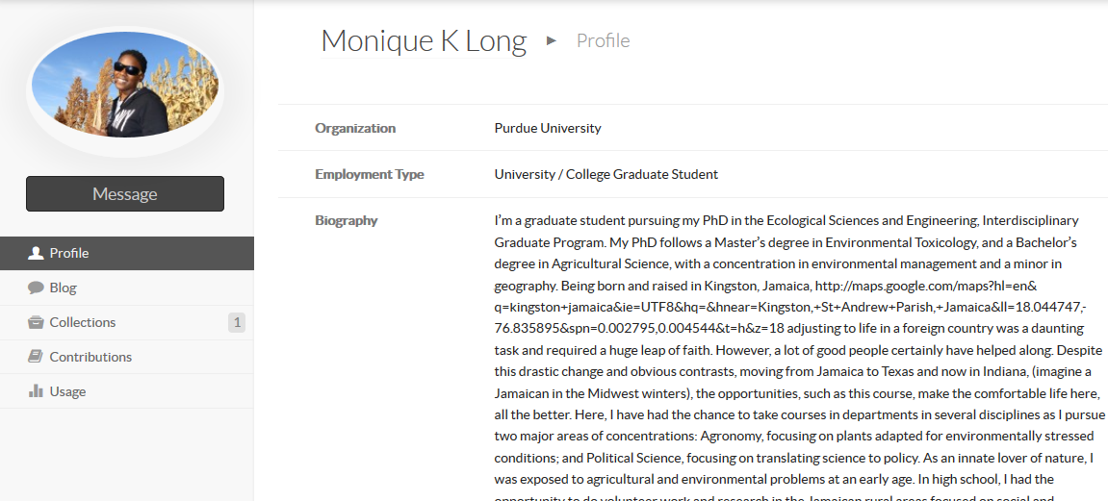
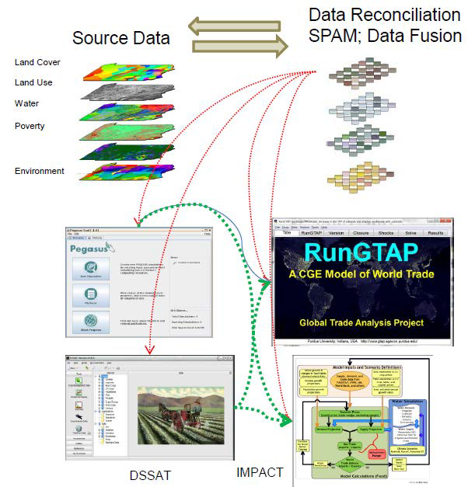
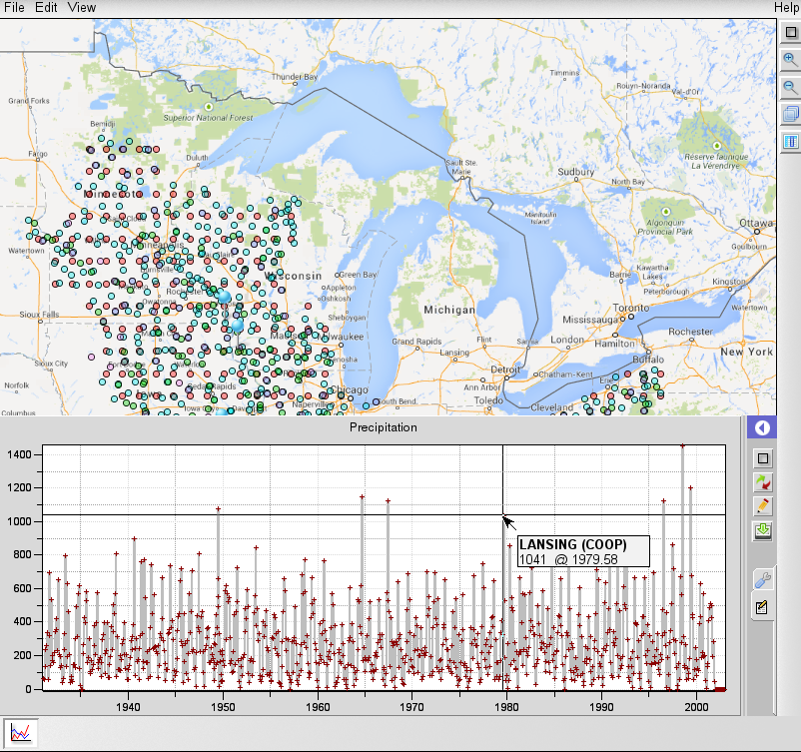
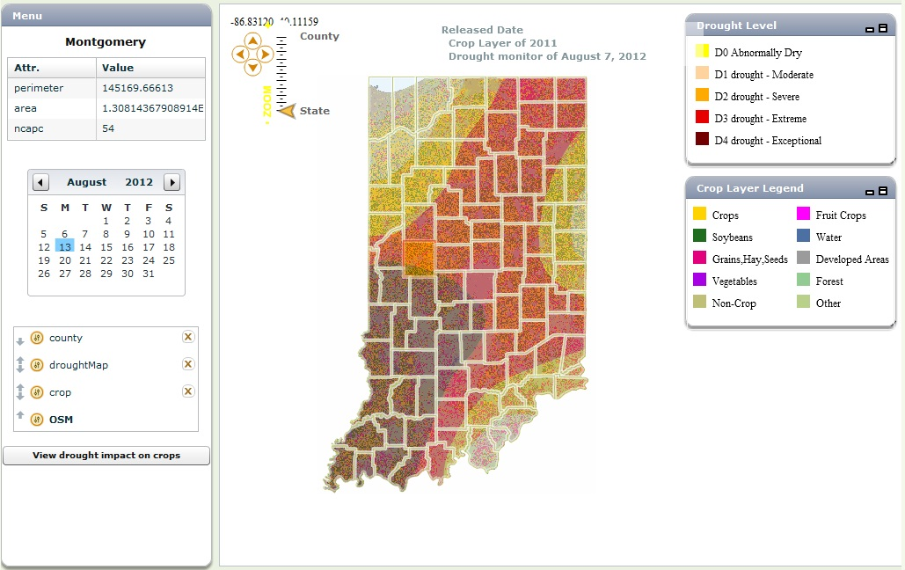
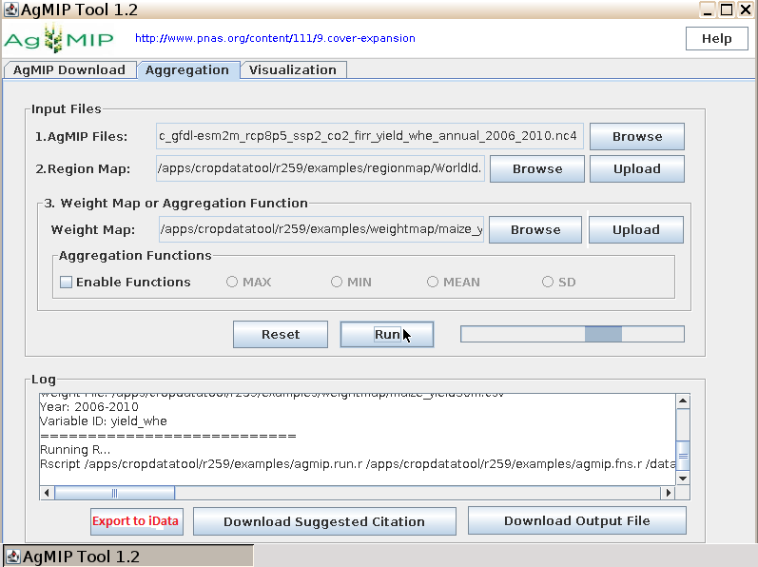
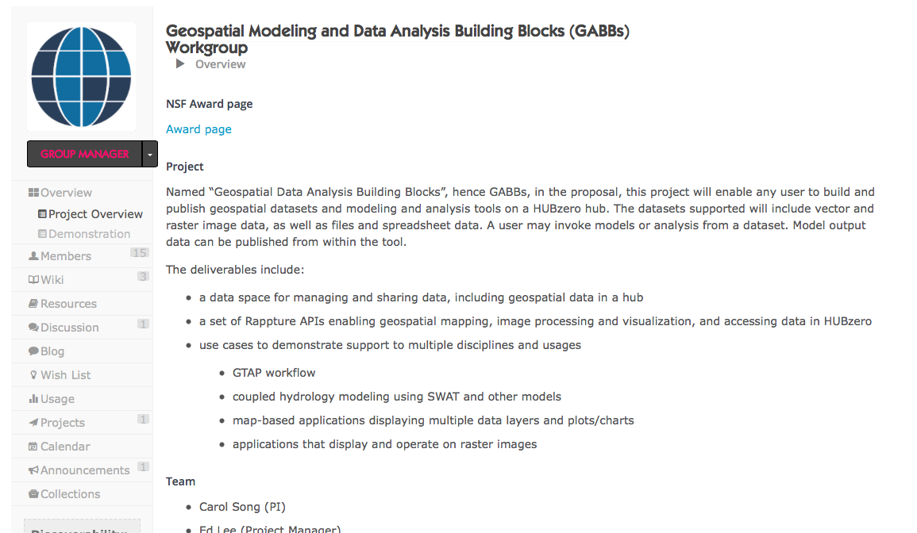
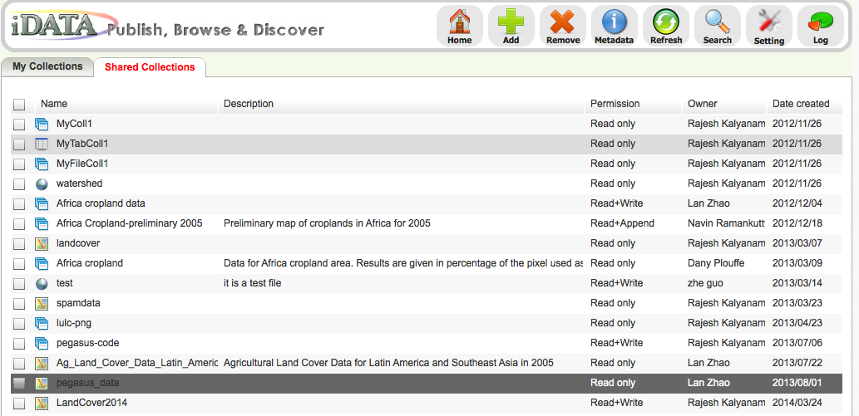
Enabling Scientific Collaboration Using HUBzero Platform
Scientific Data Collections
Interactive Online Models and Tools
Community Engagement and Collaboration
Data publishing, sharing, discovery and exploration
Self manage data and share research among scientists
Upload publications, seminars, learning materials, and publish as resources
One-stop shop for accessing data, tools, information, training and publishing
DIY tool development
Interactive online tools with no download or installation
Transparent access to large scale computation resources
Rapid tool development library RAPPTURE and GUI builder
Open collaborative cyberinfrastructure for research and education
Workflows connecting data and modeling tools
User groups, wikis, forums, ticketing system, projects, tags, citations, reviews, profiles, and ratings
Serves more than 1,000,000 unique visitors in past 12 months

