Slide 1
Geospatial data in global change analysis: GLOBIOM experience
Petr Havlík
Environmental Resources and Development Group
Ecosystems Services & Management Programme
International Institute for Applied Systems Analysis (IIASA), Austria
GEOSHARE: Post-pilot Workshop
West Lafayette, USA, September 11, 2014

Slide 2
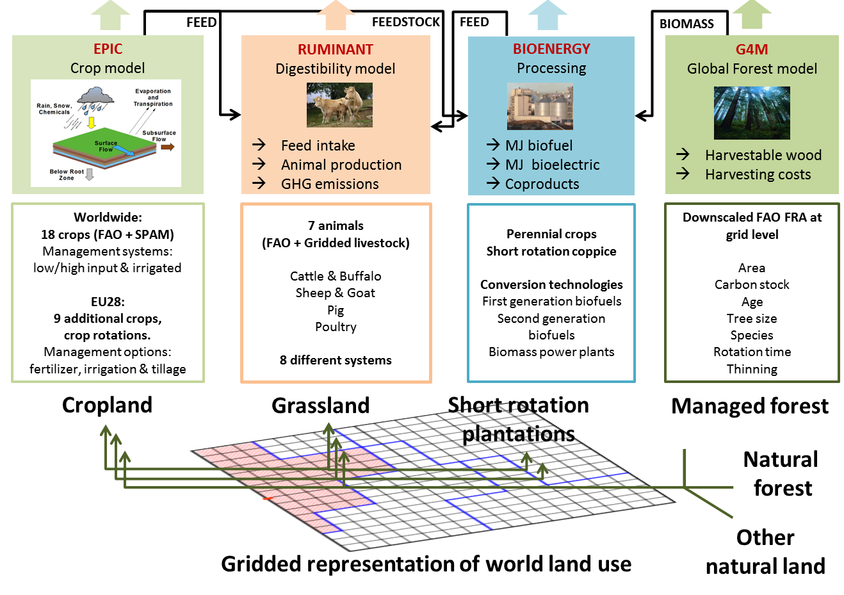
GLOBIOM workflow
MESSAGE (POLES, WITCH): Integrated Assessment Model
GLOBIOM: Markets and Trade
Havlík et al. (2014)

Slide 3
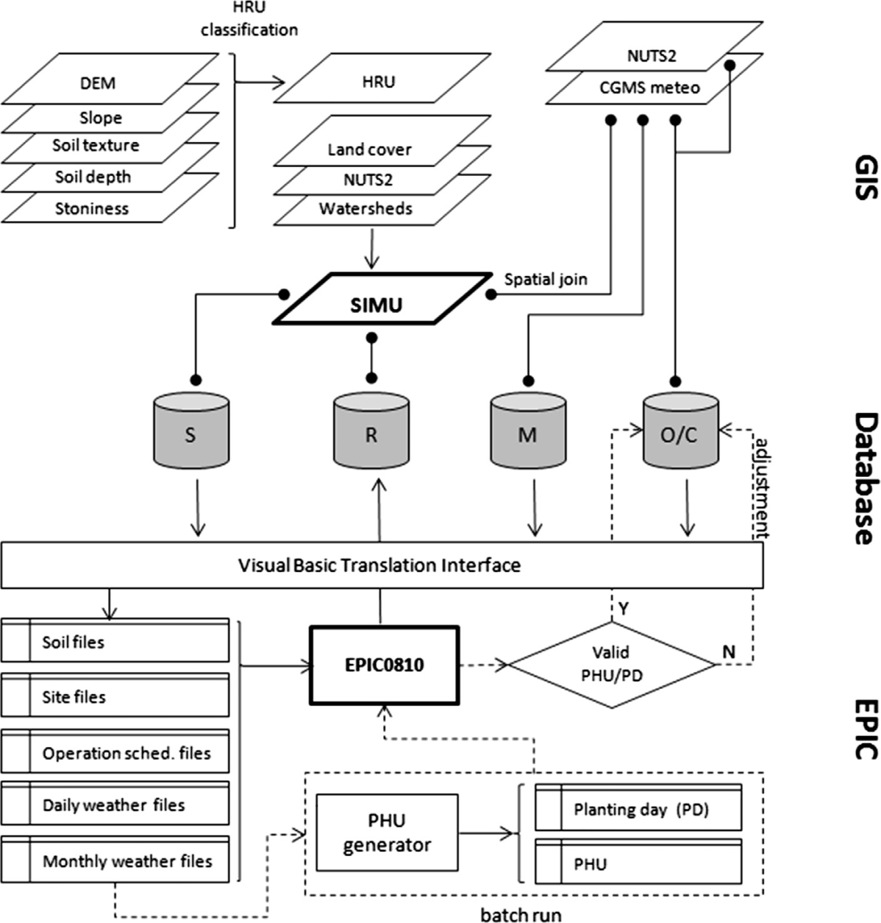
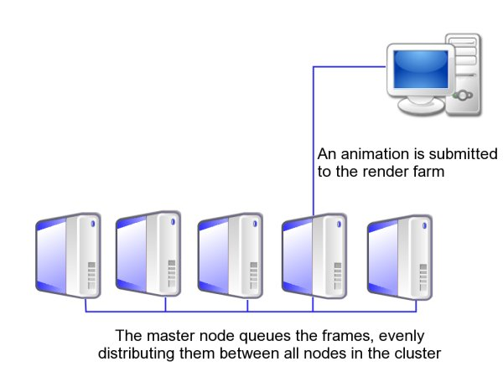


Crop sector sub-workflow
DB server
Client
Job-distribution server
IIASA computer cluster
Balkovič et al. (2013, 2014)

Slide 4
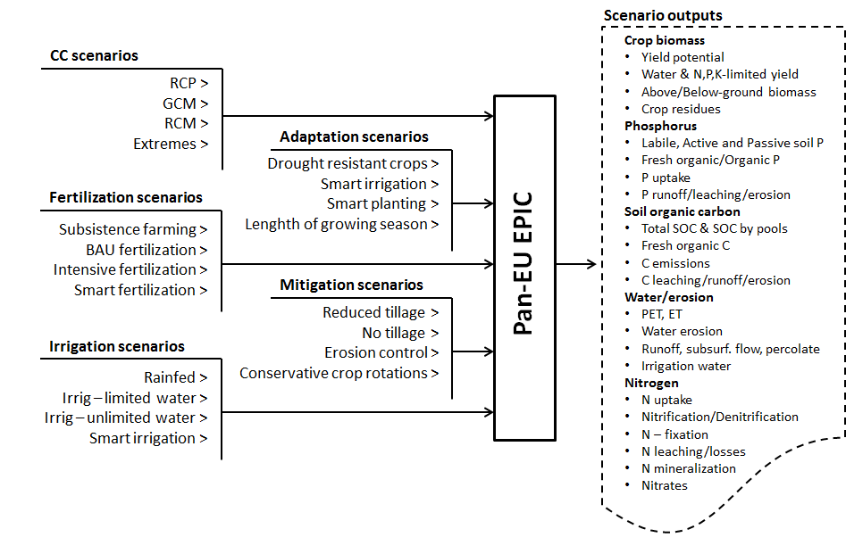
Crop sector sub-workflow
Hyper-cube to GLOBIOM
Balkovič et al. (2013, 2014)

Slide 5
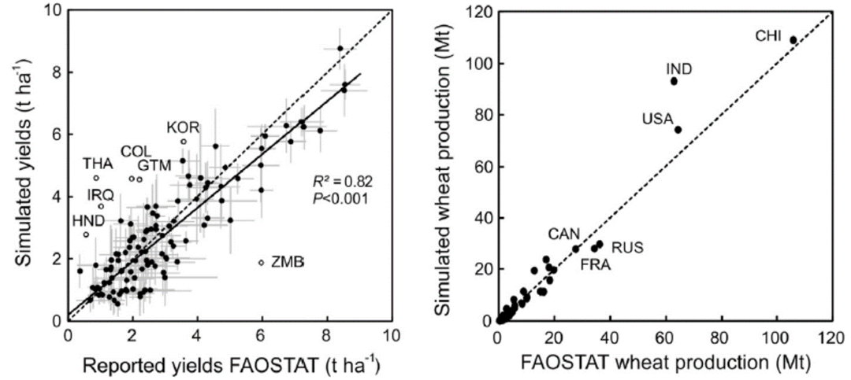
Crop sector sub-workflow
Calibrated runs – Europe
(Balkovič et al. 2013)
Calibrated runs – Global (Balkovič et al. 2014)

Slide 6
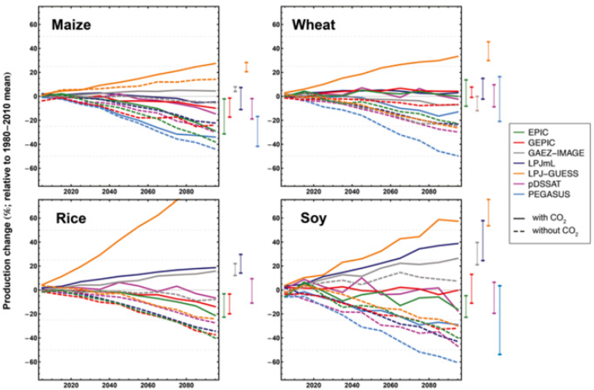
Crop model uncertainty
Relative change (%) in RCP8.5 decadal mean production
Source: Rosenzweig et al. (2014)

Slide 7
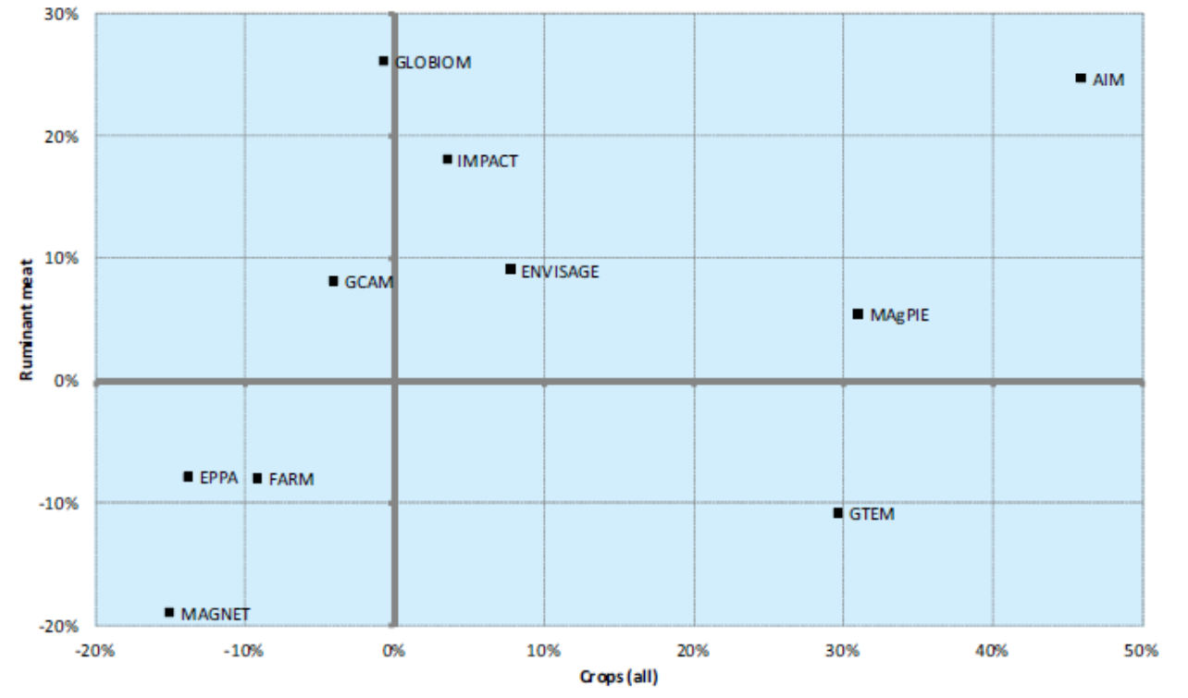
Economic model uncertainty
Crop versus ruminant prices in 2050 across models
Source: von Lampe et al. (2014)

Slide 8
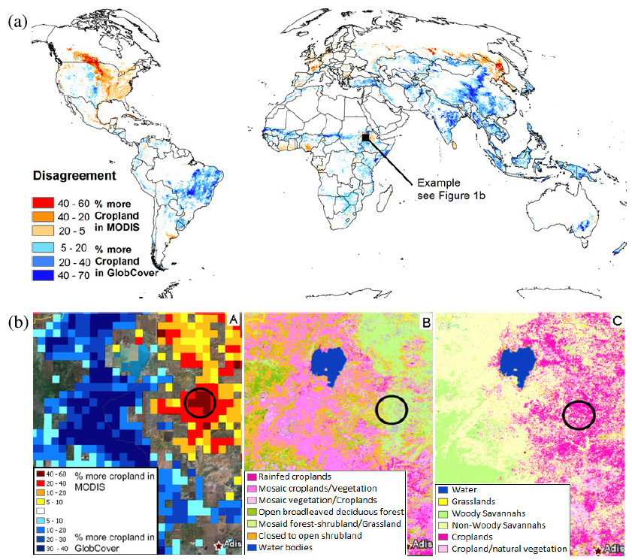
“Data” uncertainty
Disagreement between MODIS v.5 and GlobCover 2005 in cropland
Overall disagreement in cropland:
505.9 Mha
36% relative to FAO
(Fritz et al., 2011)

Slide 9
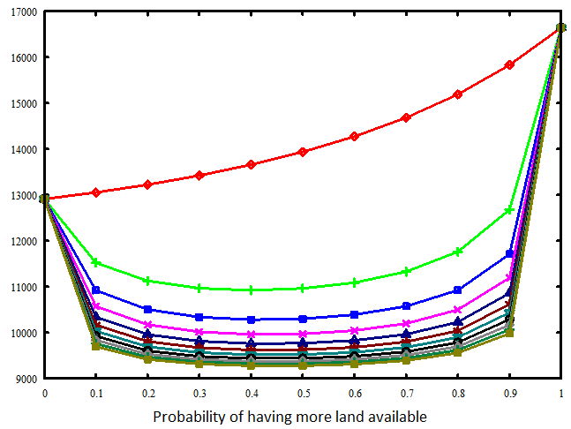
“Data” uncertainty
Value of Information (not only for modelers)
CO₂ mitigated with the REDD option [Mio tCO2]
Increasingly
risk averse
MODISmax TRUE
Probability
GLCmin TRUE
Source: Fritz et al. (2012)

Slide 10
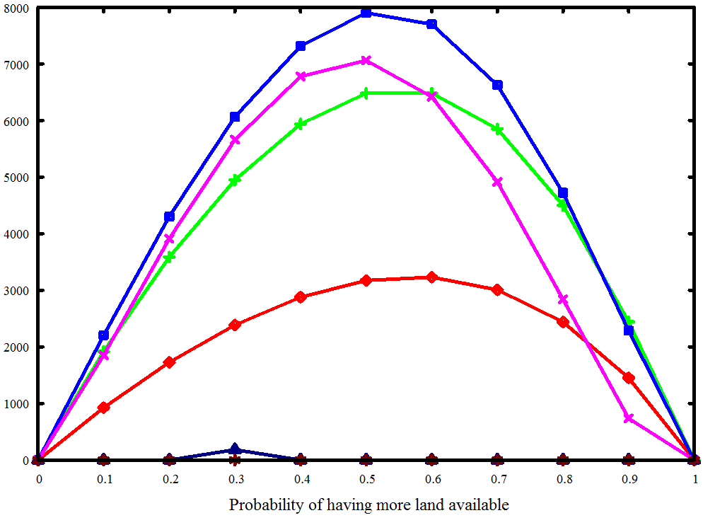

“Data” uncertainty
Value of Information (not only for modelers)
Expected VOI – low risk aversion [Mio USD]
10%
> 2 bil. USD
MODISmax TRUE
Probability
GLCmin TRUE
Source: Fritz et al. (2012)

Slide 11
Discussion 1: Endorsement?
Can we validate a “dataset” / model or only invalidate?
  - Some of them better for some regions, commodities,…
How large the community needs to be to provide a more objective endorsement than peer reviewed publications?
Can the system be set-up in a way which allows to document, compare, improve several existing “datasets“ / models?

Slide 12
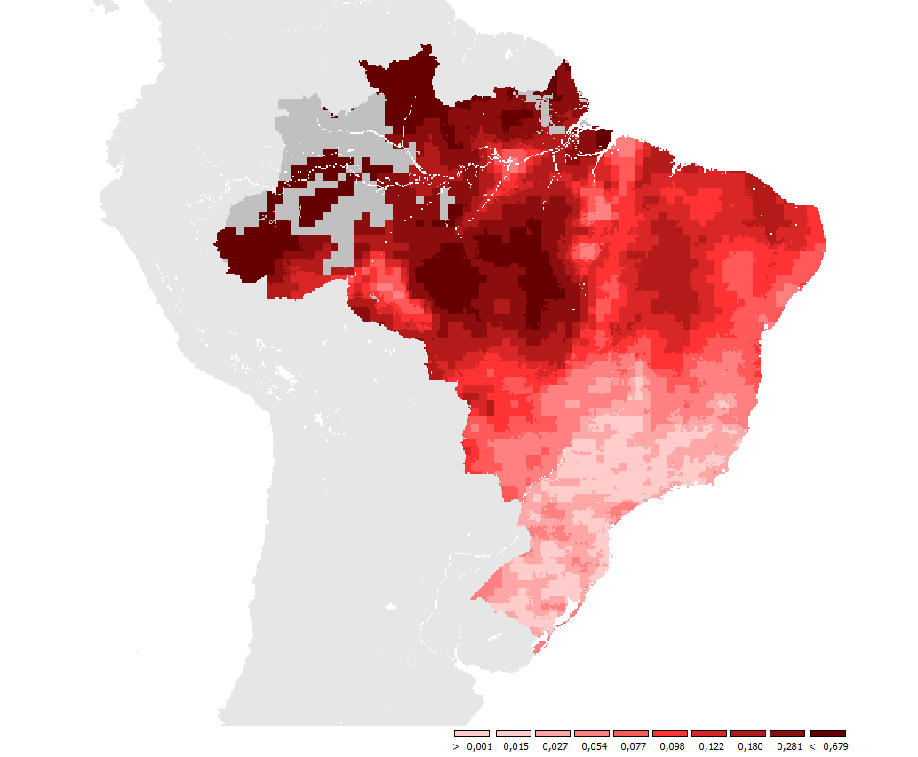
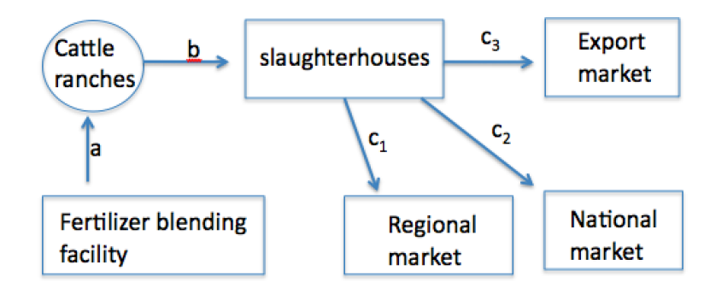
Spatially explicit cost: Brazil
Beef transport cost as share of final selling price
Cohn et al. 2014

Slide 13
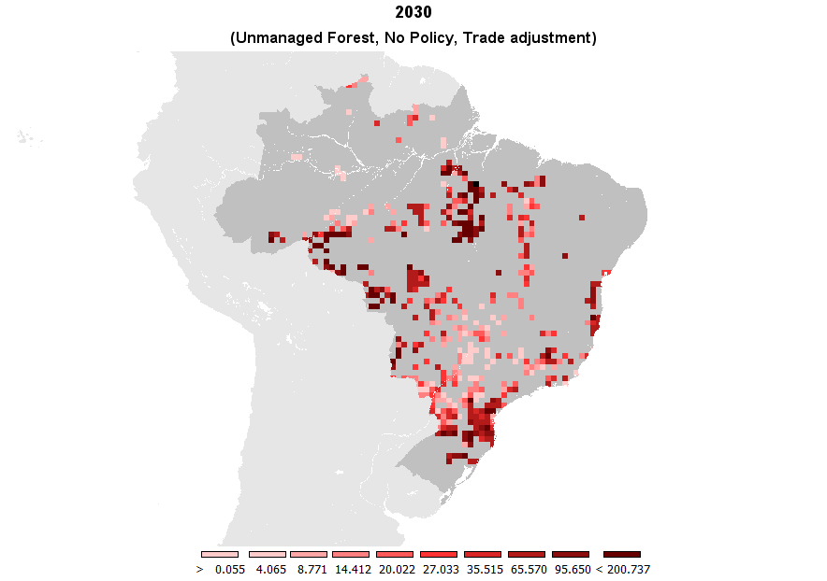
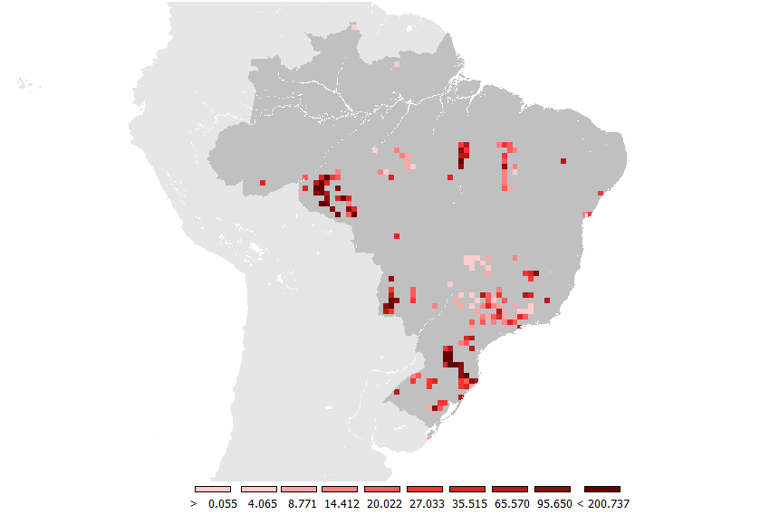
Spatially explicit cost: Brazil
Deforestation due to pasture expansion by 2030 [1000ha]
Reference
Grassland intensification subsidy
Cohn et al. 2014

Slide 14
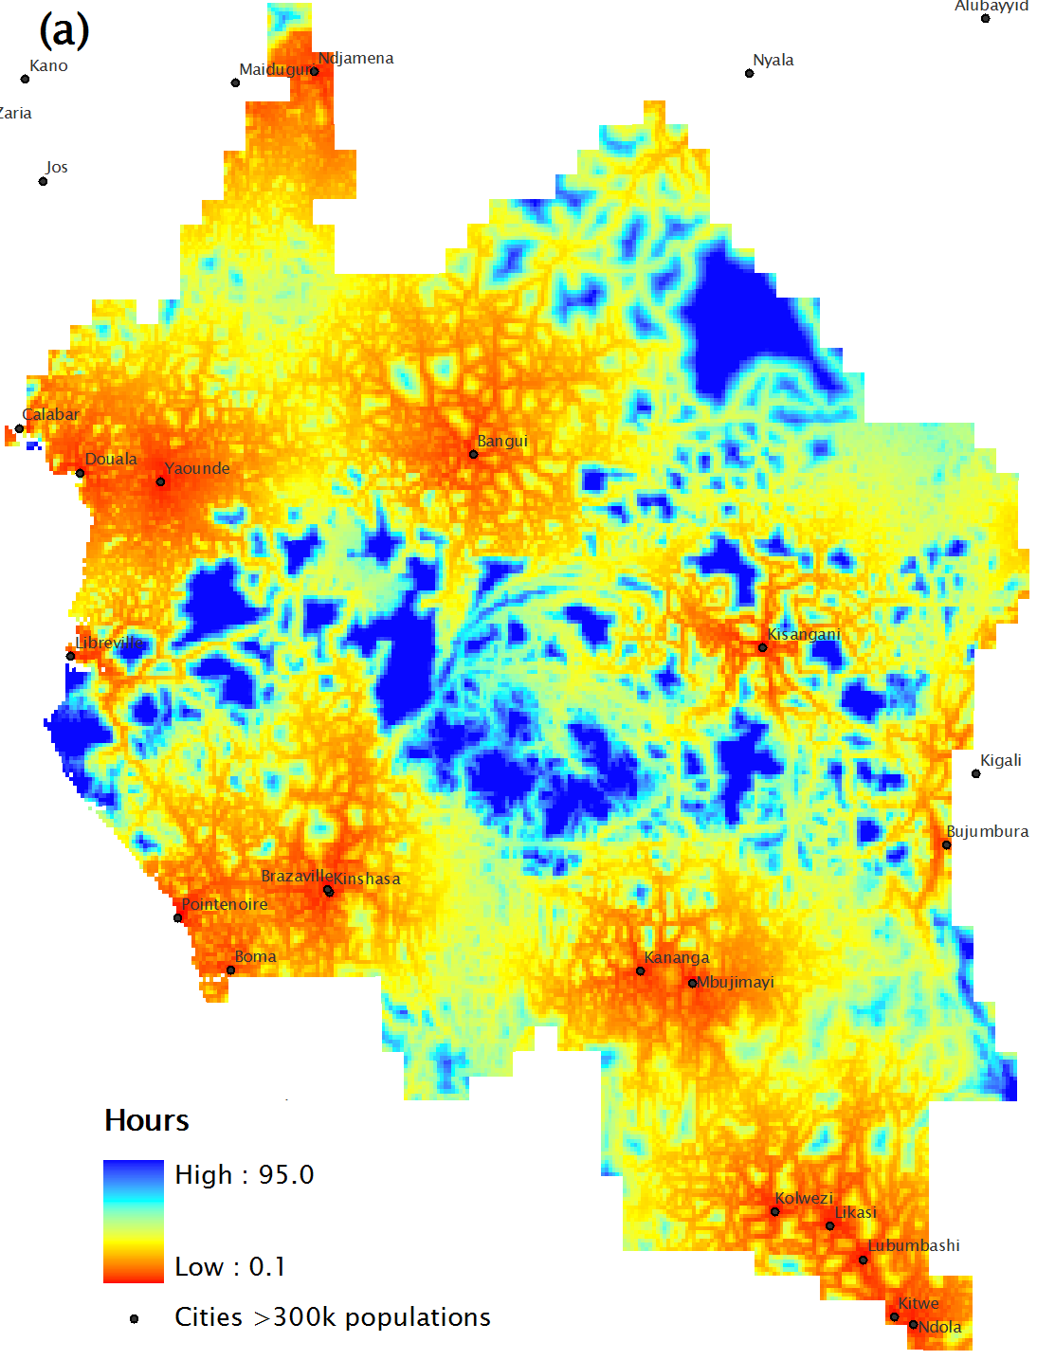
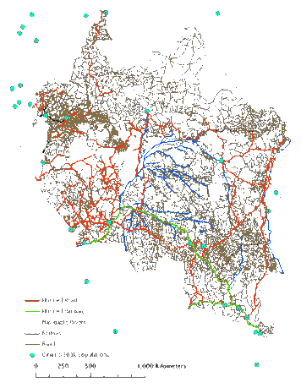
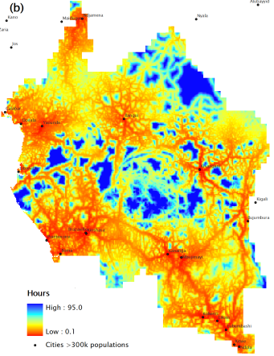
Spatially explicit cost: Congo Basin
Transportation time – Existing infrastructures
(Circa 2000)
Transportation time – New Infrastructures
(National Statistics, World Bank)
Mosnier et al. 2014

Slide 15
Spatially explicit cost: Congo Basin
Average deforested area (in million hectares) and average GHG emissions (in million tons CO2) from deforestation per year over the period 2020-2030 in the Congo Basin
Mosnier et al. 2014
Notes:
Baseline: Total area deforested due to agriculture is around 0.3 million hectares per year between 2000 and 2030
close to the historical rate of deforestation over 1990-2000 (OFAC), 0.1 million hectares per year are deforested due to fuel wood,
4% of the globally deforested area and 6% of CO2 emissions from deforestation come from Congo Basin
Deforestation increases in the Congo Basin when:
Import prices increase more than domestic prices
Lower domestic prices increase local demand and foreign demand or Congo basin products

Slide 16
Livestock sector
987 Mio poor engaged in livestock activities
17% of average daily energy intake
33% of average daily protein intake
30% of global land area
Source: Steinfeld et al. (2006)
LIVESTOCK
Arable - Rest
Arable - Feed
Meadows & Pastures
Forests
1 GHa
0.5 GHa
3.5 GHa
4 GHa
Source: FAOSTAT

Slide 17
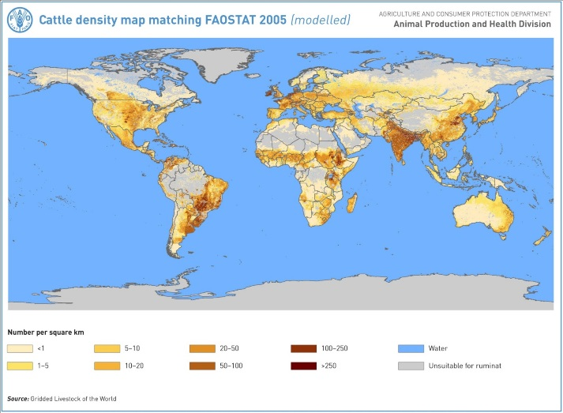
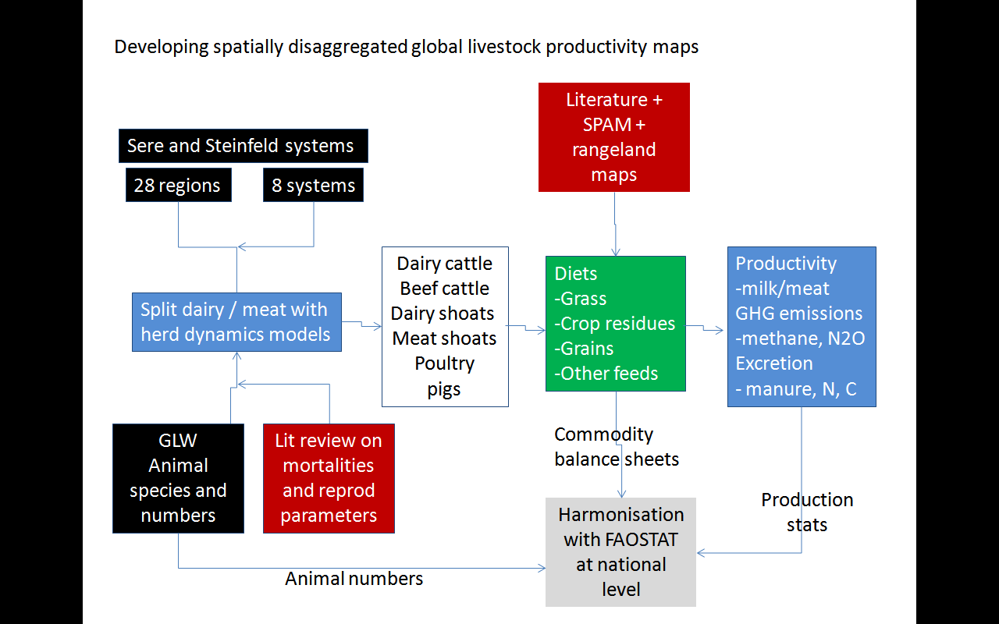
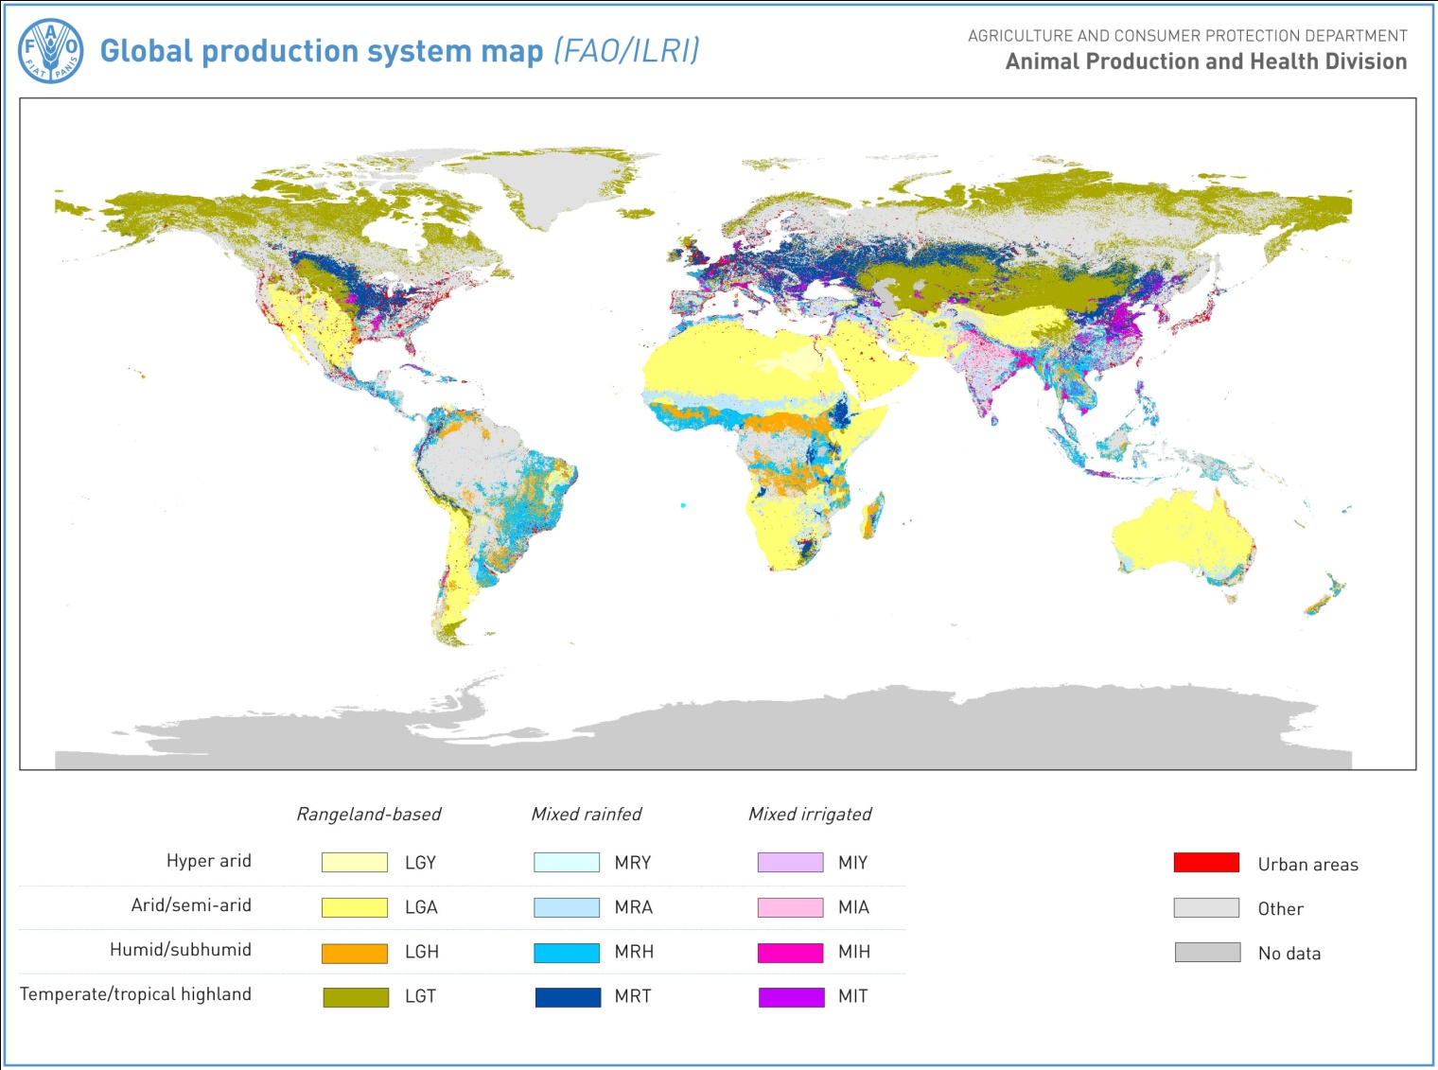
Livestock sector sub-workflow
+
Herrero et al. (2013)

Slide 18
GLOBIOM workflow(s)
MESSAGE (POLES, WITCH): Integrated Assessment Model
Currently covered in GEOSHARE
GLOBIOM: Markets and Trade

Slide 19
Discussion 2: The depth and the breadth?
Depth
  Current farming practices and their cost – the big unknowns
Breadth
  Where are the system boundaries?
  Complexity of harmonization growing exponentially with number of sectors covered?

Slide 20
What can we offer?
Contribution to existing thematic nodes (e.g. LC) and development of new ones (e.g. livestock)
Participation at the different levels of the workflows going from the datasets to decision making (crop models – EPIC, economic models – GLOBIOM), and contributing expertise in the system integration
GEO-WIKI – powerful crowd sourcing tool
Providing output from our models - already the case for crops
  - MESSAGE-GLOBIOM – one of the marker models for the SSPxRCP scenarios – output in terms of land use, commodity prices, production systems can be provided

Slide 21
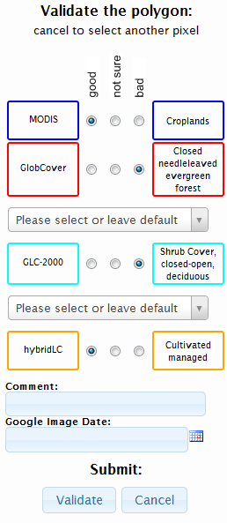
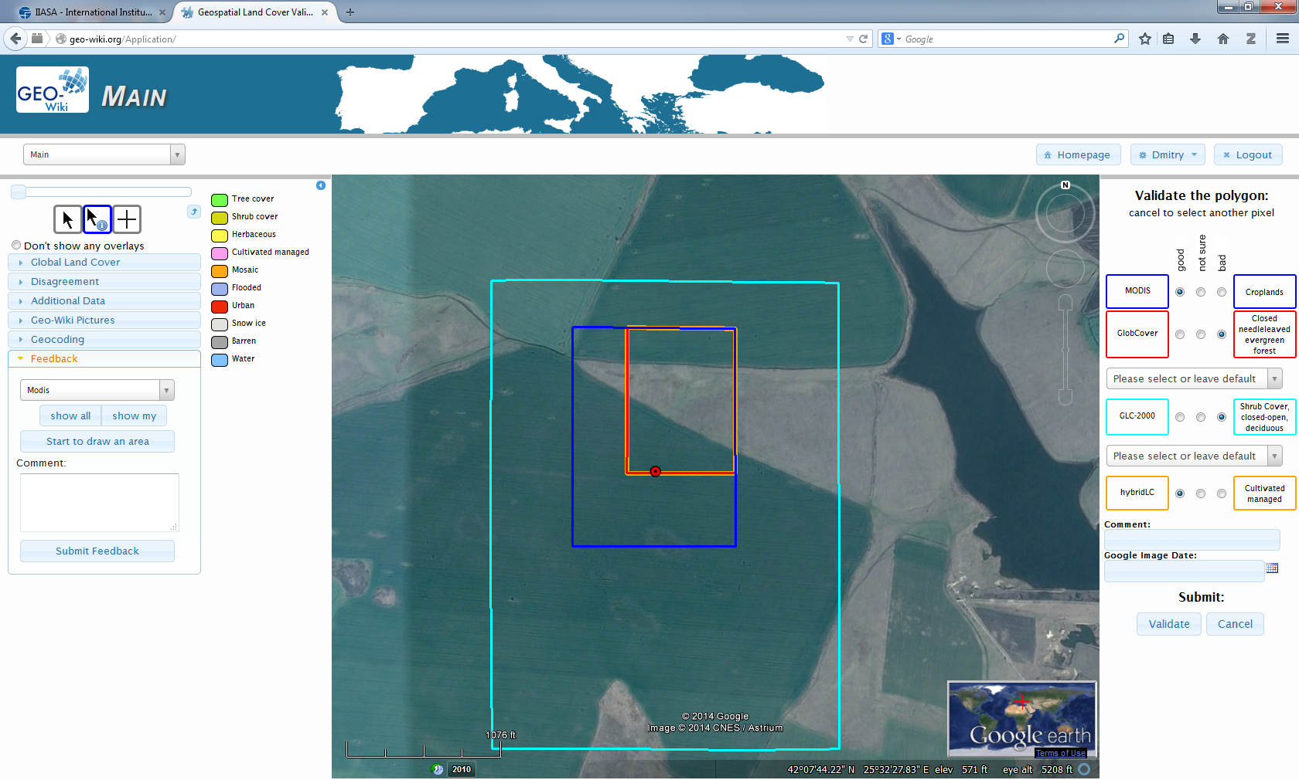
Validation options
Mobilizing regional experts / crowd
http://Geo-Wiki.org

Slide 22
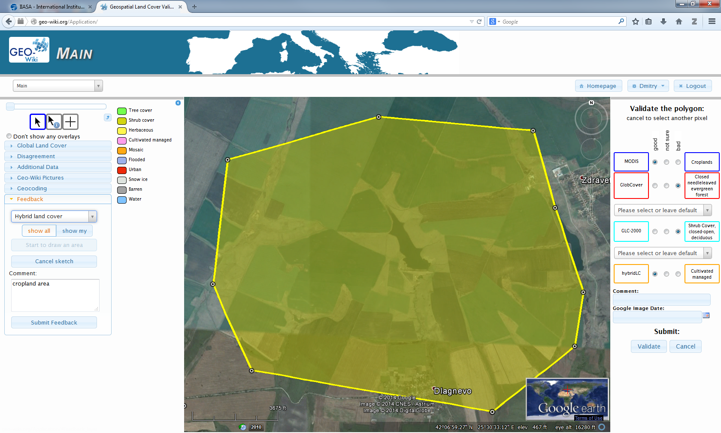
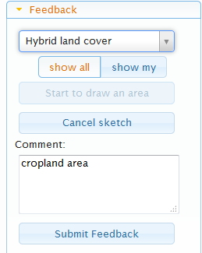
Feedback option for certain area
Mobilizing regional experts / crowd

Slide 23
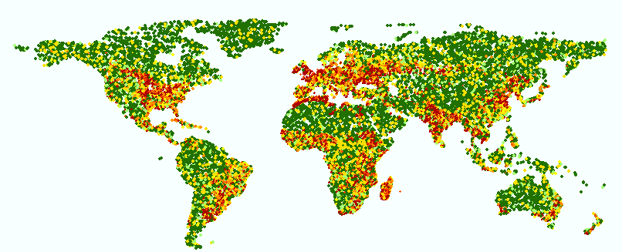
Mobilizing regional experts / crowd
About 1000 users in more than 120 countries
> 200,000 validation points
Notes:
So far we have more than 1000 users registered in more than 120 countries. And these numbers keep increasing! From these users (or who we term the ‘crowd’), we have gather more than 200,000 validation points. The map shows a plot of these validation points according to one of the pieces of information that we have asked users to input, i.e. human impact. Human impact as a percentage is simply how much humans have modified the earth’s surface so an untouched forest would have 0% human impact while the central downtown core of any city, with its paved surfaces and tall buildings would have 100% human impact. Using volunteers, we have essentially created the first map of human impact that clearly shows reasonable global patterns. We could also plot this by land cover.

Slide 24
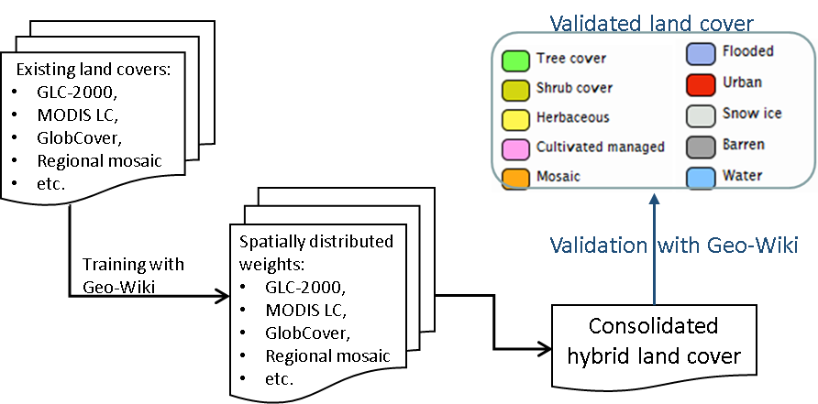
Mobilizing regional experts / crowd
Land cover sub-workflow
See et al. (2014)

Slide 25
What can we offer?
Contribution to existing thematic nodes (e.g. LC) and development of new ones (e.g. livestock)
Participation at the different levels of the workflows going from the datasets to decision making (crop models – EPIC, economic models – GLOBIOM), and contributing expertise in the system integration
Providing geo-wiki – potentially powerful tool for crowd sourcing
Providing output from our models - already the case for crops
  - MESSAGE-GLOBIOM – one of the marker models for the SSPxRCP scenarios – output in terms of land use, commodity prices, production systems can be provided

Slide 26
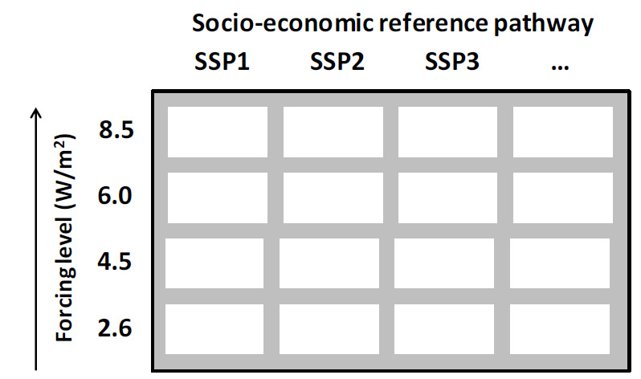
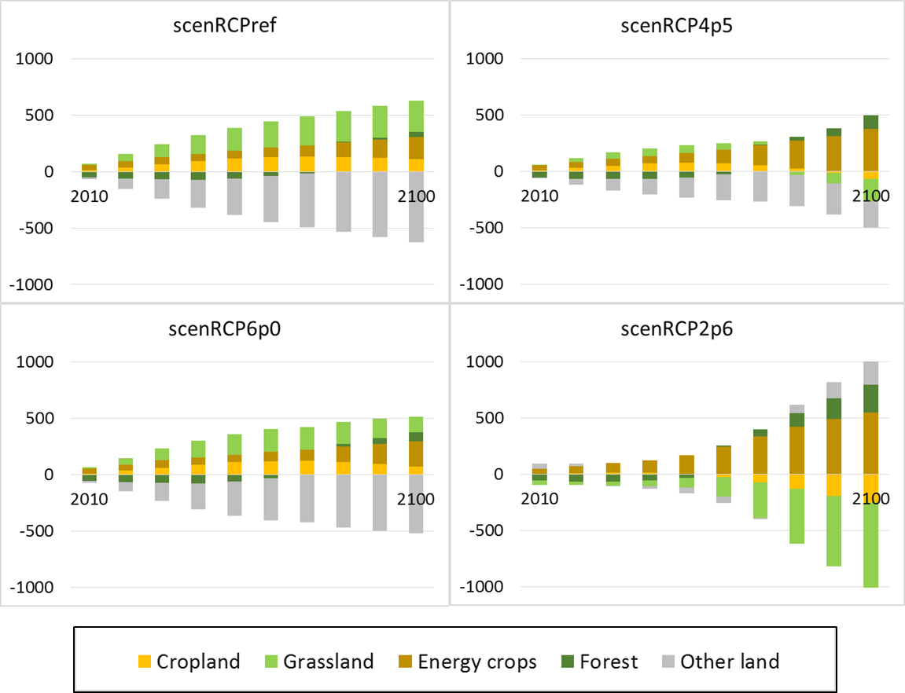
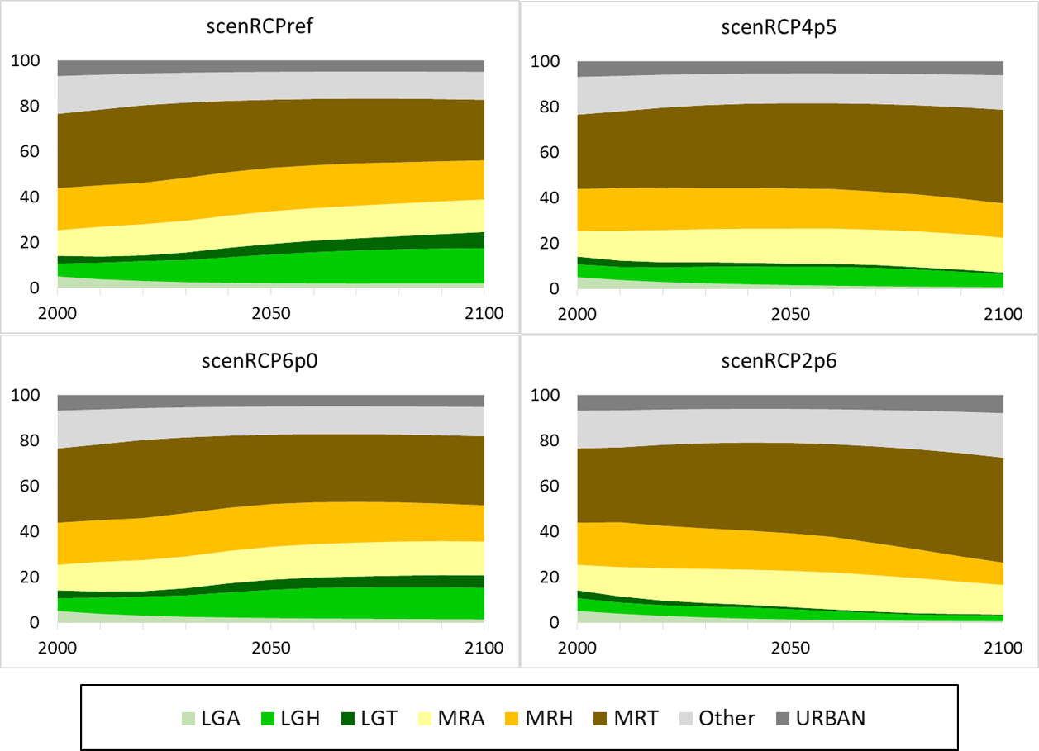
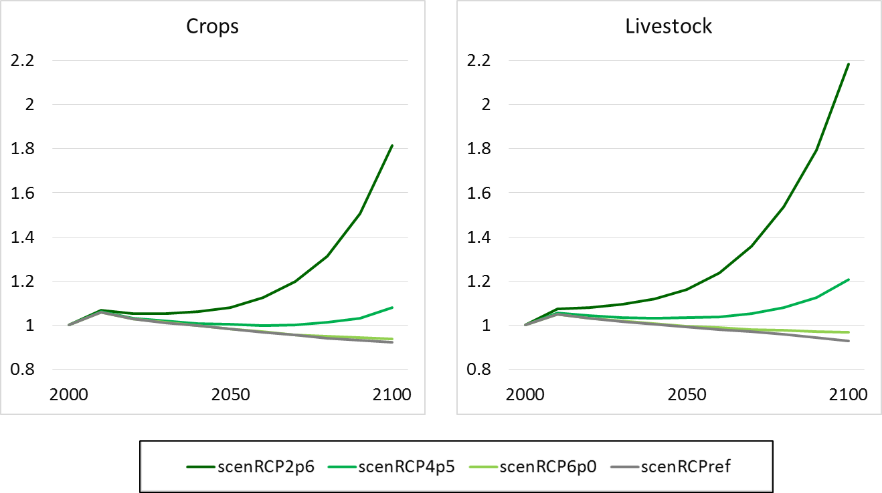
IAM IPCC scenarios
Potential immediate contribution
Land cover change
Livestock production systems
Commodity prices

Slide 27
What do we expect?
Platform allowing for FASTER DATA AND MODEL IMPROVEMENT
  Nodes are not individuals but COMMUNITIES
  PRIMARY DATA as basis for “datasets” and model improvement
  - Most costly to acquire, however, crucial for improvement of current products
  - Land cover / land use incl. current farming practices, input levels, cost could be a good starting point

Slide 28



Thank you !
havlikpt@iiasa.ac.at
www.globiom.org

Slide 29
Further reading
Balkovič, J., van der Velde, M., Schmid, E., Skalský, R., Khabarov, N., Obersteiner, M., Stürmer, B. and Wei, X. (2013). Pan-European crop modelling with EPIC: Implementation, up-scaling and regional crop yield validation. Agricultural Systems 120: 61-75.
Balkovič, J., van der Velde, M., Skalský, R., Wei, X., Folberth, C., Khabarov, N., Smirnov, A., Mueller, N.D. and Obersteiner, M. (2014). Global wheat production potentials and management flexibility under the representative concentration pathways. Global and Planetary Change 122: 107-121.
Cohn, A.S., Mosnier, A., Havlík, P.,Valin, H., Herrero, M., Schmid, E., O’Hare, M. and Obersteiner, M. (2014). Cattle ranching intensification in Brazil can reduce global greenhouse gas emissions by sparing land from deforestation. Proceedings of the National Academy of Sciences U.S.A. 111: 7236-7241.
Fritz, S., See, L., McCallum, I., Schill, C., Obersteiner, M., van der Velde, M., Boettcher, H., Havlík, P., and Achard, F. (2011). Highlighting continued uncertainty in global land cover maps for the user community. Environmental Research Letters 4: 6pp.
Fritz S., S. Fuss, P. Havlík, J. Szolgayova, I. McCallum, M. Obersteiner, L. See (2012): The value of determining global land cover for assessing climate change mitigation options. In: Laxminarayan, R., M.K. Macauley (eds): The Value of Information: Methodological Frontiers and New Applications in Environment and Health. Springer, Dordrecht, Netherlands, pp. 193–230.
Havlík, P., Valin, H., Herrero, M., Obersteiner, M., Schmid, E., Rufino, M.C., Mosnier, A., Thornton, P.K., Böttcher, H., Conant, R.T. Frank, S., Fritz, S., Fuss, S., Kraxner, F., Notenbaert, A. (2014). Climate change mitigation through livestock system transitions. Proceedings of the National Academy of Sciences U.S.A. 111: 3709-3714.
Herrero, M., Havlík, P., Valin, H., Notenbaert, A., Rufino, M. C., Thornton, P. K., … Obersteiner, M. (2013). Biomass use, production, feed efficiencies, and greenhouse gas emissions from global livestock systems. Proceedings of the National Academy of Sciences of the United States of America. doi:10.1073/pnas.1308149110

Slide 30
Further reading
Mosnier, A., Havlík, P., Obersteiner, M., Aoki, K, Schmid, E., Fritz, S., McCallum, I, Leduc, S. (2014). Modeling Impact of Development Trajectories and a Global Agreement on Reducing Emissions from Deforestation on Congo Basin Forests by 2030. Environmental and Resource Economics 57: 505-525.
Rosenzweig, C., Elliott, J. et al. (2014). Assessing agricultural risks of climate change in the 21st century in a global gridded crop model intercomparison. Proceedings of the National Academy of Sciences U.S.A. 111: 3268-3273.
See L, Schepaschenko D, Lesiv M, McCallum I, Fritz S, Perger C, Vakolyuk M, Schepaschenko M, van der Velde M,
Kraxner F, Obersteiner M et al. (2014). Building a hybrid land cover map with crowdsourcing and geographically weighted regression. ISPRS Journal of Photogrammetry and Remote Sensing, Article in press (Published online 19 July 2014).
von Lampe, M., Willenbockel, D., Ahammad, H., Blanc, E., Cai, Y., Calvin, K., Fujimori, S., Hasegawa, T., Havlík, P., Heyhoe, E., Lotze-Campen, H., Schmitz, C., Tabeau, A., Valin, H., et al. (2014). Why do global long-term scenarios for agriculture differ? An overview of the AgMIP Global Economic Model Intercomparison. Agricultural Economics 45(1): 3-20.

