Slide 1
Climate Change Impacts on Food Security in 2050:
An application of the GEOSHARE AgMIP Tool
Uris Baldos
Purdue University
September 2014

Slide 2
SIMPLE: An example of an economic model of agriculture a Simplified International Model of Prices, Land use and the Environment (Baldos & Hertel, 2013)
Demand
Population
Food Security
Outcomes
Income per capita
Demand
Response
Per Capita
Demand
Food Consumption
Global
Crop Market
Global
Biofuel Use
Food
Prices
Global Crop
Price
Input
Prices
Non Land
Inputs
Input Substitution
Land
Inputs
Non Land Price
Response
Climate: Temp, Precip & CO₂
Land Rent
Response
Crop Productivity Growth
Supply

Slide 3
Deriving climate change impacts for future projections
GEOSHARE AgMIP Tool
-Quick access to AgMIP archives of gridded crop yield outcomes on different climate change scenarios
-Easily aggregate productivity impacts from grid-cell to user specified aggregation
“Quick-fix” Approach
-Rely on published productivity impacts (World Bank; IFPRI; journals, etc…)
-Original data might not be compatible with own model (limited regions, crop coverage, crop models, GCMs)
“Comprehensive” Approach
-Step by step calculation of productivity shocks due to climate change using GCM outputs and crop models
-Highly resource intensive (time, personnel, expertise etc…)
Yield impacts due to Climate Change

Slide 4
Using the AgMIP Tool: a ‘SIMPLE’ Application
Design scenarios via AgMIP tools:
Crop Model: PEGASUS
GCMs: MIROC-ESM-CHEM, GFDL-ESM2M
Other options:
No CO2 fert. / RCP8p5: ‘Pessimist’
CO2 fert. / RCP2p6: ‘Optimist’
Aggregate grid-cell yield changes and apply shocks in a global model of agriculture (SIMPLE)
Examine changes in crop prices, caloric consumption as well as caloric malnutrition headcount in 2050
All done in less than one hour!!!

Slide 5
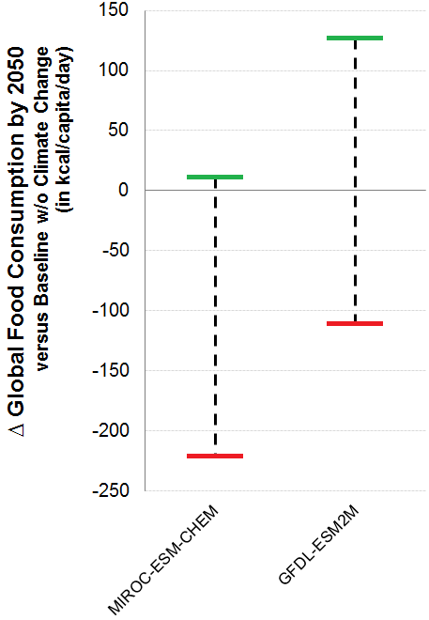
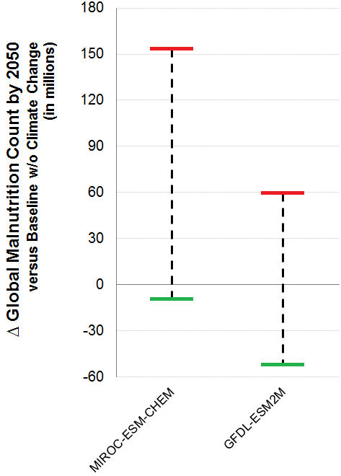
Selected Food Security Results:
Food Consumption
Malnutrition Count
“Optimist”: Lowest RCP (2.6) + CO2 fertilization
“Pessimist”: Highest RCP (8.5) + no CO2 fertilization

Slide 6
GEOSHARE AgMIP Tool is a key source of gridded climate change yield impacts
GEOSHARE AgMIP Tool
-Quick access to AgMIP archives of gridded crop yield outcomes on different climate change scenarios
-Easily aggregate productivity impacts from grid-cell to user specified aggregation
“Quick-fix” Approach
-Rely on published productivity impacts (World Bank; IFPRI; journals, etc…)
-Original data might not be compatible with own model (limited regions, crop coverage, crop models, GCMs)
“Comprehensive” Approach
-Step by step calculation of productivity shocks due to climate change using GCM outputs and crop models
-Highly resource intensive (time, personnel, expertise etc…)
Yield impacts due to Climate Change

Slide 7
Thank you!
(see poster for additional details)

Slide 8
Nutritional Outcomes in SIMPLE
Increase in average caloric consumption = shifts distribution to the right
Climate change impacts shifts caloric distribution
Lower incidence of caloric malnutrition
Caloric Distribution: 2006
Caloric Distribution: 2050
Caloric Distribution: 2050
Caloric Distribution: 2050 + CC “Optimist”
Minimum Dietary Energy Requirement
Caloric Distribution: 2050 + CC “Pessimist”
Minimum Dietary Energy Requirement

