Slide 1
Open access SPAM for Ghana: Challenges and opportunities
Ulrike Wood-Sichra and Liangzhi You
International Food Policy Research Institute, Washington DC
GEOSHARE: Geospatial Open Source Hosting of Agriculture, Resource & Environmental Data for Discovery and Decision Making
Sep 10-11, 2014

Slide 2
Leading to “SPAM Challenges and Opportunities”
What is SPAM
The SPAM process
Visualization of downscaling
SPAM results
Equations behind SPAM
Crop list and statistical data coverage
Challenges
Opportunities

Slide 3
SPAM ?
X
X
from http://www.cs4fn.org/

Slide 4
Spatial Production Allocation Model (SPAM)
Drawing on a variety of inputs, SPAM uses an entropy-based, data-fusion approach to “plausibly” assess cropping system distribution and performance at a “meso-gridded” scale: 5-minute globally, 30-seconds at country level (if data available)
Major input layers in SPAM:
National and subnational production statistics: area, yield (production)
Production system
Rural population density
Cropland extent
Irrigation map
Crop suitability
Existing crop distribution maps
Crop prices

Slide 5
The SPAM process
Sub-national area (crop)
irrigated_ land
agricultural_land
suitable_area (crop)
crop distribution (crop)
other data (..,crop)
SPAM
pixelized area (crop)

Slide 6
The SPAM process
Sub-national area (crop)
42 crops simultaneously
PRIOR irrigated
irrigated_ land
PRIOR subsistence
agricultural_land
suitable_area (crop)
PRIOR rainfed_high
crop distribution (crop)
PRIOR rainfed_low
other data (..,crop)
SPAM
pixelized area (crop)

Slide 7
Behind the scene adjustments/calculations
The SPAM process ... continued
FIXED!!
Sub-national area (crops)
Sum >=
irrigated_ land
Pre-process
Sum >=
agricultural_land
pix = max(ag,irr)
Sum >=
suitable_area (crop)
pix = f(suit,ag,irr)
some more data
irrigated
subsistence
rainfed-high
rainfed-low
PRIORS

Slide 8
Visualization of Downscaling
example: Ghana harvested area rice per region

Slide 9
Visualization of Downscaling ... continued
layer 1: Northern Region - harvested area rice

Slide 10
Visualization of Downscaling ... continued
layer 2: Northern Region – irrigated area
harvested area rice
irrigated area

Slide 11
Visualization of Downscaling ... continued
layer 3: Northern Region – agricultural area
harvested area rice
irrigated area
agricultural area

Slide 12
Visualization of Downscaling ... continued
layer 4: Northern Region – rural population
harvested area rice
irrigated area
agricultural area
rural population

Slide 13
Visualization of Downscaling ... continued
layer 5: Northern Region – suitable irrigated area rice
harvested area rice
irrigated area
agricultural area
rural population
suitable irrigated area rice

Slide 14
Visualization of Downscaling ... continued
layer 6: Northern Region – suitable rainfed high area rice
harvested area rice
irrigated area
agricultural area
rural population
suitable irrigated area rice
suitable rainfed high area rice

Slide 15
Visualization of Downscaling ... continued
layer 7: Northern Region – suitable rainfed low area rice
harvested area rice
irrigated area
agricultural area
rural population
suitable irrigated area rice
suitable rainfed high area rice
suitable rainfed low area rice

Slide 16
Visualization of Downscaling ... continued
result 1: Northern Region – allocated irrigated area rice
some more data

Slide 17
Visualization of Downscaling ... continued
result 2: Northern Region – allocated rainfed high area rice
some more data

Slide 18
Visualization of Downscaling ... continued
result 3: Northern Region – allocated rainfed low area rice
some more data

Slide 19
Visualization of Downscaling ... continued
result 4: Northern Region – allocated subsistence area rice
some more data

Slide 20
Visualization of Downscaling ... continued
result 5: Northern Region – allocated rice area total
scaled to FAO Country Totals
some more data

Slide 21
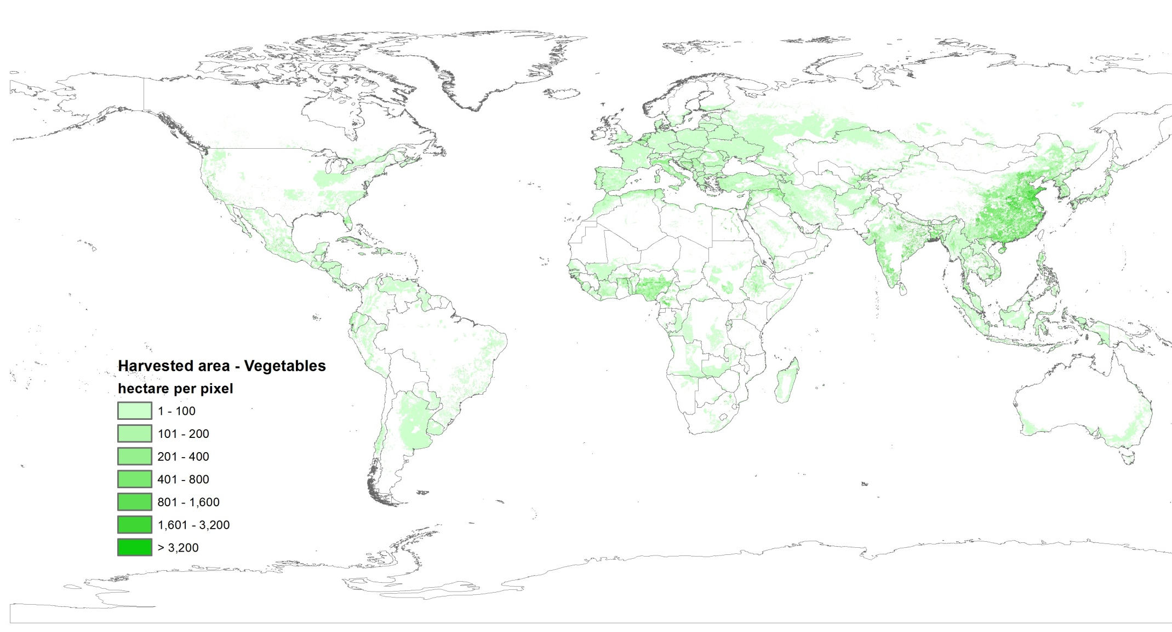
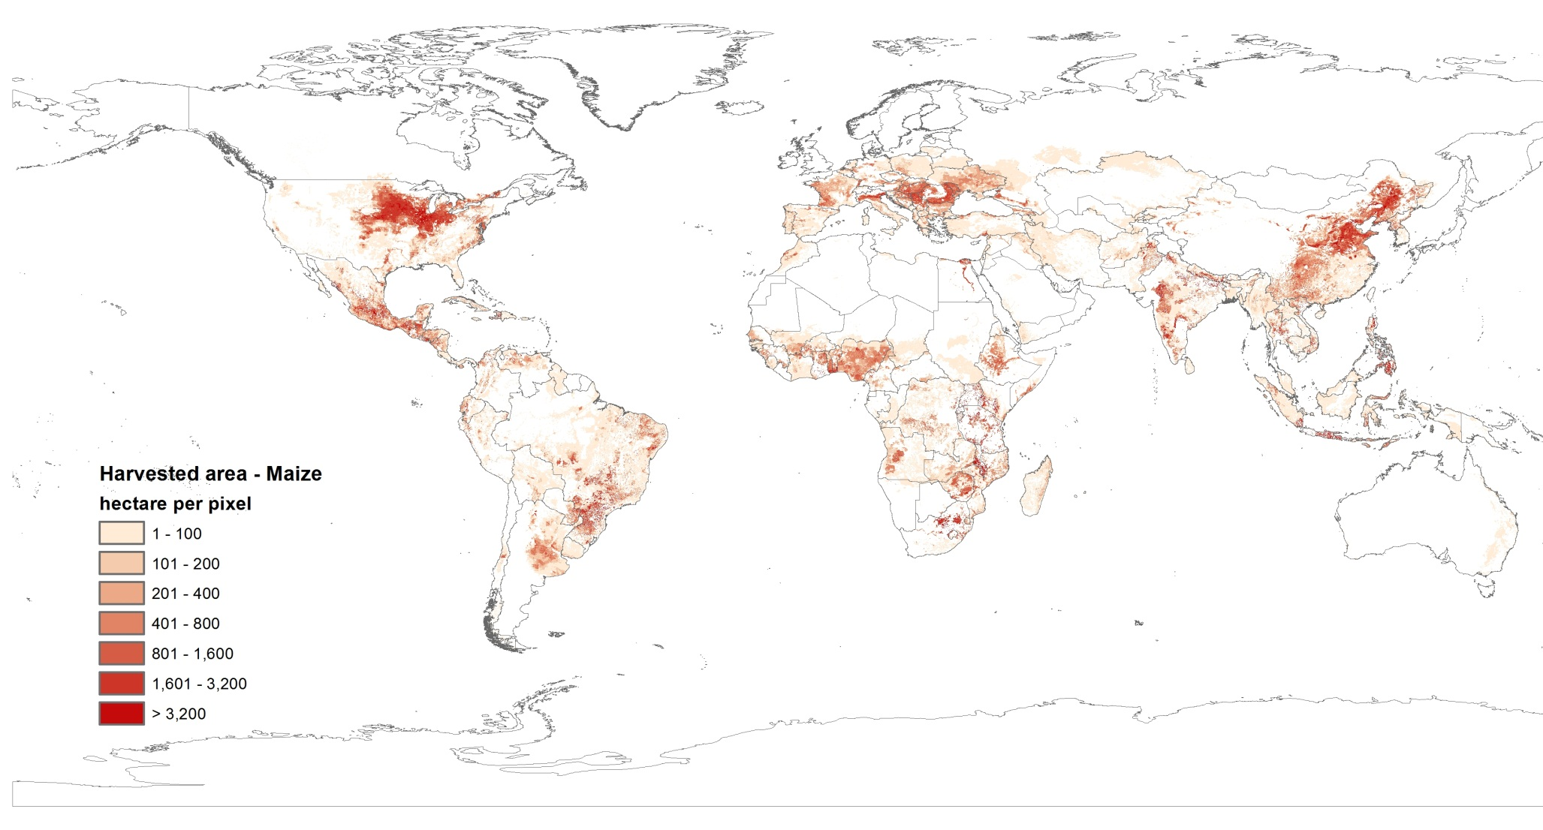
Crop Distribution – Maize 2005
SPAM Results
Crop Distribution – Vegetables 2005

Slide 22
Equations behind SPAM
Minimize difference between prior and allocated area share for all pixels, crops and production systems in a cross entropy equation
subject to constraints (limits) dictated by existing
agricultural area
irrigated area
suitable area
crop area statistics
and solve in GAMS
But first calculate the priors for each pixel, crop and production system as a function of potential revenue, irrigated area and agricultural land,
where potential revenue is a function of percentage of crop area, crop price, rural population density and potential yield
Notes:
Here is the model: I don’t what to bore you with equations. I am explaining it now.
We are minimizing the cross entropy between the allocated area shares and their prior. We use potential revenue as our prior.
Subject to the following conditions
First, the sum of allocated areas must be equal to the statistical area for each crop.
Second, In every pixel, the allocated area is no more than what satellite sees as crop land. Third, in every pixel, you cannot allocate more than what is suitable. The last conditions comes naturally.
Let me illustrate the model with an example. Today we have 10 people in the room. What spatial allocation model does is to figure out where each person is sitting. The landcover image is like satellite image of this room. It can tell whether there is people or not but cannot tell which one. The suitable area in the model is like chairs in the room: you are more likely sitting in chairs and the table is obviously unsuitable area because people are unlikely to sit on the table. However, if there are more people than the number of chairs, people may stand. In fact this is exactly what happens in the model. In some cases, there is more area to be allocated than what is “suitable”. We need to include so-called marginal suitable land. The prior is like what we know beforehand. Given the information that I am giving the speech, I probably stand in the front. Dianne is the host of the meeting, she may sit in the front. Et cetra.

Slide 23
Equations behind SPAM
now it becomes serious
S_{ijl} is the area share allocated to pixel i and crop j at input level l
Potential Revenue
Prior
∏_{ijl} = f(Potential revenue , Irrigated area , Cropland)
Notes:
Now let’s describe Spatial allocation model. The challenge is to transform all real-value into the probability form. (1) point. Now the unknowns are area shares rather than actual areas. It satisfies [0,1] naturally.
Another important definition is (2) point … Here I actually want you to look into details. Notice Price is only subscribed by j because we don’t claim to know local crop prices in every pixel. However, the price variation is also important, so we put another item Pricevarij here. It is related to market access by location by crops. For example, for perishable crops like vegetable, the price may decline rapidly further away from the market.

Slide 24
SPAM Prior Calculation
Subsistence crop area:
Irrigated crop area:
Rainfed crop area:

Slide 25
SPAM Optimization
Subject to:
Notes:
Here is the model: I don’t what to bore you with equations. I am explaining it now.
We are minimizing the cross entropy between the allocated area shares and their prior. We use potential revenue as our prior.
Subject to the following conditions
First, the sum of allocated areas must be equal to the statistical area for each crop.
Second, In every pixel, the allocated area is no more than what satellite sees as crop land. Third, in every pixel, you cannot allocate more than what is suitable. The last conditions comes naturally.
Let me illustrate the model with an example. Today we have 10 people in the room. What spatial allocation model does is to figure out where each person is sitting. The landcover image is like satellite image of this room. It can tell whether there is people or not but cannot tell which one. The suitable area in the model is like chairs in the room: you are more likely sitting in chairs and the table is obviously unsuitable area because people are unlikely to sit on the table. However, if there are more people than the number of chairs, people may stand. In fact this is exactly what happens in the model. In some cases, there is more area to be allocated than what is “suitable”. We need to include so-called marginal suitable land. The prior is like what we know beforehand. Given the information that I am giving the speech, I probably stand in the front. Dianne is the host of the meeting, she may sit in the front. Et cetra.

Slide 26
SPAM2005 Crop List and ...
 | 1 | wheat |  | 14 | dry beans |  | 28 | sugarcane
 | 2 | rice |  | 15 | chickpea |  | 29 | sugar beet
 | 3 | maize |  | 16 | cowpea
 | 4 | barley |  | 17 | pigeon pea |  | 30 | cotton
 | 5 | pearl millet |  | 18 | lentils |  | 31 | other fibres
 | 6 | finger/small millets |  | 19 | other pulses |  | 32 | arabica coffee
 | 7 | sorghum |  |  |  |  | 33 | robusta coffee
 | 8 | other cereals |  | 20 | soybeans |  | 34 | cocoa
 |  |  |  | 21 | groundnuts |  | 35 | tea
 | 9 | potato |  | 22 | coconuts |  | 36 | tobacco
 | 10 | sweet potato |  | 23 | oil palm |  | 37 | banana
 | 11 | yam |  | 24 | sunflower |  | 38 | plantains
 | 12 | cassava |  | 25 | rapeseed |  | 39 | tropical fruit
 | 13 | other roots & tubers |  | 26 | sesame seed |  | 40 | temperate fruit
 |  |  |  | 27 | other oil crops |  | 41 | vegetables
 |  |  |  |  |  |  | 42 | rest
sugar c.
pulses
fibres
cereals
stimulants
oil crops
roots & tubers
fruits & veg
“rest” accounts for only 2-5 % of global crop harvested area – with exceptions
all the rest

Slide 27
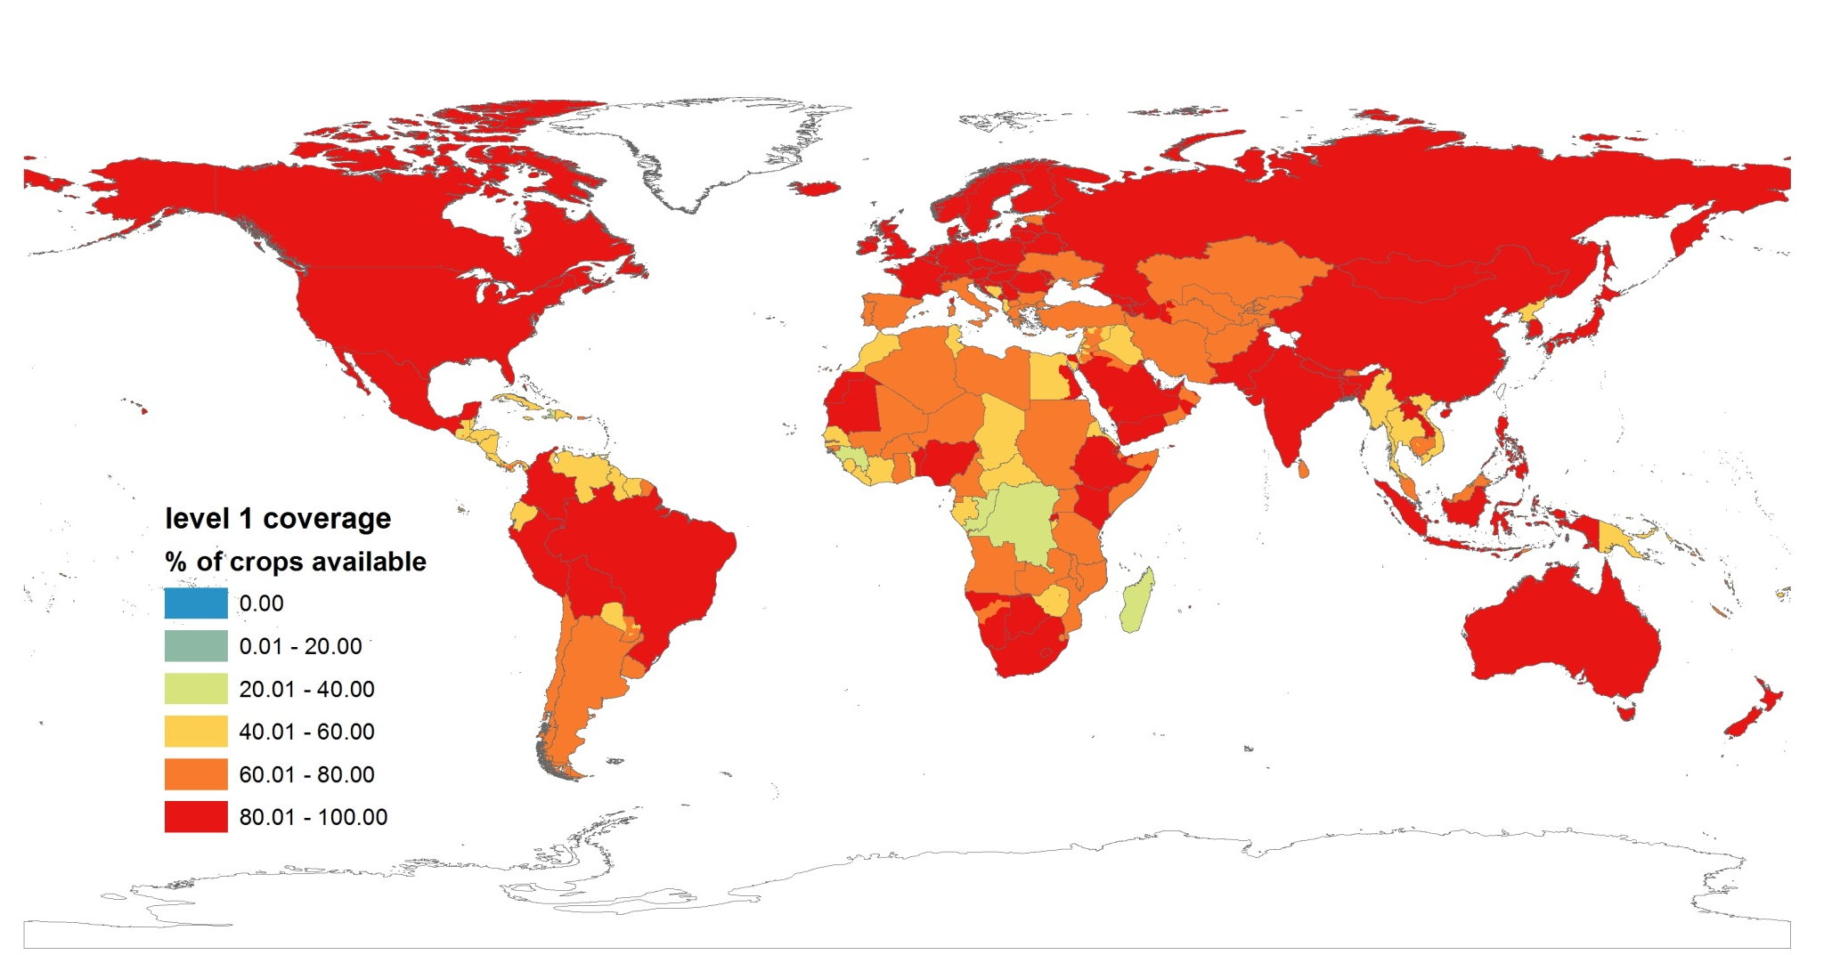
... Statistical Area Coverage – subnational

Slide 28
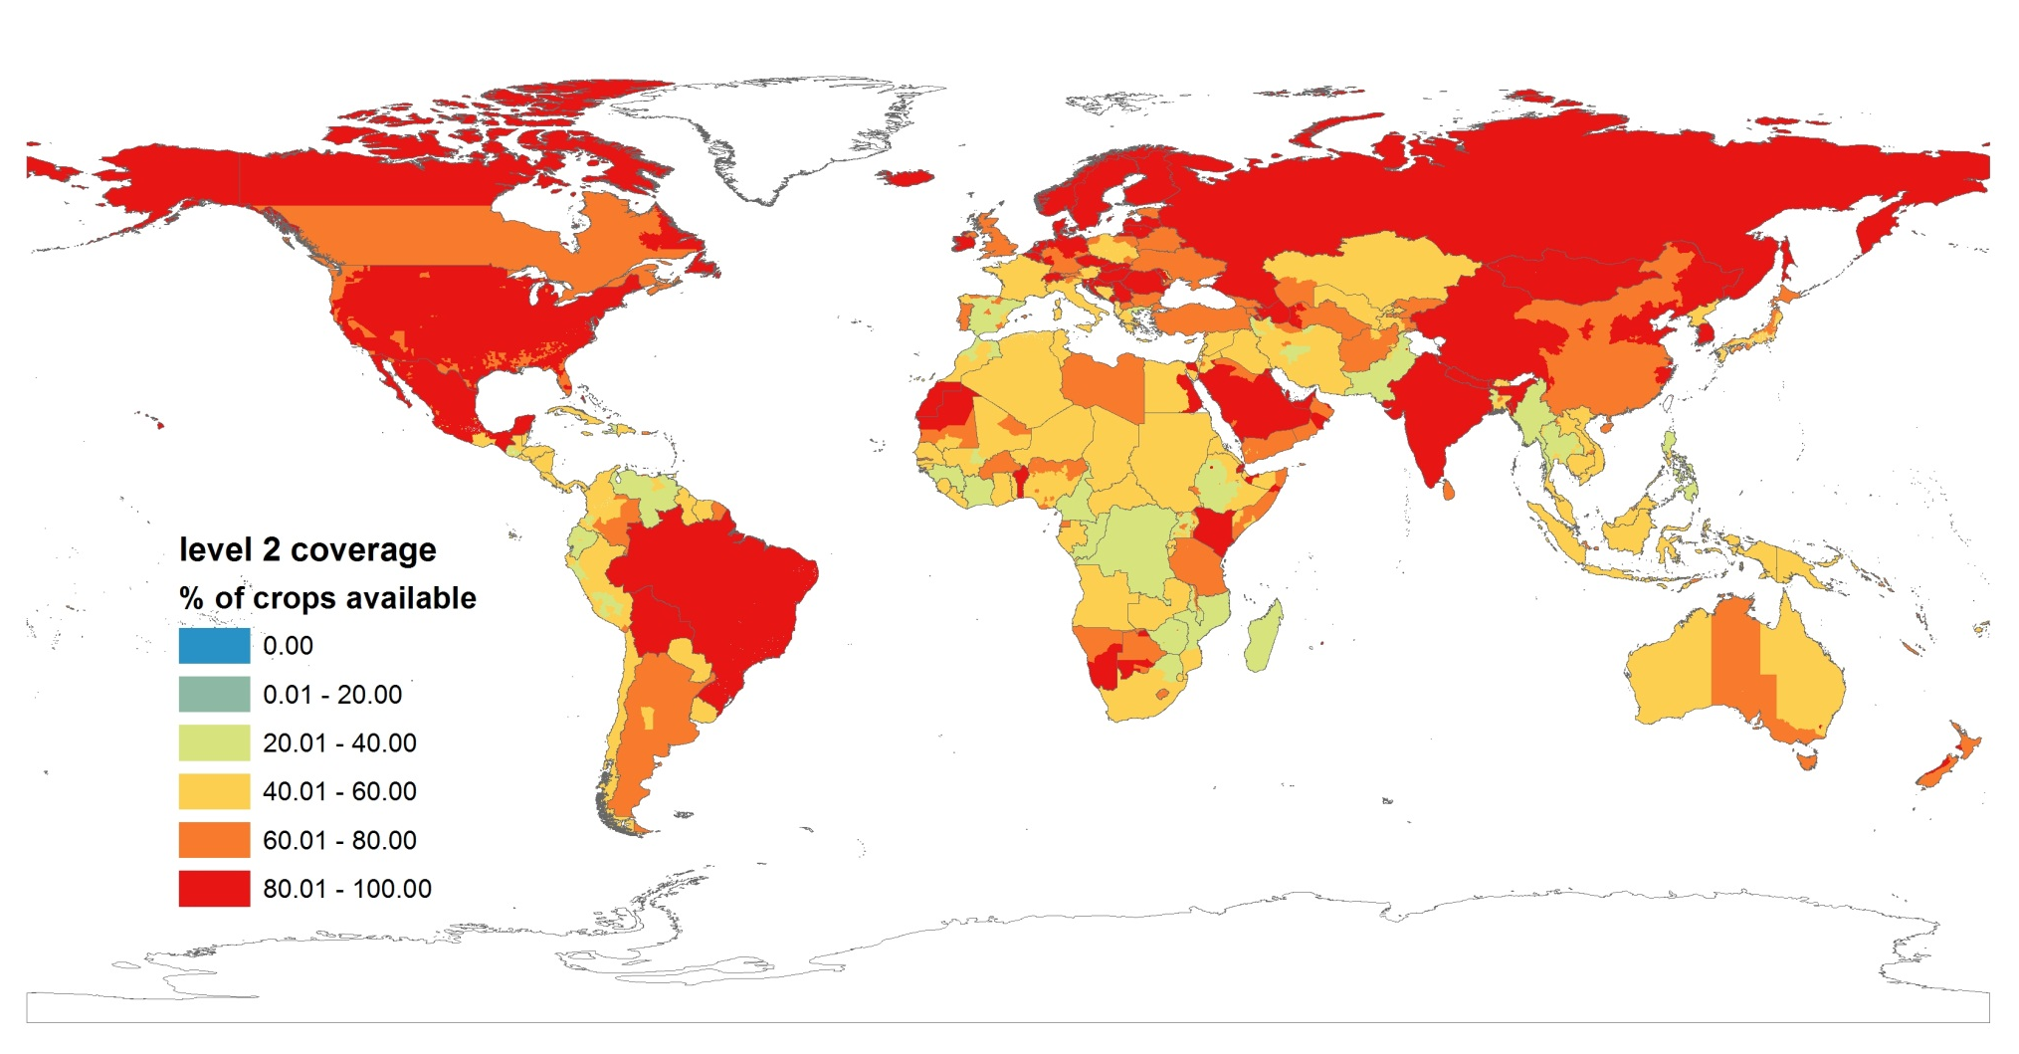
... Statistical Area Coverage – subnational

Slide 29
Crop Distribution – Maize/Vegetable 2005

Slide 30
Validation
Validation process by other CGIAR centers (e.g. IRRI, CIAT, ILRI, CIP, CYMMT). Each focuses on the mandate crops.
Crop map view ‘parties’ by local experts and agronomists
Crowd-sourcing on a dedicated website (mapSPAM.info)
Through implementation on the HUB with GEOSHARE

Slide 31
Challenges
Different sources -> ‘contradictory’ information
Raster data not at same scale
Sub-national data complete, at least level1, better level2
Conform national crops -> FAO/SPAM crops
Consistencies between layers – constraints met
ag_land >= stats, irr >= crop_irr, suit_land >= ag_land >= stats
Cropping intensities & production systems shares consistent with data and model
Validation of results, eg through implementation on the HUB with GEOSHARE

Slide 32
Opportunities
Driven by applications or user preferences:
Accessibility for HUBZero community – move out of IFPRI ‘enclosure’
Include data at larger scale – 10x10 km -> 1x1 km
Use most recent data - statistics, ag_land, irrigation, distribution, administrative units
Provide and use national/sub-national prices
Change crop list – expand/reduce (suitabilities?)
Proprietory suitability conditions (modify model)
Reproducibility of results
Teaching tool for GIS, modelling, GAMS
Validation ‘easier’ at large scale, reduced area

Slide 33
Thank you !

Slide 34
Mismatch with cassava atlas
Very good
Minas Gerais missing
Area of Industrial production
There should be more in the Arg finger here

Slide 35
Generally looks good

Slide 36
Path From Admin Units to Pixels
80 grids (20 crops x 4 systems)

Slide 37
Users and Applications
CGIAR centers such as IRRI, CYMMT, CIP, CIAT, ILRI. FAO, World Bank, and universities
HarvestPlus, Agricultural Water Management, AgFuture
Fill the gaps between micro-macro linkage, between biophysical models and economic models
The most critical comparative advantage we have as a team.
Widely applied in country strategy work within IFPRI, regional priority settings such as ASARECA, CORAF, and in ReSAKSS, CAADP, AGRA

Slide 38
Issues
Unreliable, often carelessly processed/validated statistics
Challenges matching statistics with admin. area shape files
Unreliable cropland extent/area intensity estimates
Lack of data on cropping patterns and systems (e.g. cropping intensity – converting harvested to physical land footprint)
Unsatisfactory data on location-specific biophysical conditions (e.g., soils) and economic behaviour (e.g., prices and risks)
Lack of established validation data, methods, and protocols
Scientific peer review does not imply data are “fit-for-purpose”
Unspecified reliability of results
Consistency of approach has potential tradeoff with reliability (e.g. patchwork of best national data vs consistent regional data)
Notes:
Database queries and rules currently in Foxpro will be developed

