Slide 1
Cyberinfrastructure for an Open, Collaborative GEOSHARE Community
Carol Song, Ph.D.
Rosen Center for Advanced Computing
Purdue University
GEOSHARE Post-Pilot Workshop
September 10-11, 2014

Slide 2
Data Sharing, Exploring, and Usage
Global Gridded Crop Model Intercomparison data archive
  Space: Need to have local storage
  Reliable transfer: Figure out Globus Online
  Navigate folders, many layers down
  Need to deal with data formats
  Need software to process data

Slide 3
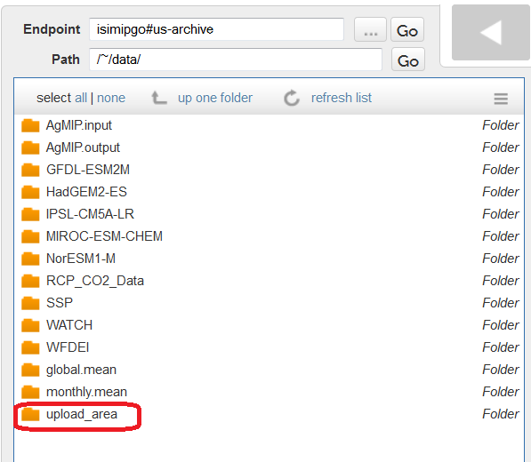
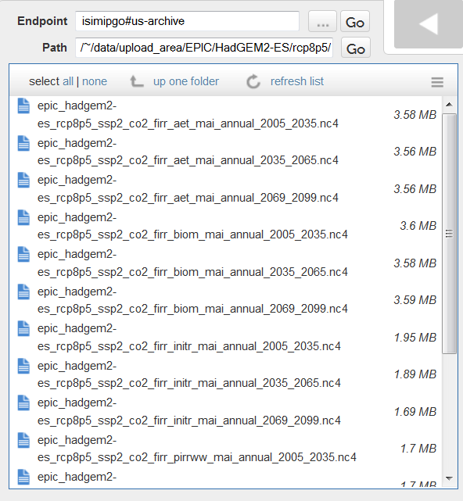
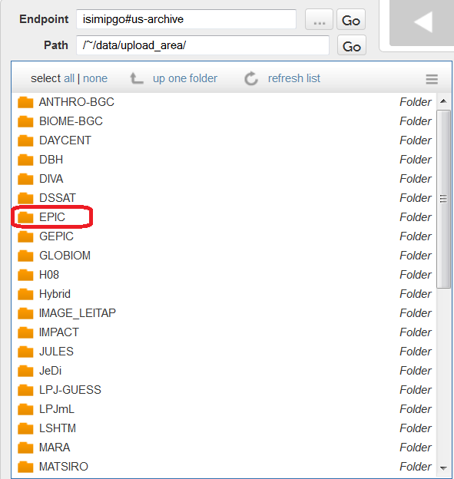
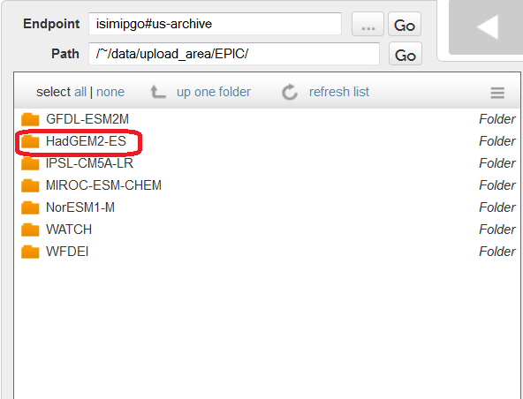
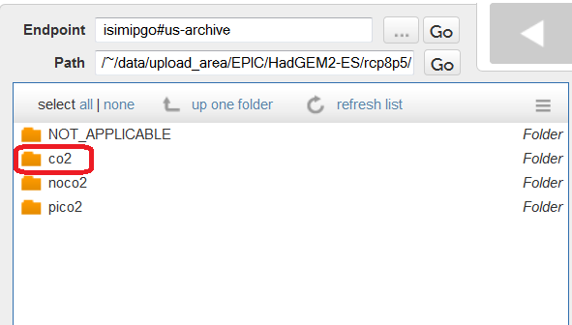
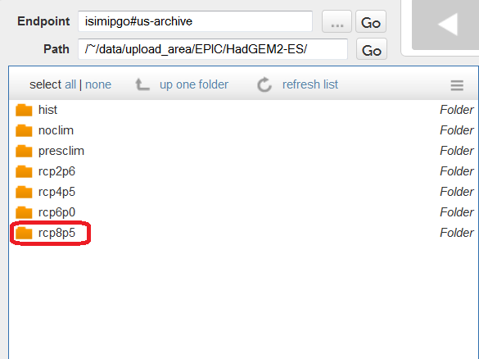
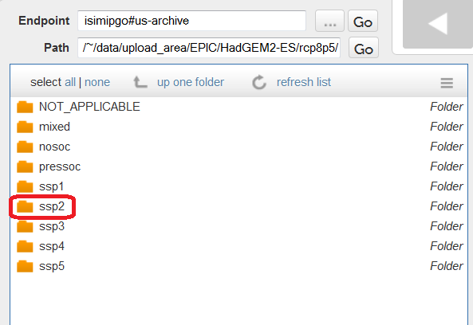
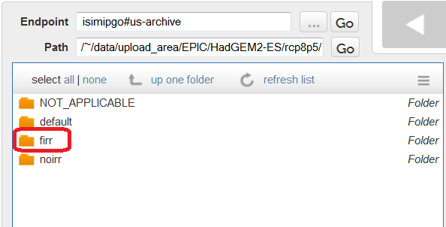
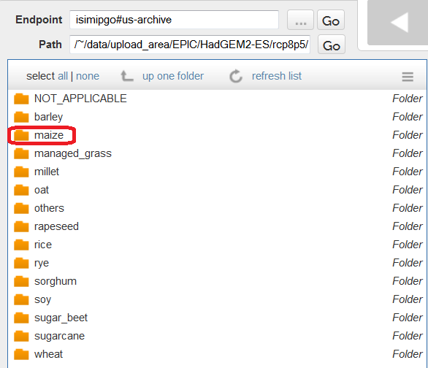
Access the AgMIP Archive
The AgMIP Tool
https://mygeohub.org/tools/agmip

Slide 4
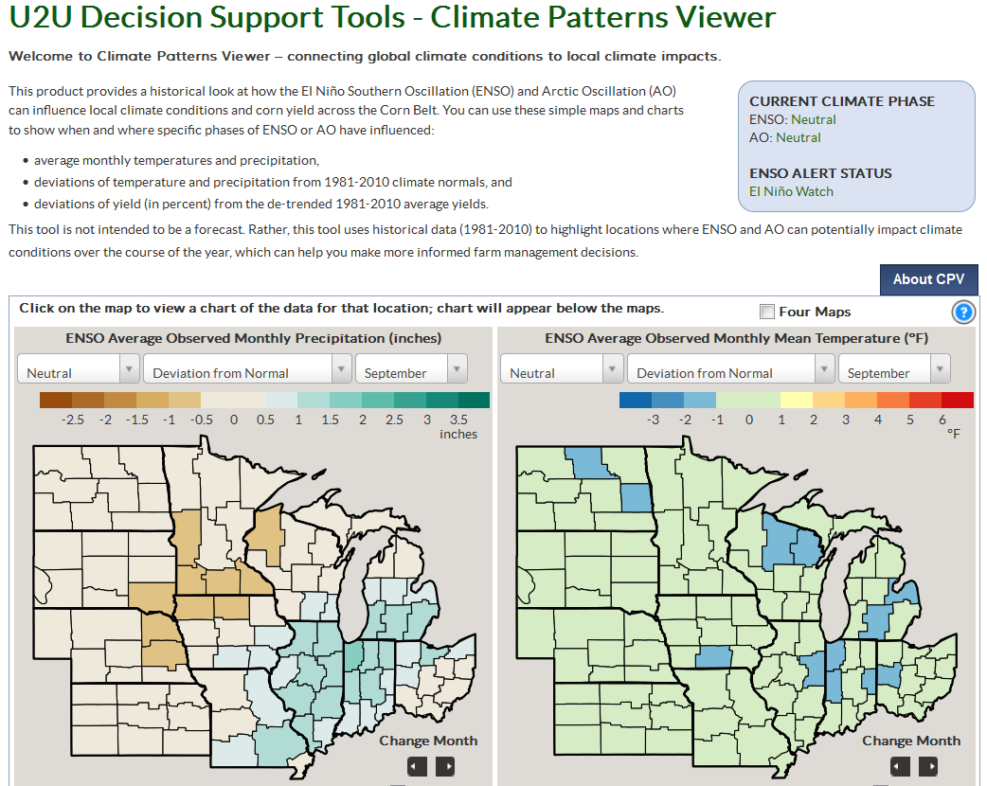
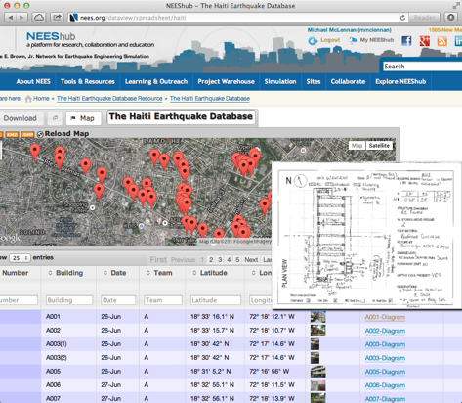
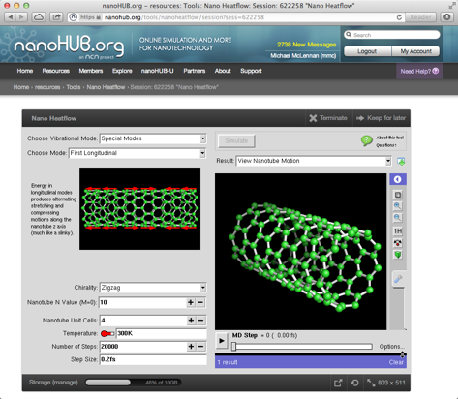
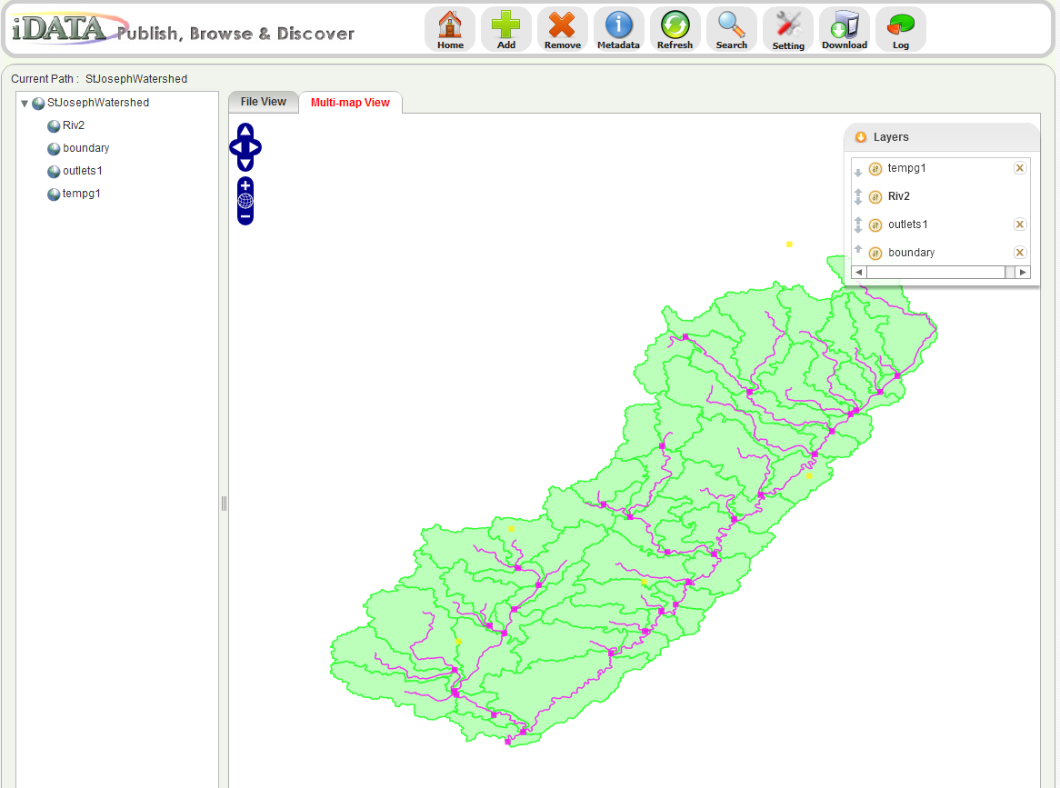
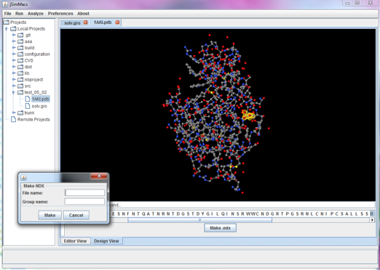
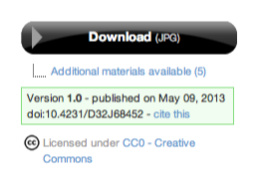


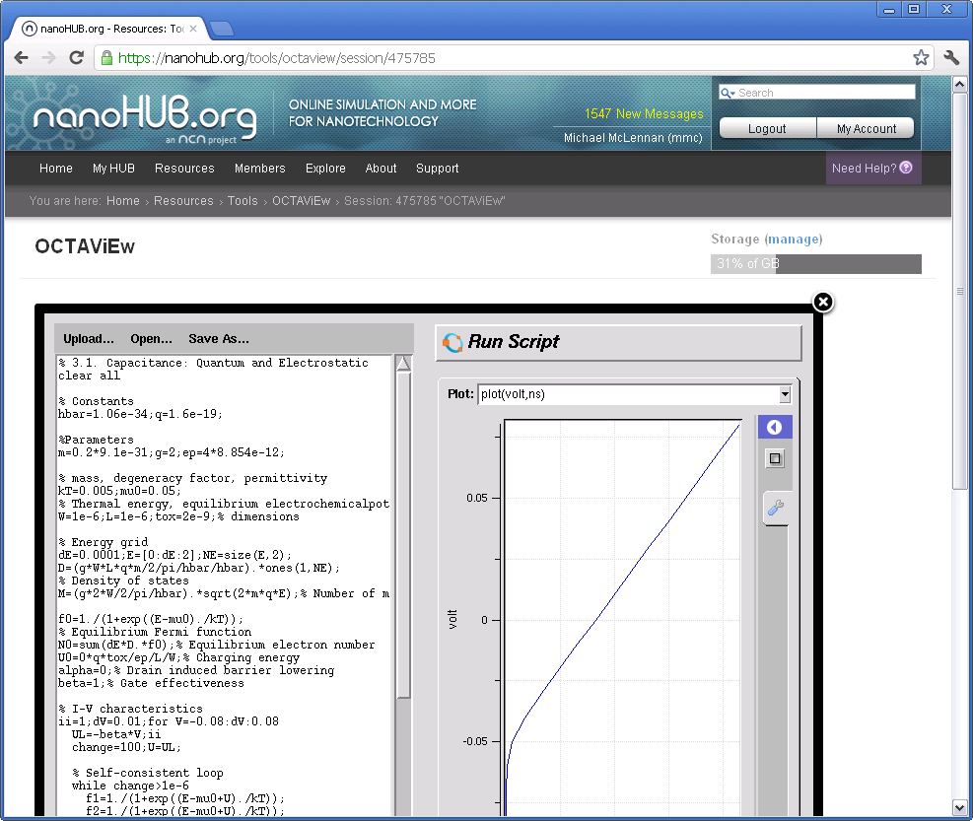
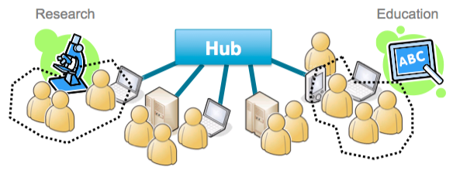
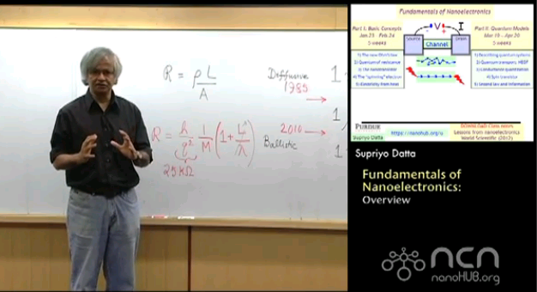
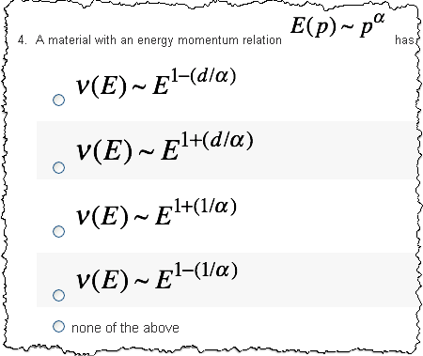
Platform for Scientific Collaboration
Computational Tools
Databases / Publications
Group/Project Collaboration
Learning Management

Slide 5






















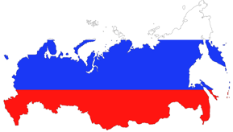




Who’s Using HUBzero?
Supporting Purdue’s largest research projects:
NEES: NSF $105M - earthquake engr data (Ramirez)
NCN: NSF $18M - nanotechnology (Klimeck/Lundstrom)
C3Bio: DoE EFRC $20M - biofuels (McCann)
PRISM: DoE $17M - mems devices (Murthy/Strachan)
Supporting Purdue infrastructure
Purdue University Research Repository (PURR) – data mgmt
PurdueNExT / nanoHUB-U – online education
Supporting many other Purdue Projects
Outside Institutions

Slide 6






60+ Hubs for many disciplines
visitors users
689,743 330,251 nanoHUB.org
343,350 112,862 nees.org
64,131 32,763 pharmaHUB.org
59,517 4,669 HABRIcentral.org
56,355 14,646 vhub.org
47,967 23,088 GlobalHUB.org
46,710 12,643 cceHUB.org
44,723 5,372 PURR
41,689 5,396 iemhub.org
40,289 8,207 StemEdHub.org
39,188 6,362 ciHUB.org
39,134 7,933 molecularHUB.org
~1,500,000
visitors total
Courtesy of M. McLennan, Purdue University

Slide 7


Global community
27
Non-profit organization
Independent owner of HUBzero code
Promotes dissemination and outreach
Sponsors HUBbub Conference
Coordinates software contributions
Foundation, LLC
Courtesy of M. McLennan, Purdue University

Slide 8
HUBzero = Scientific Collaboration
Sharing, coordination, transparency, assessment in a production research platform
  Tools
  Dataset
  Knowledge (Q&A, Blog, Discussion Forum, Wiki)
  Documentation
  Educational and training materials
  Metrics (usage stats, review, rank)
  Engagement (wishlists, announcement, calendar, …)
  Citations, credits, references, DOIs
  Collaboration space (group, project)

Slide 9
Highlights
Live tools, interactive, easy to use, “always on”, delivered via browsers
Tool development
Collaboration – all DIY style
  Group
  Project
  Contribute (upload)
Impact
  metrics

Slide 10
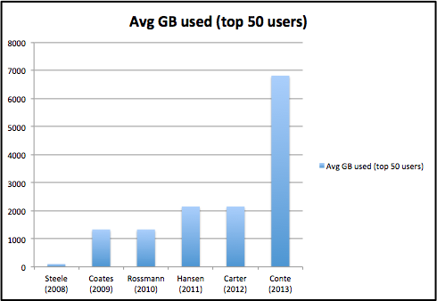
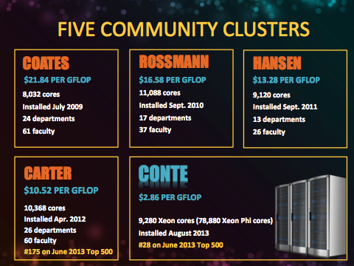
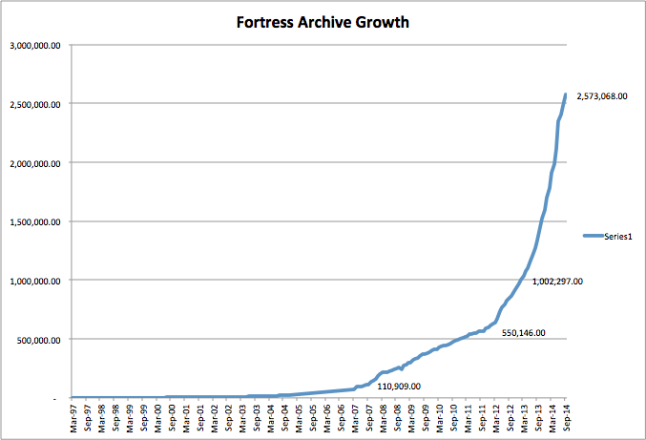
Computing @ Purdue

Slide 11
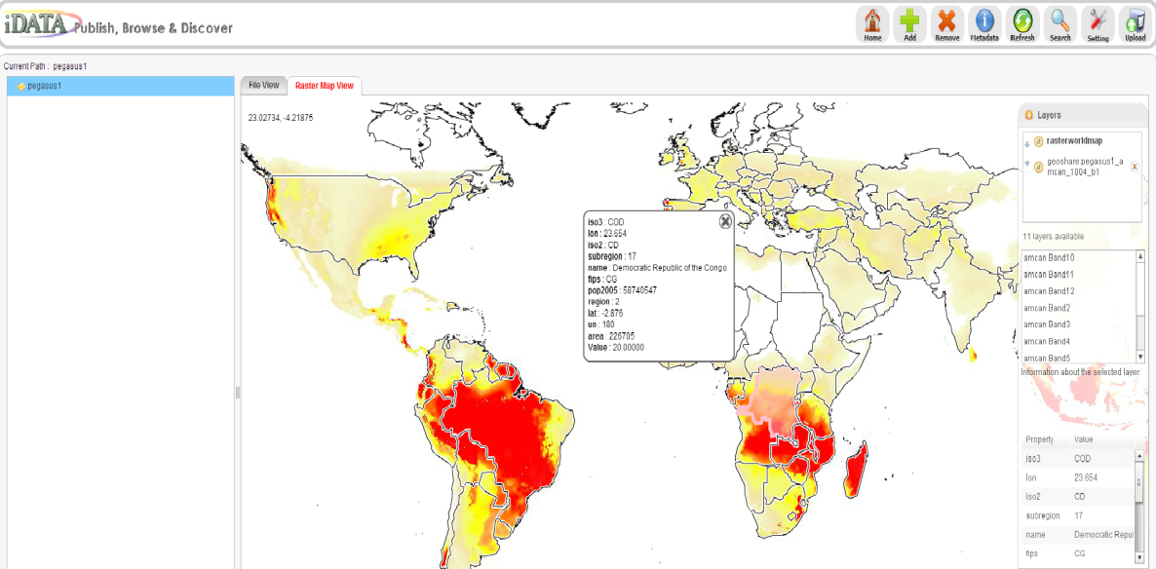
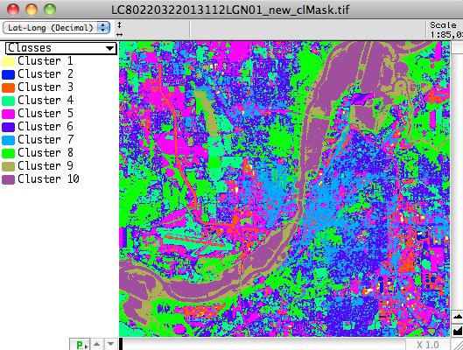
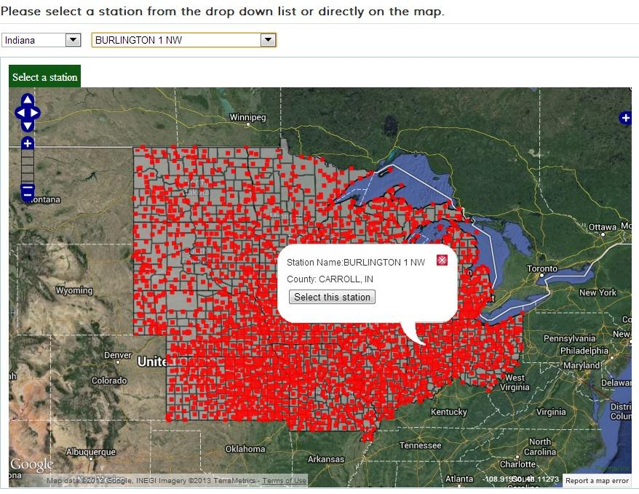
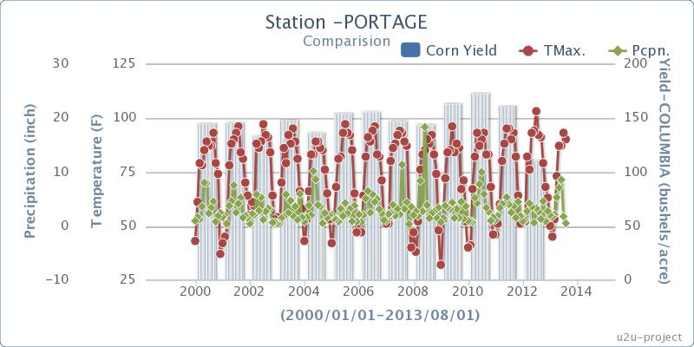
Driving Use Cases
Easy deployment of geospatial tools

Slide 12
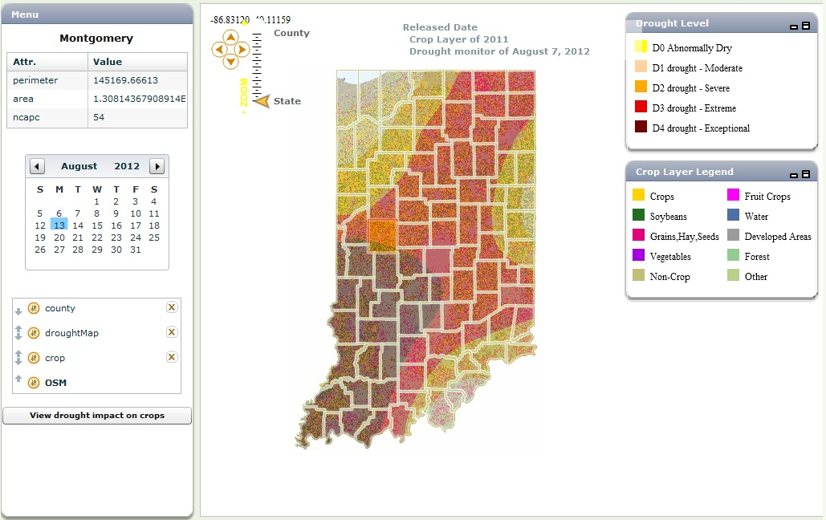
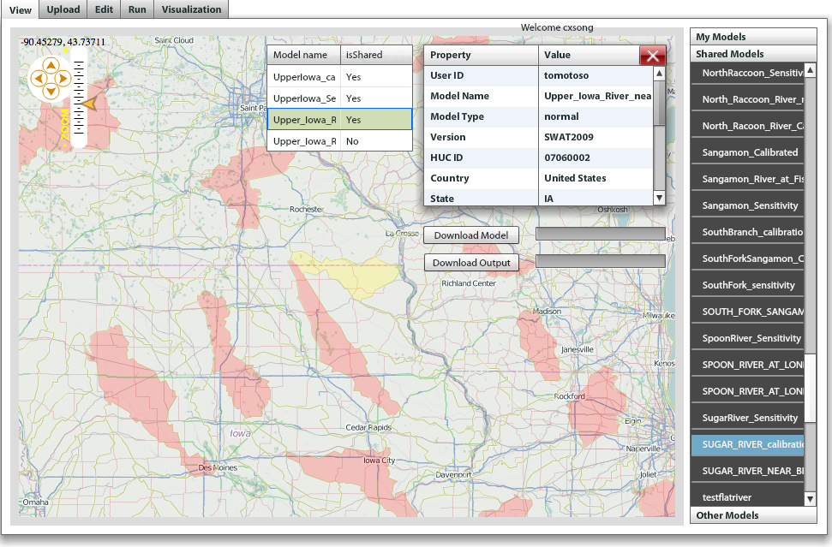
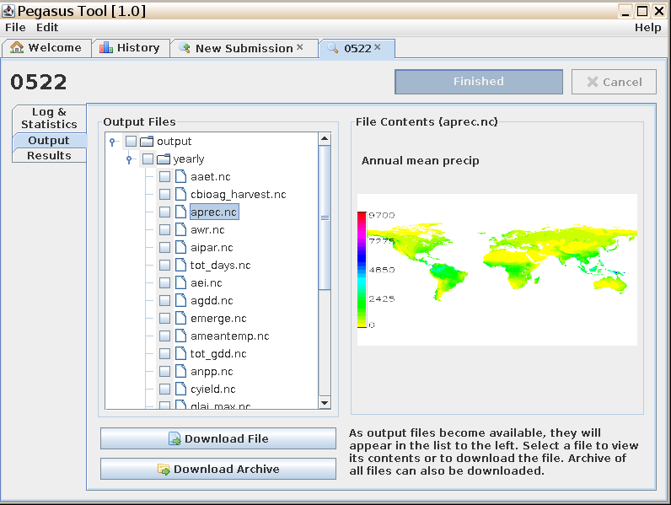
Driving example
Multi-scale and multi-disciplinary data and modeling for addressing hydrologic and ag economic issues

Slide 13

Overarching goal:
Making it easy for scientists to share geospatial data and tools
Reach broader user community
  Anyone can create an online app and share
  Anyone can share geospatial data
NSF award, $4.5M, 2013.10 – 2017.9
Notes:
Building for self service (DIY)
Leverage successful software
Develop building blocks

Slide 14
Project goals
Integrate datasets and tools
Support geospatial data processing, analysis and visualization
  Data services interface
  Rapid tool creation APIs
  Tool builder
  Map and image renderers for online tools
  Enabling geospatial data driven workflows
All of these integrated with HUBzero core
  Open source release
  Hosting

Slide 15

HUBzero
Web Server
Visualization Server
GeoRenderer
Geospatial Joomla Tools
GDAL/OGR
GEOS
OSG/osgEarth
Community Data Space
Data Services
Workspace Container
WMS/WFS/WCS/WMTS
Metadata Catalog
Rappture Toolkit
Discover
Geospatial Rappture Tools
Data Manager
Image Processing API
Manage
Non-spatial Files
Retrieve
Process
SOAP/REST/WMS/WFS/WCS/WMTS
Core API
Data tables
Transfer
Geospatial Mapping API
Raster Maps
Annotate
Publish
Vector Maps
Visualize
Data publishing API
iRODS
MySQL
PostGIS
Map Rendering Server
XSEDE
Condor
Campus Clusters

Slide 16
Challenges
Dealing with large data sets
Seamless data/tool integration
Map rendering in hub VM workspace
Service interfaces
Performance
Interfacing with other systems (Google drive, Dropbox, GIS servers)

Slide 17
GABBs Team (11+)
Carol Song, PI
Larry Biehl (remote sensing, GIS)
Venkatesh Merwade (hydrology, Civil Eng)
Nelson Villoria (global geospatial data, Ag Econ)
Betsy Hillery (project manager)
Michael McLennan (HUBzero architect)
Rob Campbell (sr developer, tool development)
Leif Delgass (sr developer, visualization)
George Howlett (sr developer, RAPPTURE Toolkit)
Lan Zhao (research scientist, geospatial applications, data management)
Rajesh Kalyanam (GIS data processing, management)

Slide 18
a hint of new capabilities to come…..

