Slide 1
Implications of irrigation for climate change impacts in India
10 September, 2014
Delphine Deryng (University of East Anglia)
Gang Zhao & Stefan Siebert (University of Bonn)
Contact: d.deryng@uea.ac.uk

Slide 2
Study setup
Region: India
Crops: Maize, Soybean, Wheat*
Climate change scenarios: CMIP5 (5 GCMs + RCP 8.5)
Crop model: PEGASUS (+ 3 ISI-MIP crop models: GEPIC, pDSSAT, LPJmL)
Irrigation data:
MIRCA2000 (Portmann et al., 2010)
National Informatics Centre in India NIC (www.nic.in)
Global Map of Irrigated Areas version 5 (GMIA5 www.fao.org/nr/water/aquastat/irrigationmap/index10.stm)
Harvested areas:
Earthstat (Monfreda et al., 2008)
National Informatics Centre in India NIC (www.nic.in)
* PEGASUS simulates spring wheat but the winter cultivar is typically grown in India

Slide 3
Irrigation and crop data used
MIRCA2000
NIC + NRSC
NIC + GMIA5
Year 2000 2005 2005
Cropland
Census data District level District level District level
Remote sensing 1 km 56 m 56 m
Crop type
Census data Diverse District level District level
Irrigated land
Census data District level District level District level
Spatial pattern GMIA4 --- GMIA5
Irrigated crops
Census data State District level ---

Slide 4
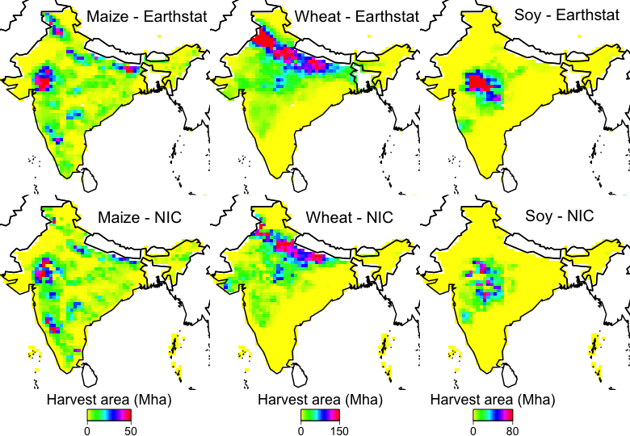
Differences in crop rainfed and irrigated areas
Harvested
Area
Notes:
Maize is grown in North-East and central of India; Soy North-East and wheat north

Slide 5
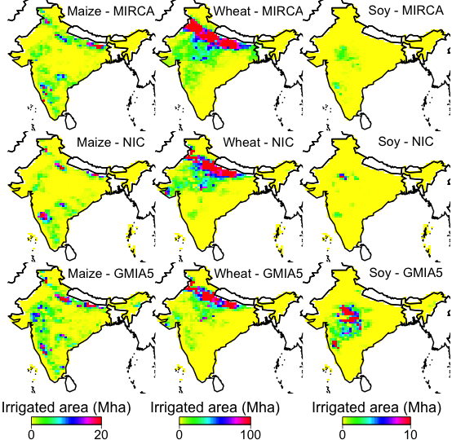
Irrigated crop area
Notes:
For the first dataset, both the irrigation and cropping area is from the NIC (national information center of India, http://www.nic.in/). The seasonality of the crops is from the agromet (Agricultural Meteorology Division, http://www.imdagrimet.gov.in/). The landuse information was sourced from the Bhuvan information system (http://bhuvan.nrsc.gov.in/bhuvan/data-dictionary). For the second dataset, the irrigation ratio (irrigation/cropping area) for the second product is from the GMIA5 (http://www.fao.org/nr/water/aquastat/irrigationmap/index10.stm). In the MIA5, the irrigation ratio is uniform for all three crops. The cropping area for the second dataset is the same source as the first one. The irrigation ratio multiplied the cropping areas to get the irrigation area in the second dataset.
Most wheat fields are irrigated. Soy little irrigation

Slide 6
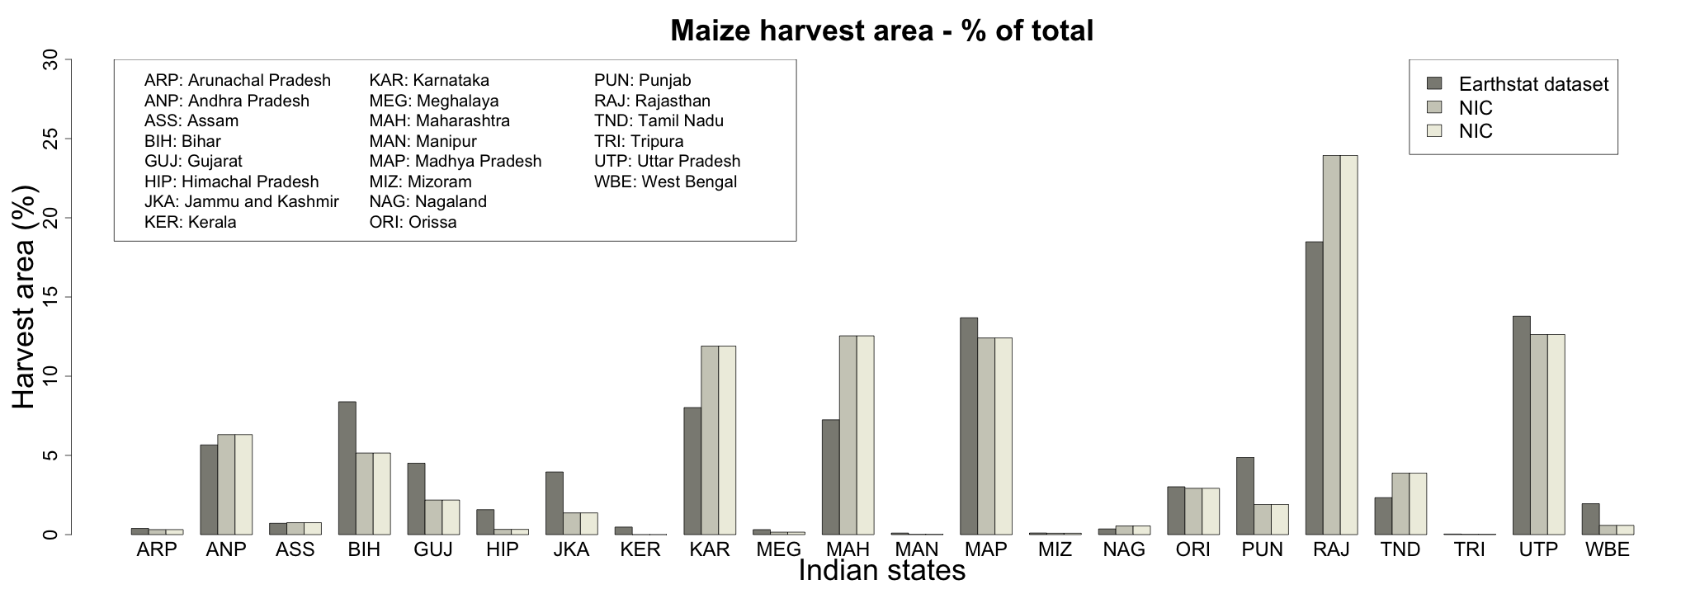
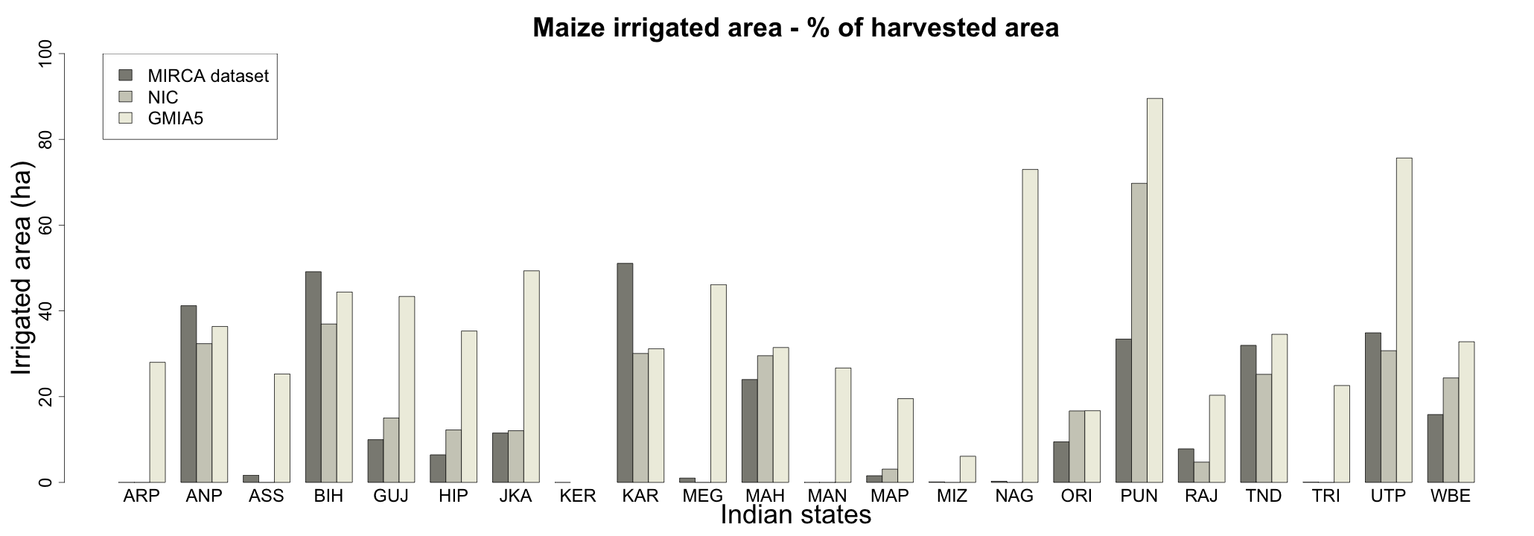
Maize
Notes:
Most maize production is grown in Rajasthan (20% of total harvested areas) where only 3-20% is irrigated
Notable states of production are: Karanataka, Madhya Pradesh, Maharashtra and Rajasthan.
Large differences in irrigation data: much more irrigation with GMIA5 than the other datasets.

Slide 7
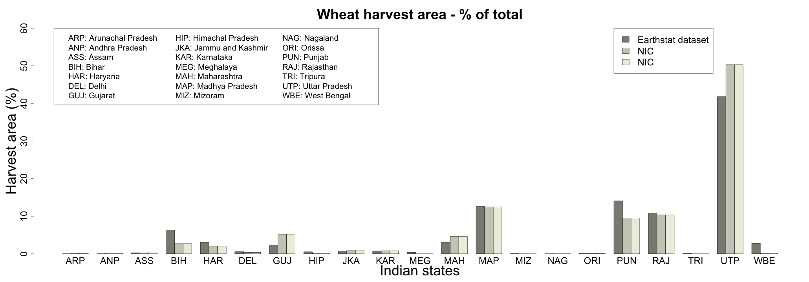
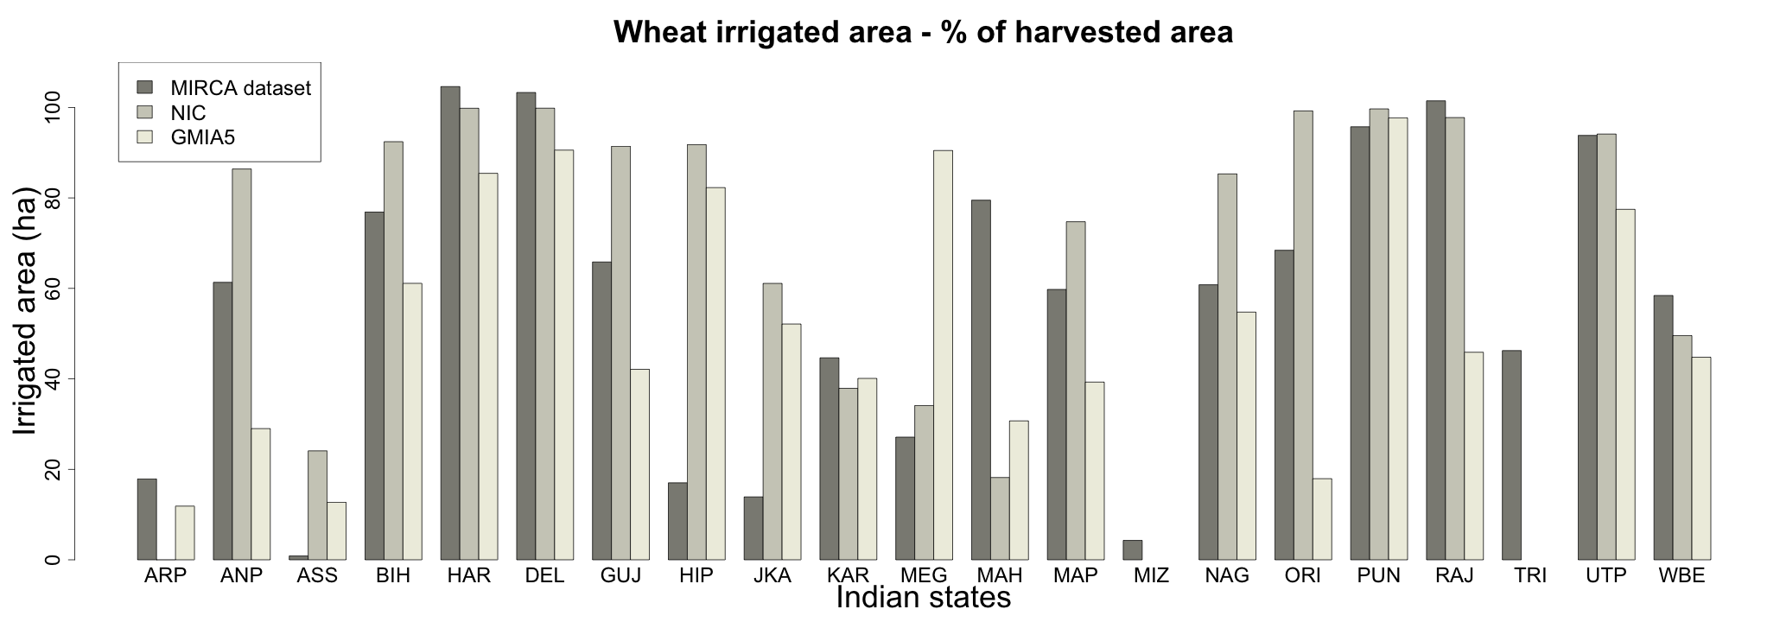
Wheat
Notes:
Most wheat is irrigated.
Notable states of production are: Madhya Pradesh, Punjab, Rajasthan and Uttar Pradesh

Slide 8
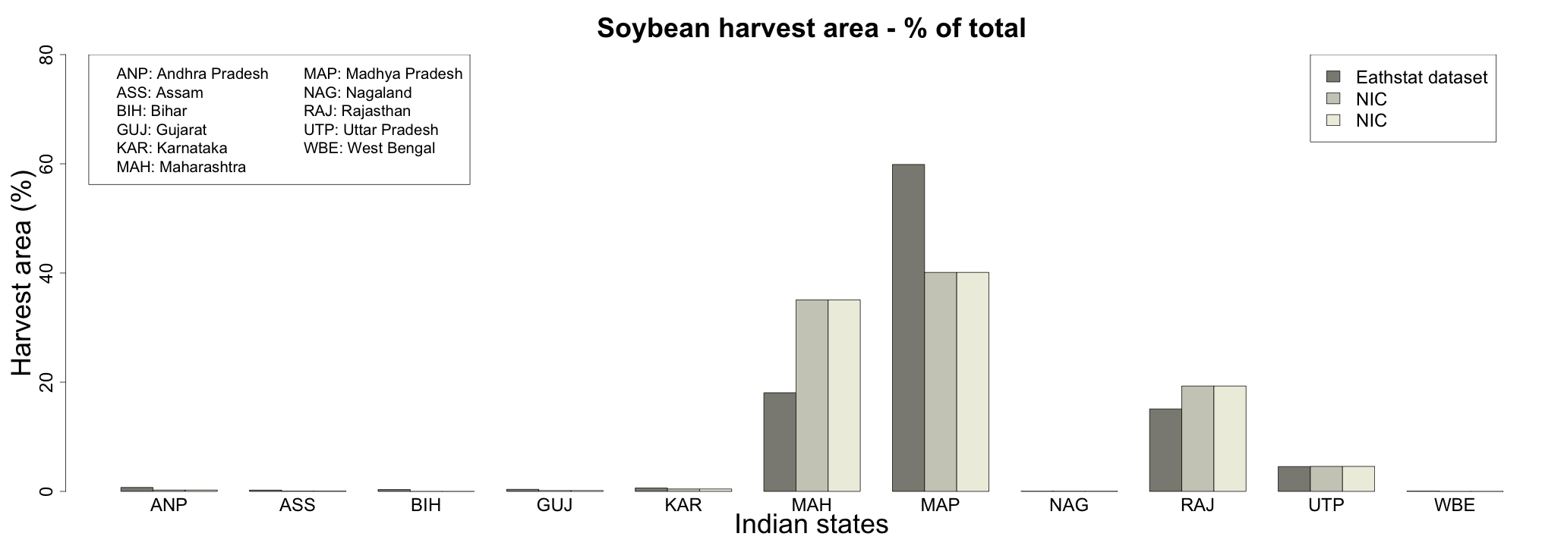
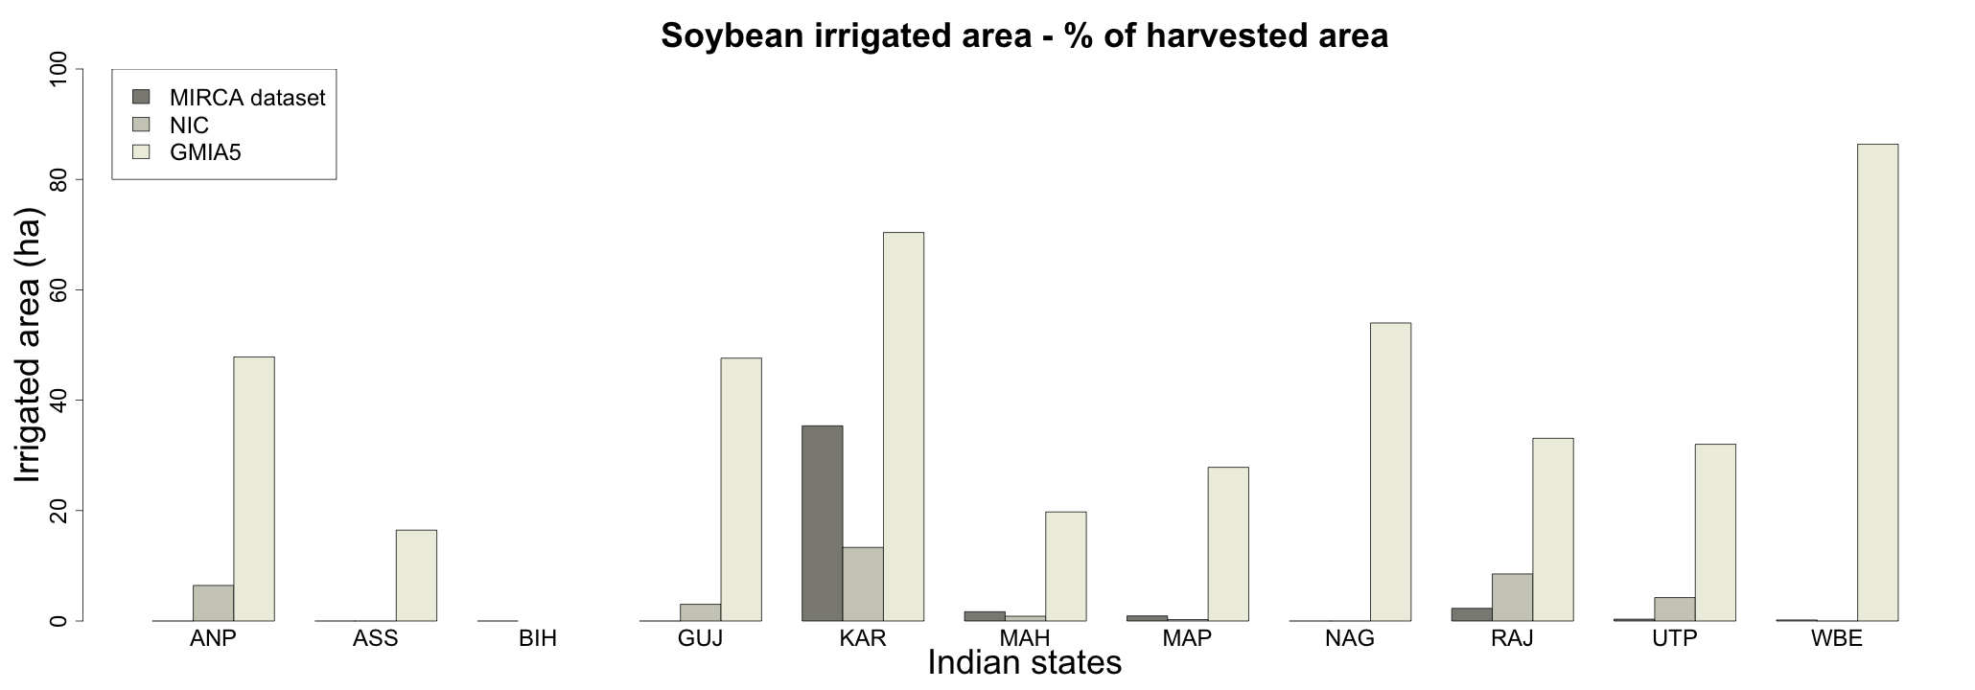
Soybean
Notes:
Large discrepancy in the irrigation dataset in terms of % but actual irrigated soy areas are small.
Notable states of production are: Maharashtra, Madhya Pradesh, Rajasthan

Slide 9
Impact of crop and irrigation data on yield simulated for climate change
Notes:
Large discrepancy in the irrigation dataset in terms of % but actual irrigated soy areas are small.
Notable states of production are: Maharashtra, Madhya Pradesh, Rajasthan

Slide 10
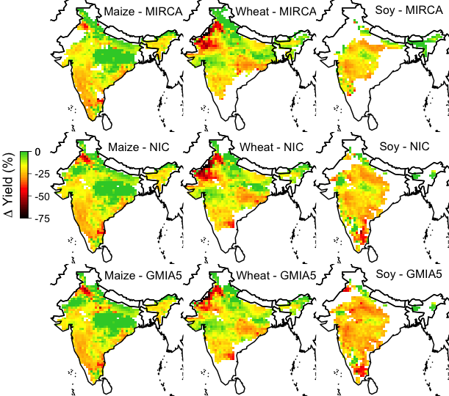
PEGASUS
% change in yield in 2020s
Notes:
Differences in harvest area can cause more differences in the impact than irrigation data. E.g. soybean!

Slide 11
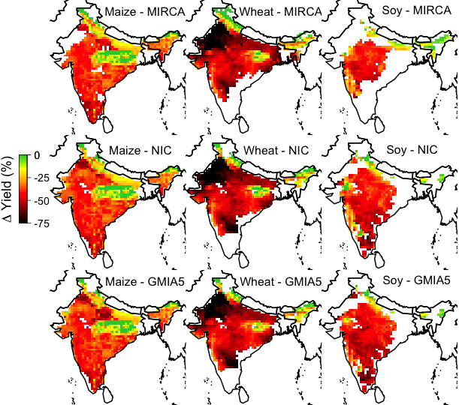
PEGASUS
% change in yield in 2050s
Notes:
Differences in harvest area can cause more differences in the impact than irrigation data. E.g. soybean!

Slide 12
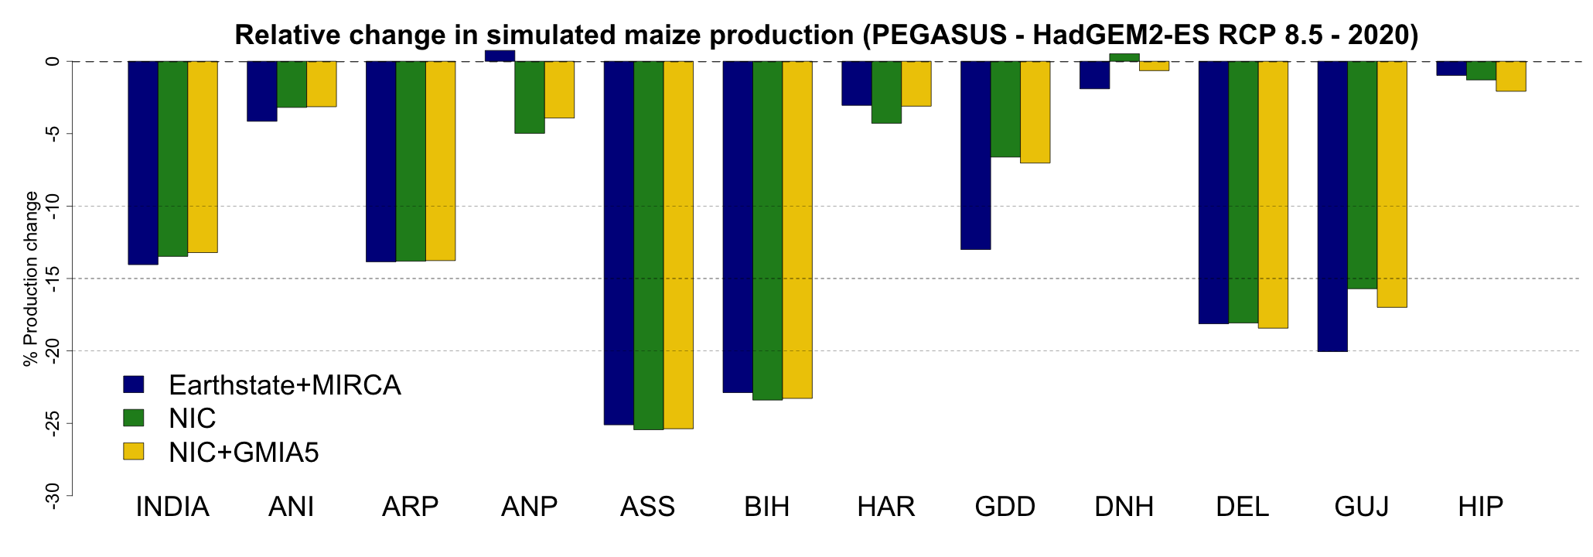
Implication for crop simulations
Impact on Maize production by the 2020s under business as usual GHG emissions pathway (RCP 8.5)
Notes:
Big differences in GGCMs! More important than for the irrigation and harvested areas datasets. Punjab is very weird. Look at differences in impact between GEPIC and PEGASUS due to the different irrigation-harvest area datasets.
Also large differences in Jammu and Kashmir for PEGASUS

Slide 13
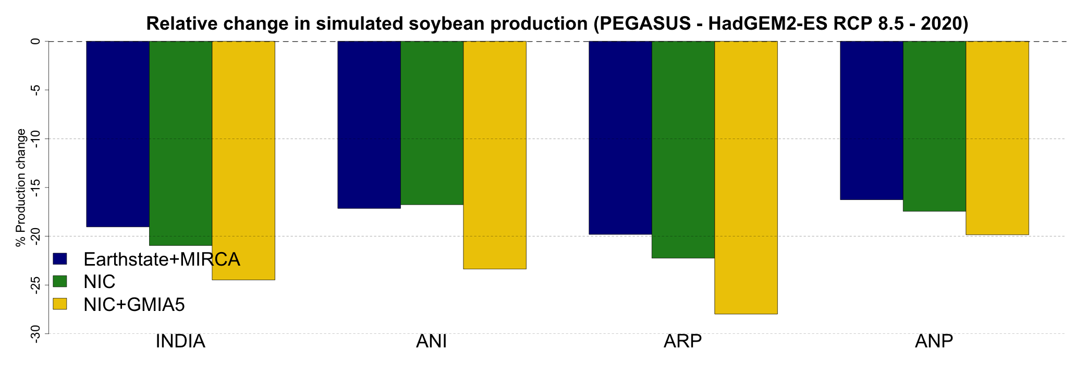
Implication for crop simulations
Impact on Maize production by the 2020s under business as usual GHG emissions pathway (RCP 8.5)
Notes:
Big differences in GGCMs! More important than for the irrigation and harvested areas datasets. Punjab is very weird. Look at differences in impact between GEPIC and PEGASUS due to the different irrigation-harvest area datasets.
Also large differences in Jammu and Kashmir for PEGASUS

Slide 14
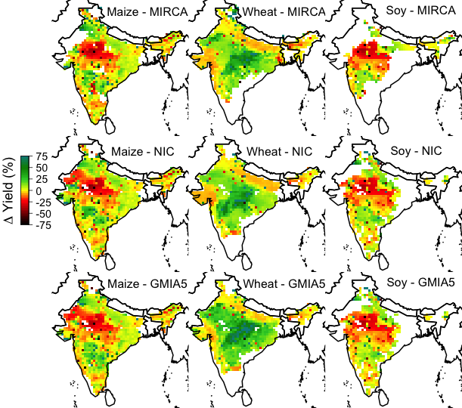
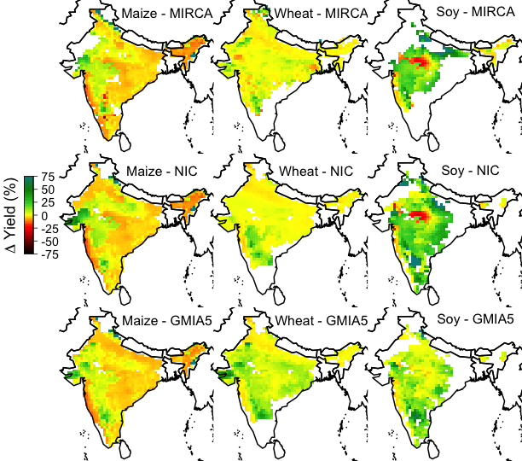
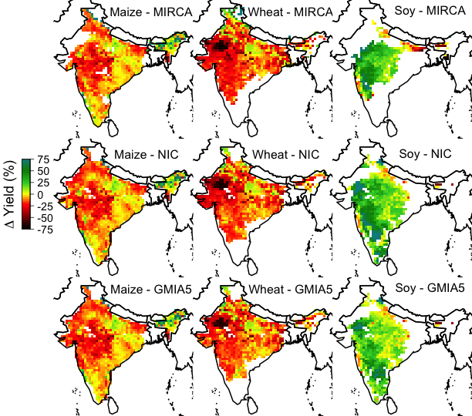
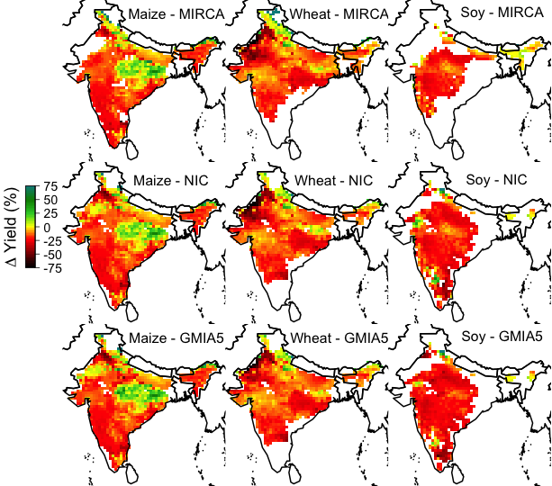
Sources of uncertainties HadGEM2-ES RCP 8.5 - 2020s
GEPIC
LPJmL
pDSSAT
PEGASUS

Slide 15
Sources of uncertainties HadGEM2-ES RCP 8.5 - 2020s
GEPIC
LPJmL
Detailed
point-specific
crop models:
Different
calibration
methods,
planting dates
decisions,
cultivars…
CO₂
fertilisation
effect
PEGASUS
Extreme
heat stress
pDSSAT

Slide 16
Discussion & Questions
Large differences in irrigation and harvested areas concern small producing regions
However these regions are likely to be more vulnerable to climate change impact on irrigation water resources and crop yields (?)
Classification of the sources of modelling uncertainties:
Crop models (they include difference processes and calibration process differ)
Climate input (GCMs)
Irrigation and crop data
Why???
Notes:
Open quesiton to discuss

Slide 17
Discussion & Questions
Why is the impact of improved irrigation and crop data on simulated yield relatively small???
Change in yield under changing climate investigated => low
resolution of climate change signal versus high resolution crop and
irrigation data => data effect maybe larger in high resolution regional
studies
Current global crop models cannot simulate realistic cropping seasons
in multiple cropping regions => this may have contributed to strong
differences across models
Notes:
Open quesiton to discuss

Slide 18
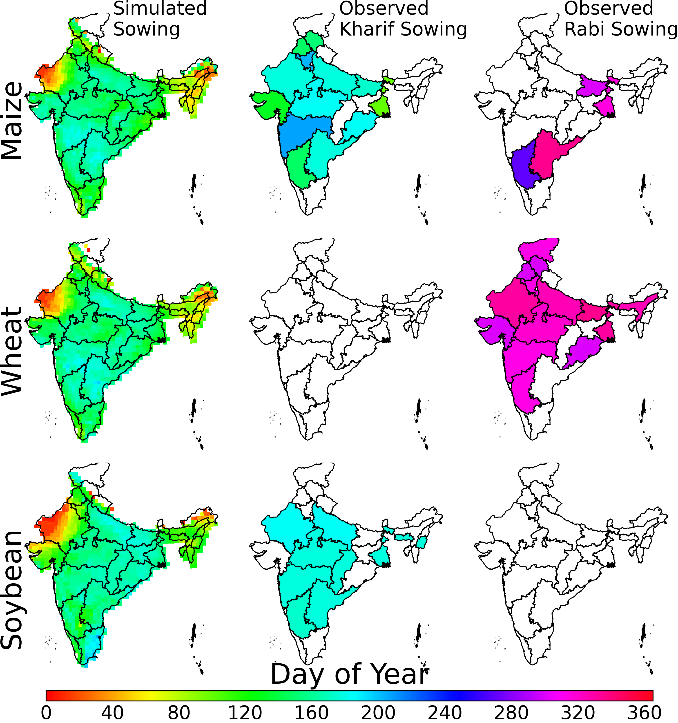
PEGASUS
National data (NIC)
Notes:
Open quesiton to discuss

Slide 19
Thank You!
Please do e-mail me if you have any questions, comments, suggestions!
d.deryng@uea.ac.uk

