Slide 1

Understanding irrigation in India
Stefan Siebert and Gang Zhao
Crop Science Group, University of Bonn, Germany

Slide 2
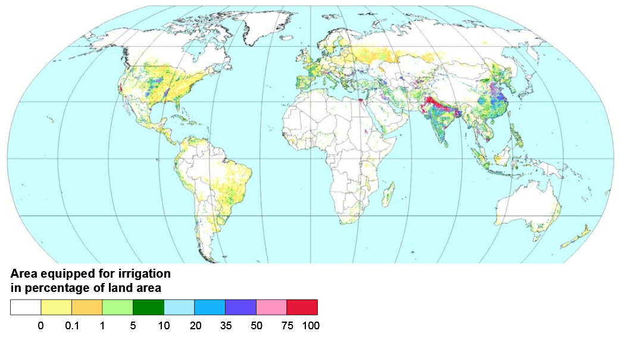
Understanding irrigation in India
Why India?
20% of irrigated land
17% of population
11% of cropland
14% of harvested
crop area
Siebert et al., 2013
Motivation
Methodology
Results
Discussion
02

Slide 3
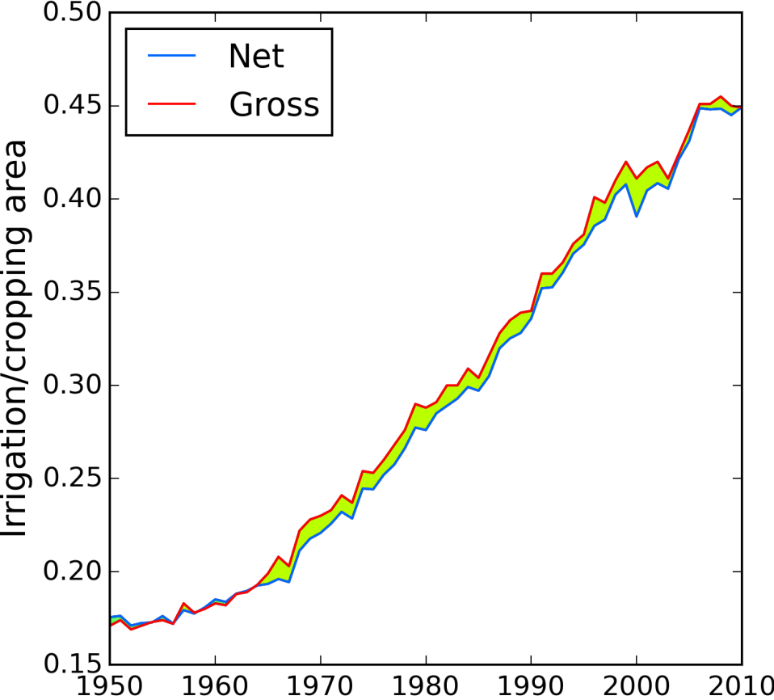
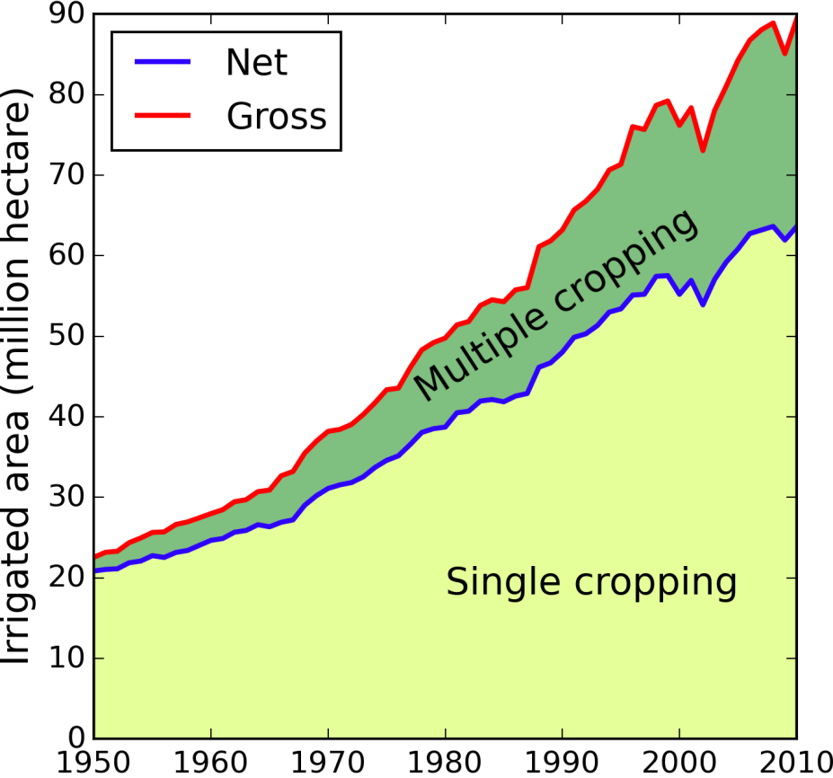
Understanding irrigation in India
Why India?
Source: NIC, 2014
Source: NIC, 2014
Motivation
Methodology
Results
Discussion
03

Slide 4
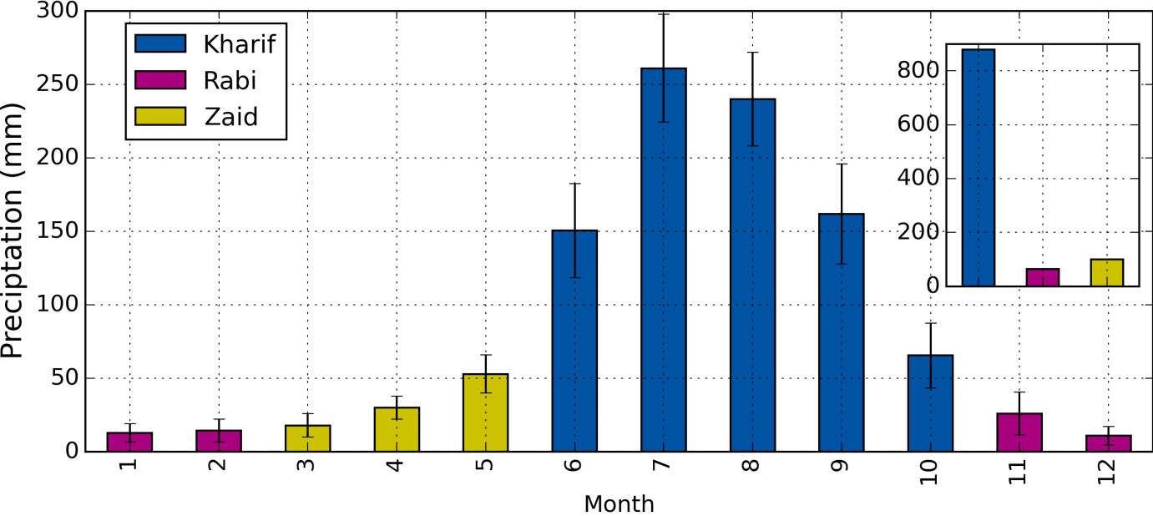
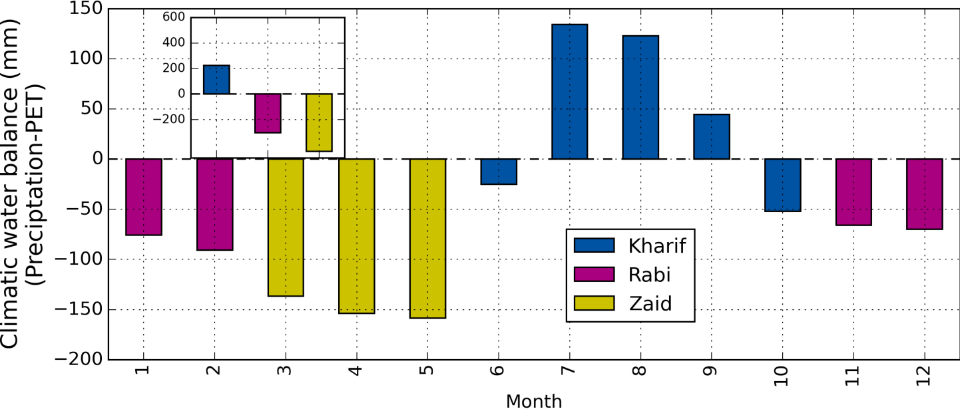
Aridity differs a lot between seasons!
Drought stress and irrigation water requirements differ a lot between seasons!
Data source: CRU, CGIAR CSI, 2014
Motivation
Methodology
Results
Discussion
04

Slide 5
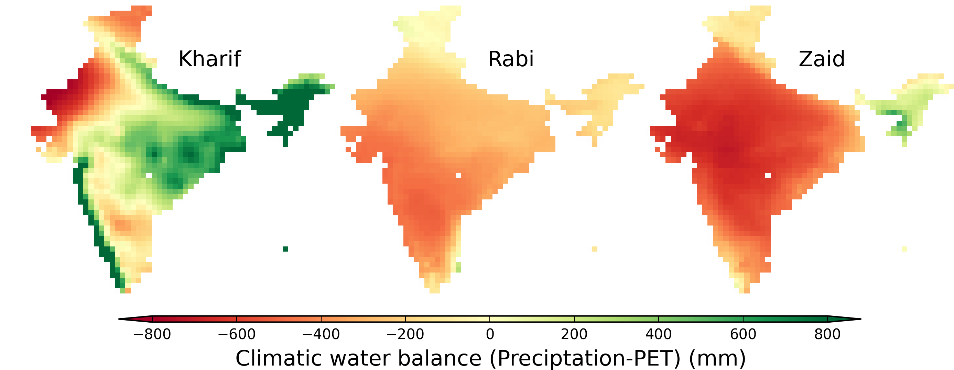
Data source: CRU, CGIAR CSI, 2014
Rice
Rice
Rice
Wheat, Barley, Mustard
Pearl Millet
Pearl Millet
Pigeon Pea
Pigeon Pea
Crops differ a lot between seasons!
Motivation
Methodology
Results
Discussion
05

Slide 6
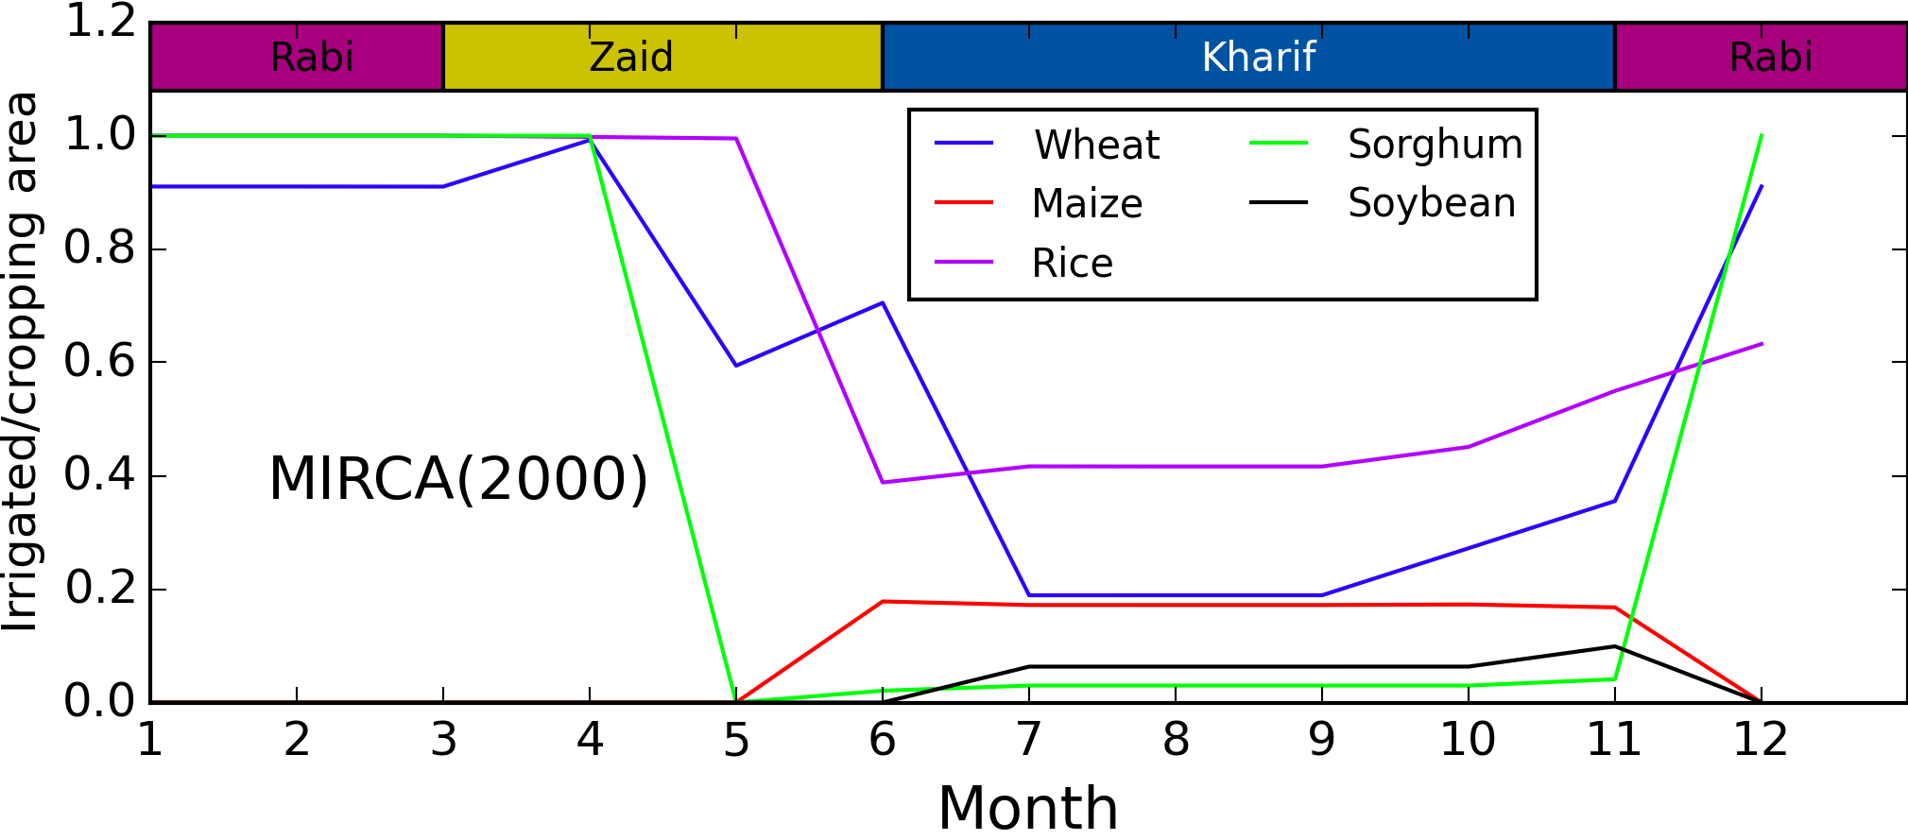
Data source: MIRCA2000, Portmann et al., 2010
Irrigated crop fraction differs a lot between seasons!
Objective of the GEOSHARE pilot study:
Develop dataset on monthly growing area of irrigated and rainfed crops in India based on fusion of national data
Motivation
Methodology
Results
Discussion
06

Slide 7
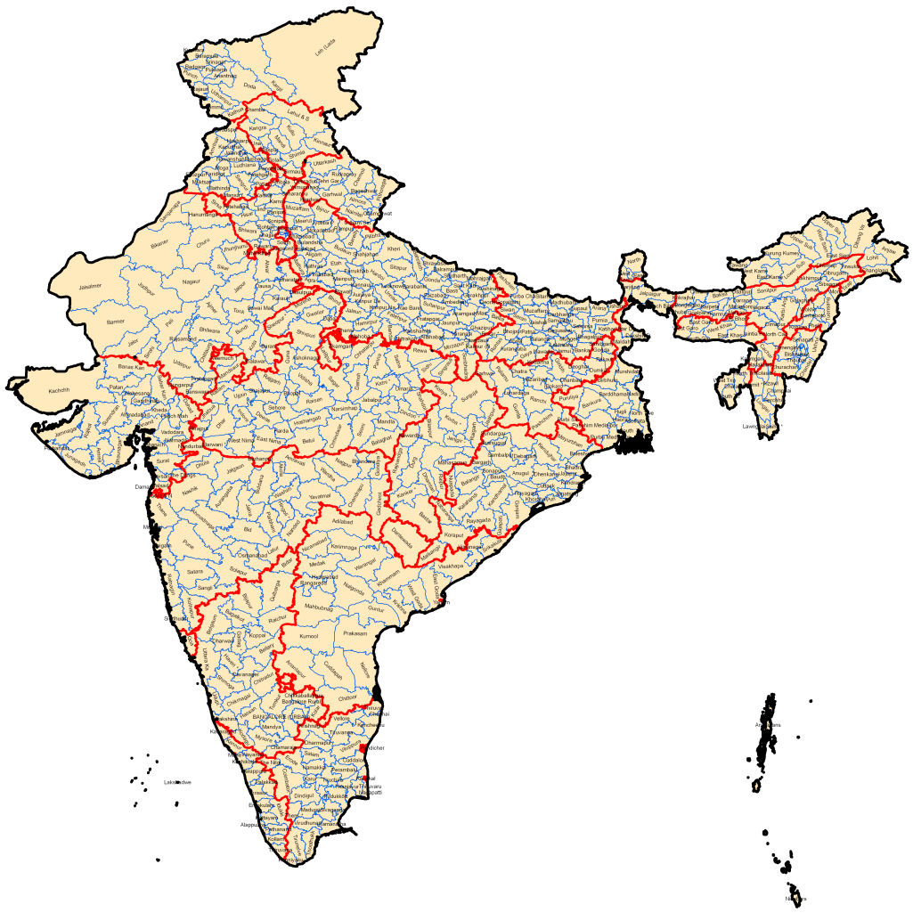
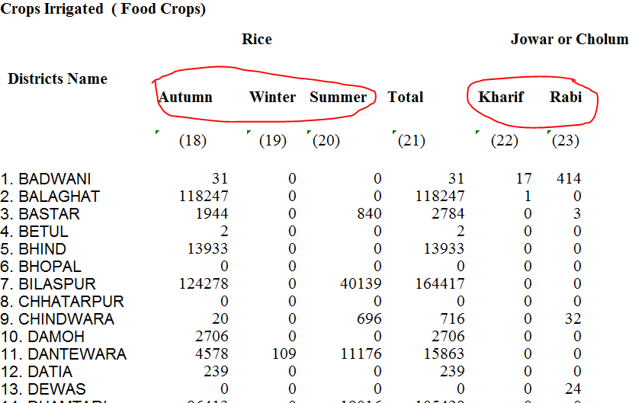
Input data:
1) Crop – and season specific growing area statistics for
irrigated and rainfed crops, per district, 2005/2006
NIC Land Use Statistics
Motivation
Methodology
Results
Discussion
07

Slide 8

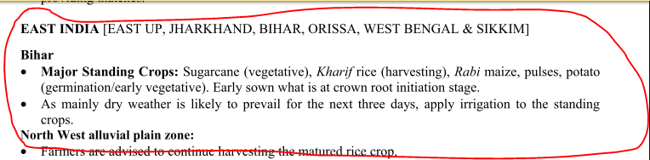
Input data:
2) Crop advisories for 6 agro-meteorological zones, weekly,
information per state
IMD
Motivation
Methodology
Results
Discussion
08

Slide 9
Monthly irrigated and rainfed growing areas of following crops:
District wise crop statistics
(data set 1)
+
Wheat
Maize
Rice
Barley
Sorghum
Pearl Millet (Bajra)
Finger Millet (Ragi)
Chick Pea (Gram)
Pigeon Pea (Tur)
Soybean
Groundnut
Sesame
Sunflower
Cotton
Linseed
Sugarcane
Tobacco
Fruits + vegetables
Condiments + spices
Fodder crops
AgriMet crop advisories
(data set 2)
Motivation
Methodology
Results
Discussion
09

Slide 10
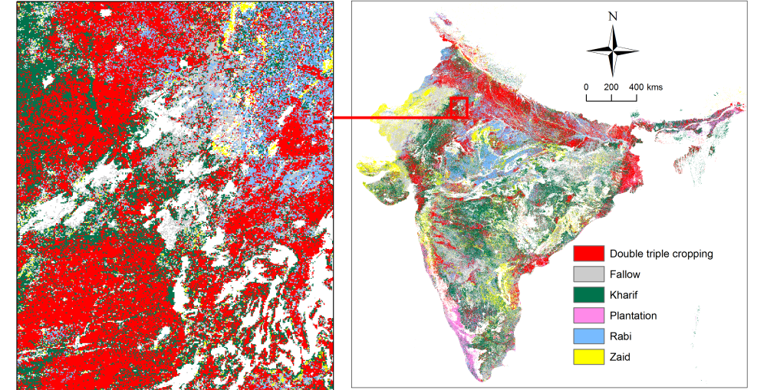
Input data:
3) High resolution seasonal land use statistics (2004-2011)
National Remotes Sensing Centre
Motivation
Methodology
Results
Discussion
10

Slide 11
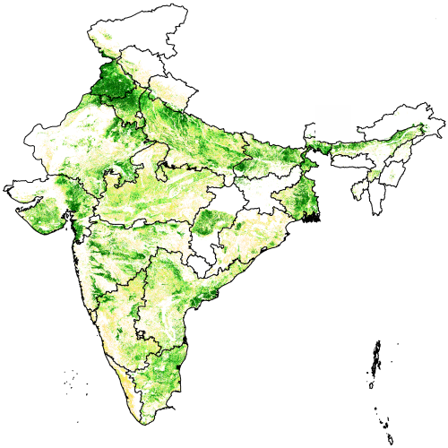
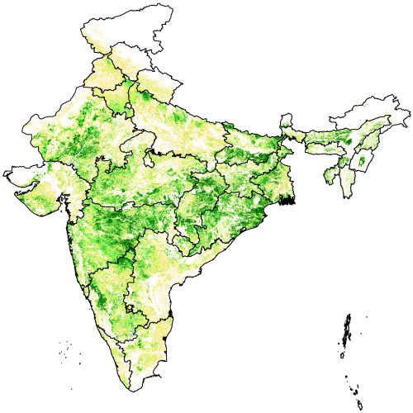
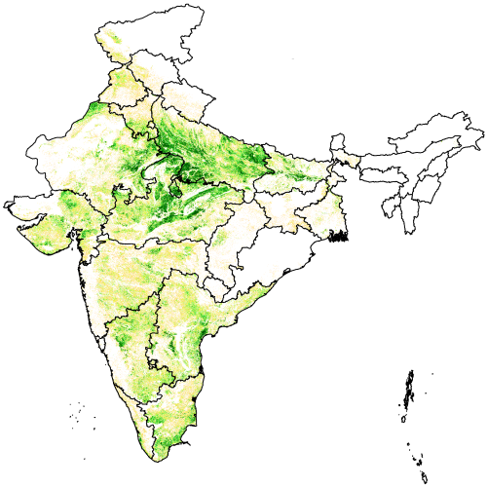
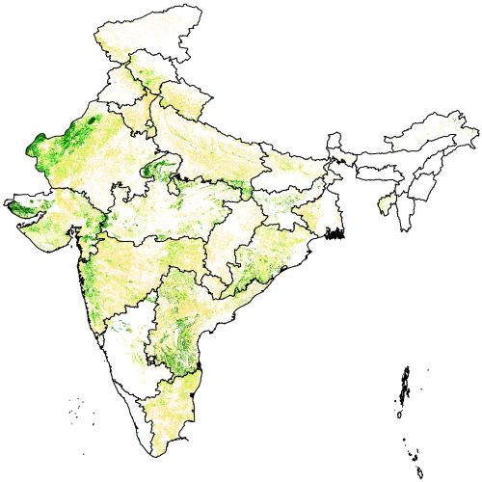
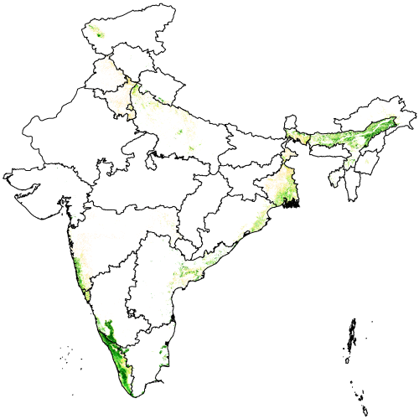
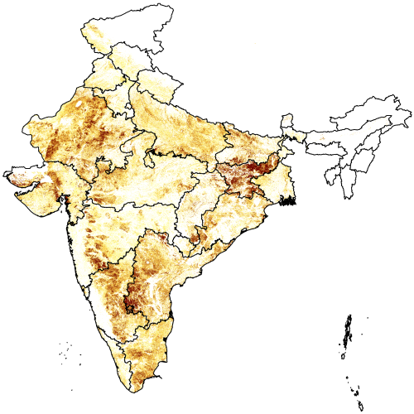
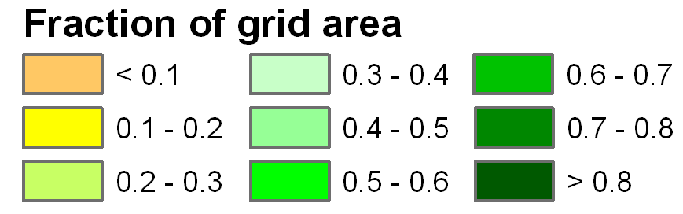
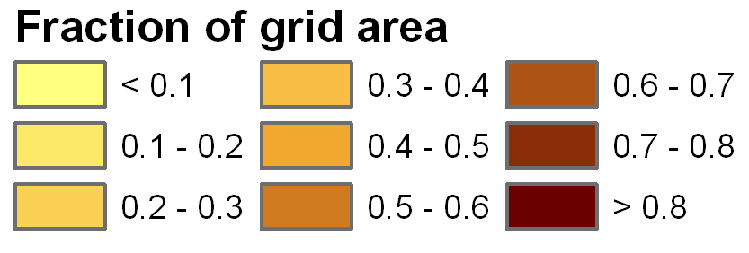
Input data:
3) High resolution seasonal land use statistics (2004-2011)
National Remotes Sensing Centre
Multiple
cropping
Kharif
only
Rabi
only
Zaid
only
Permanent
cropping
Fallow
Motivation
Methodology
Results
Discussion
11

Slide 12
Using high resolution remote sensing data to disaggregate the district wise crop statistics
Crop in survey based statistics
(Dataset 1 + Dataset 2)
Remote sensing based crops
(Dataset 3)
Perennial crops
Plantation
Multiple cropping
Kharif season crops
Kharif season only
Rabi season crops
Rabi season only
Zaid season crops crops
Zaid season only
Fallow
Motivation
Methodology
Results
Discussion
12

Slide 13
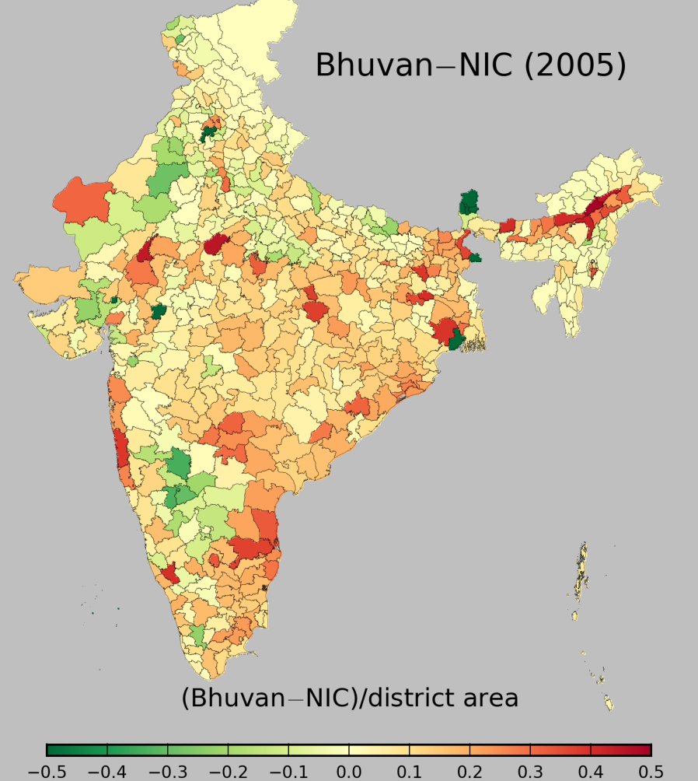
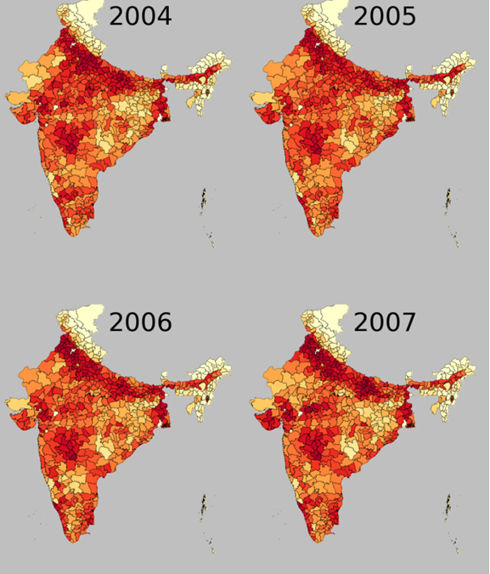
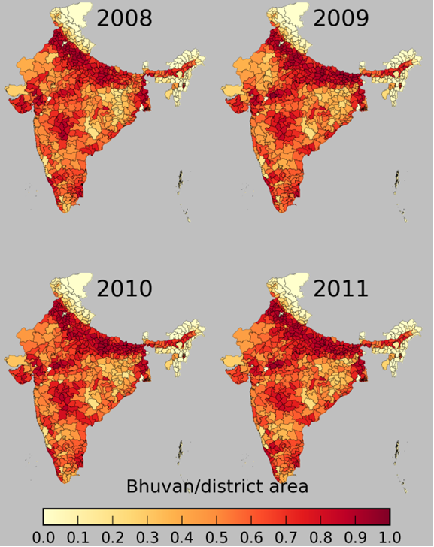
Use of independent data => inconsistencies between survey based statistics and remote sensing data
Adjusting remote sensing data:
Step 1: using data from different years
Motivation
Methodology
Results
Discussion
13

Slide 14
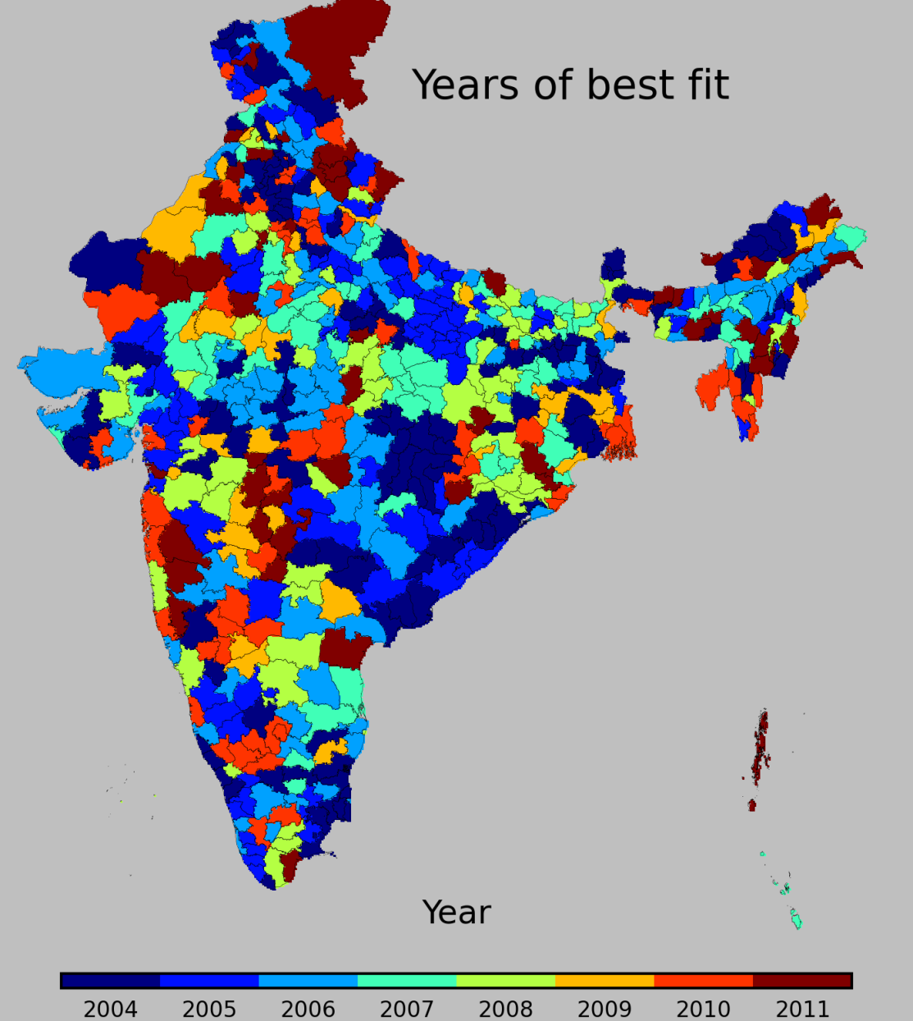
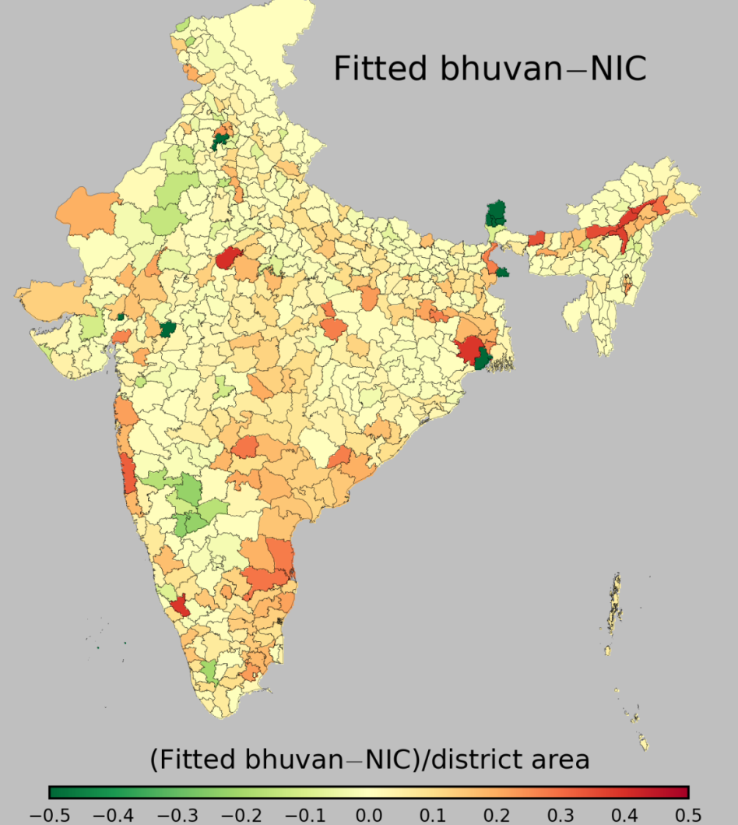
Adjusting remote sensing data:
Step 1: using data from different years
Motivation
Methodology
Results
Discussion
14

Slide 15
Adjusting remote sensing data:
Step 2: using “fallow land” category to adjust season specific crop area
Crop in survey based statistics
(Dataset 1 + Dataset 2)
Remote sensing based crops
(Dataset 3)
Perennial crops
Plantation
Multiple cropping
Kharif season crops
Kharif season only
Rabi season crops
Rabi season only
Zaid season crops crops
Zaid season only
Fallow
Motivation
Methodology
Results
Discussion
15

Slide 16
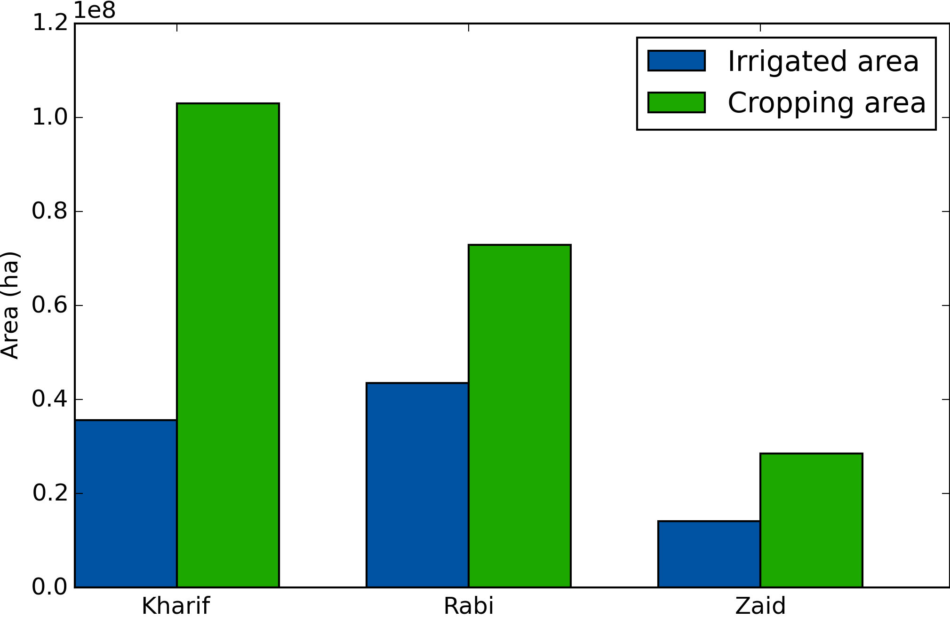
Results
Motivation
Methodology
Results
Discussion
16

Slide 17
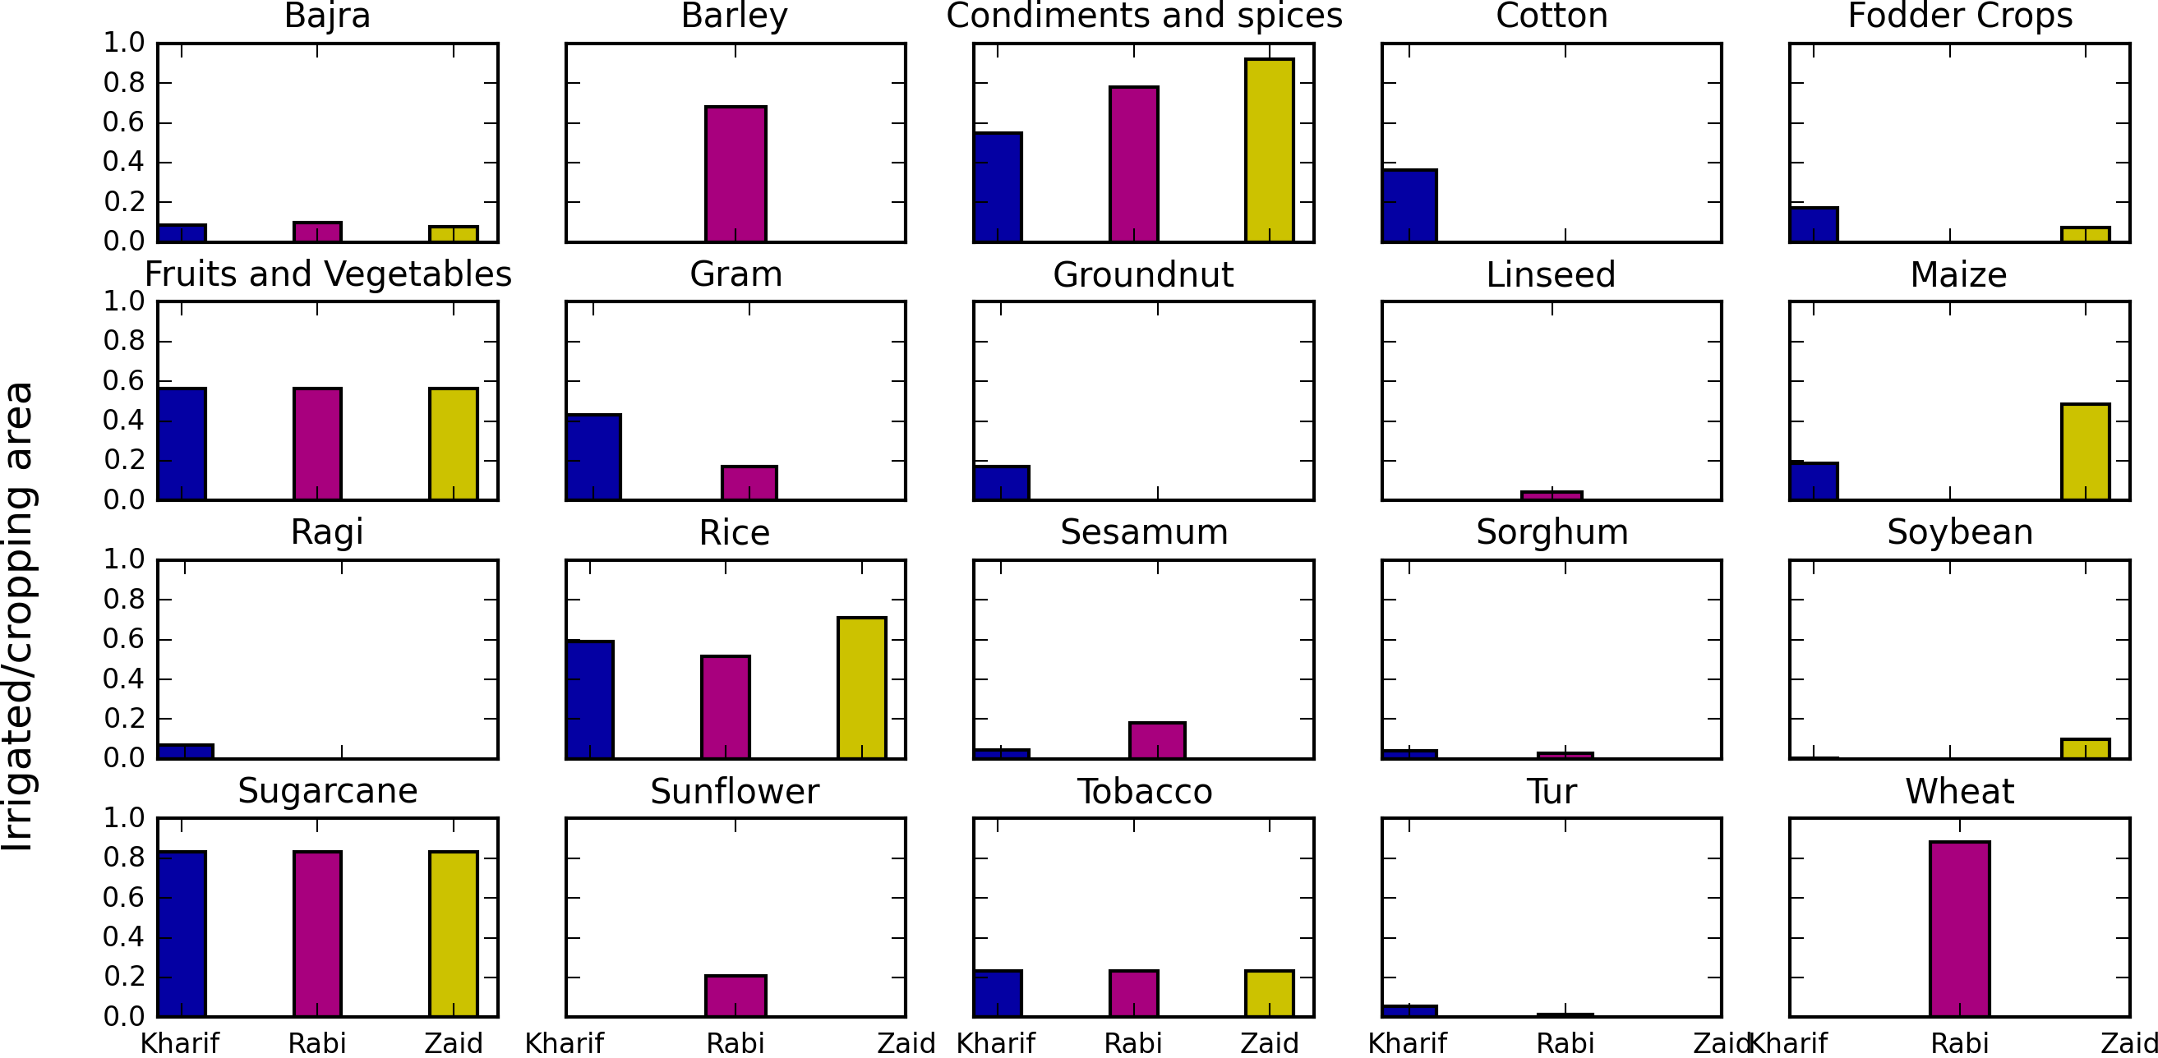
Results
Motivation
Methodology
Results
Discussion
17

Slide 18
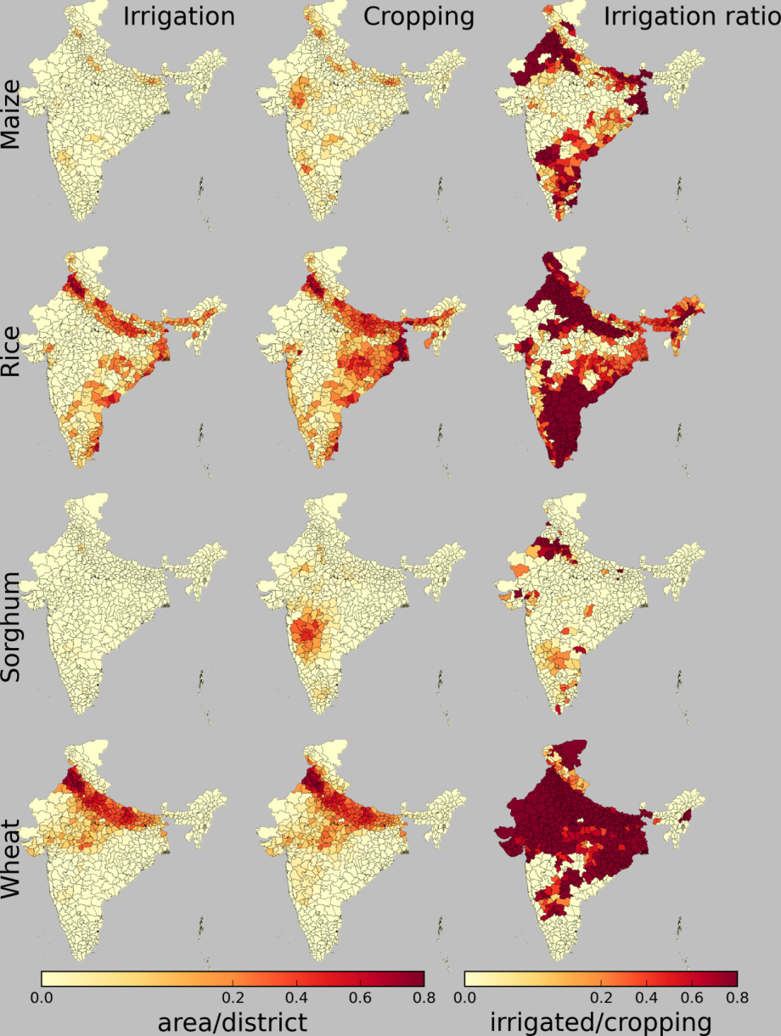
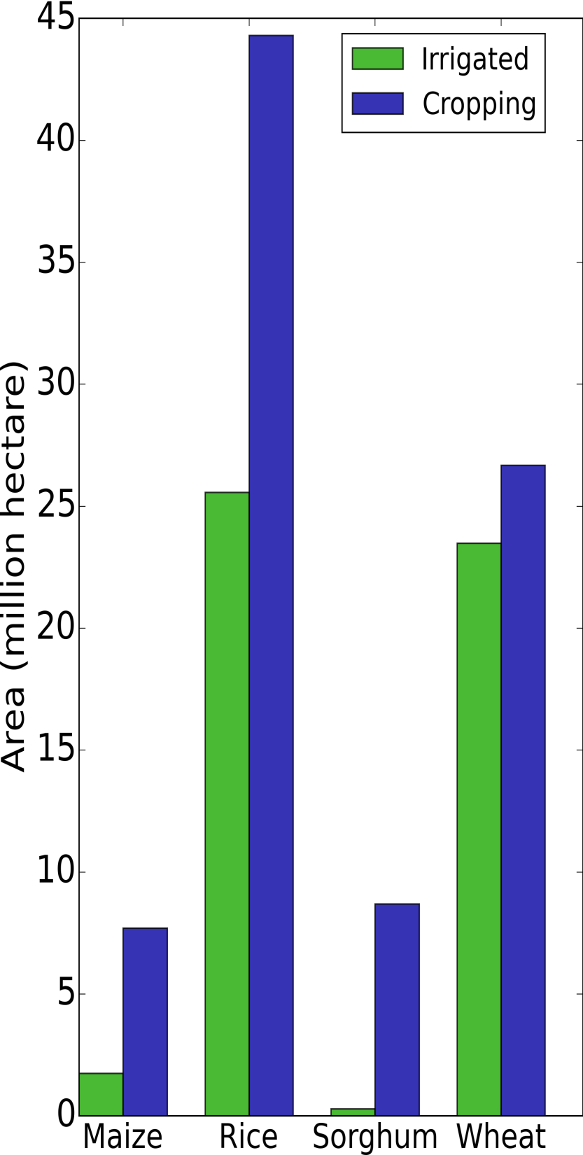
Motivation
Methodology
Results
Discussion
18

Slide 19
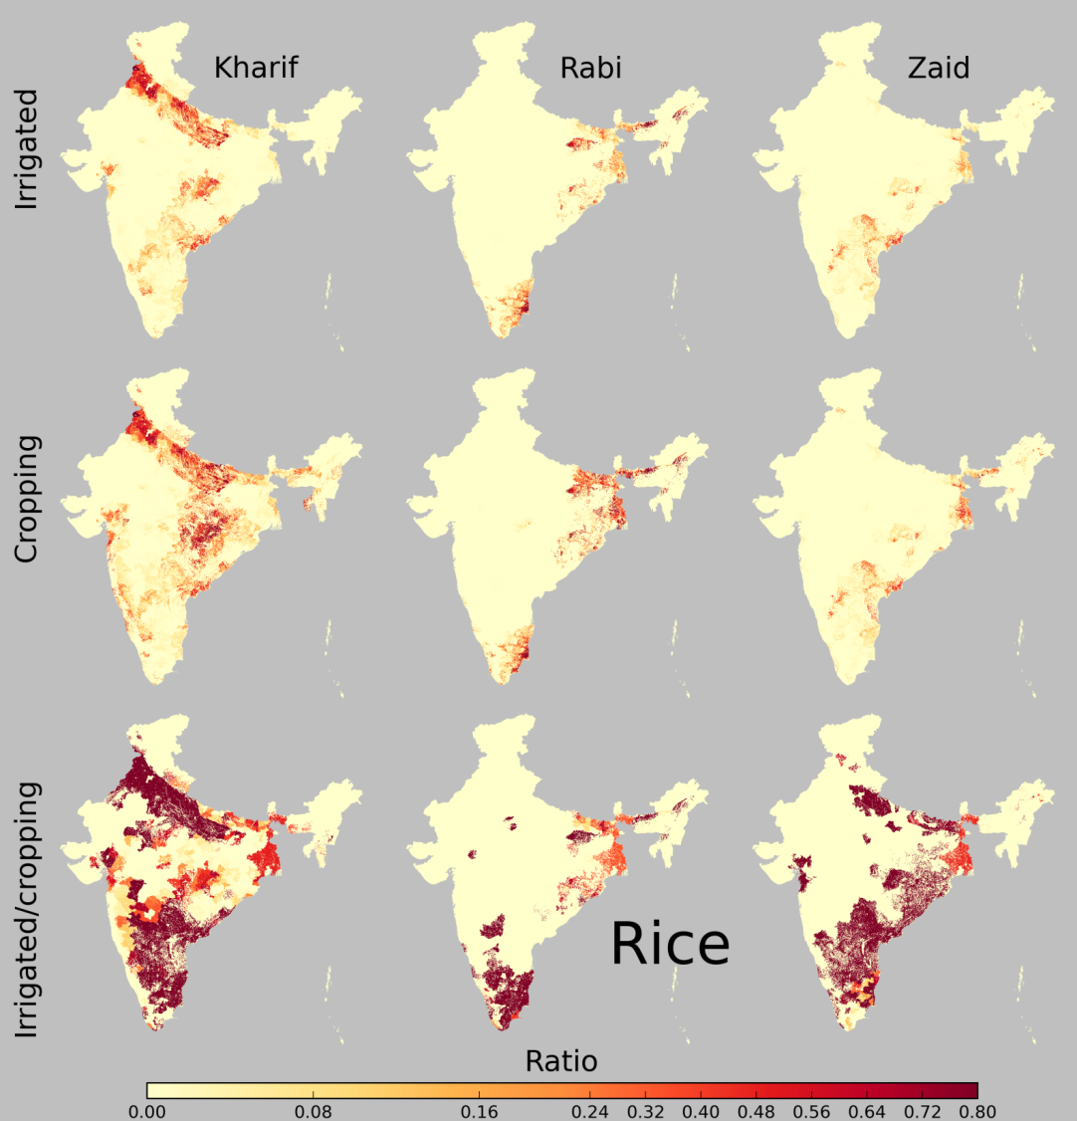
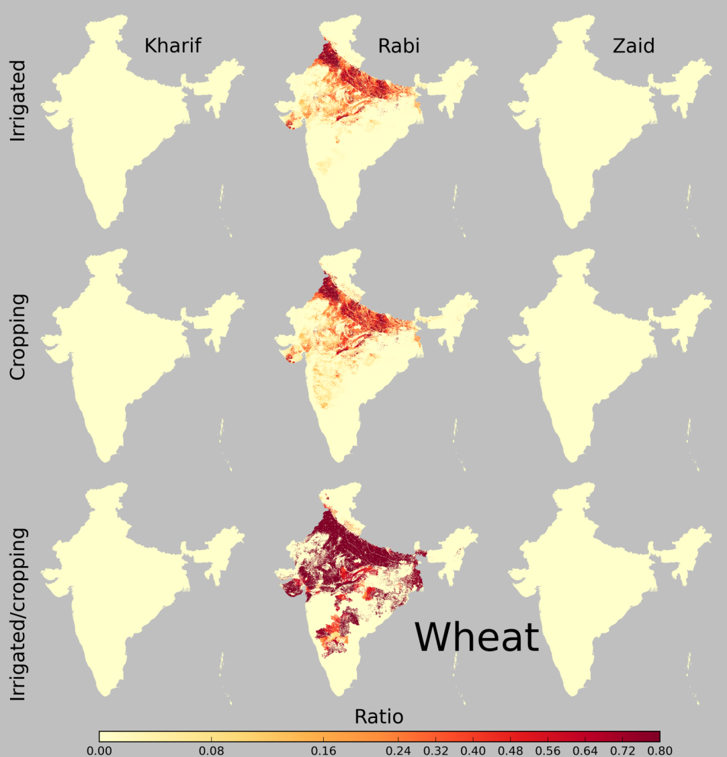
Results
Motivation
Methodology
Results
Discussion
19

Slide 20
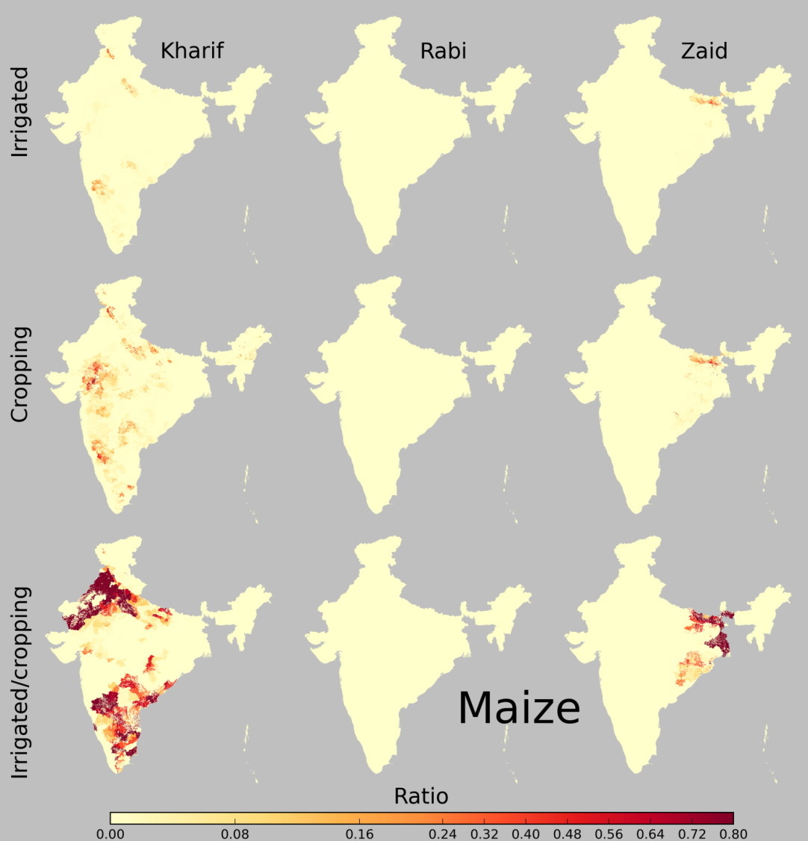
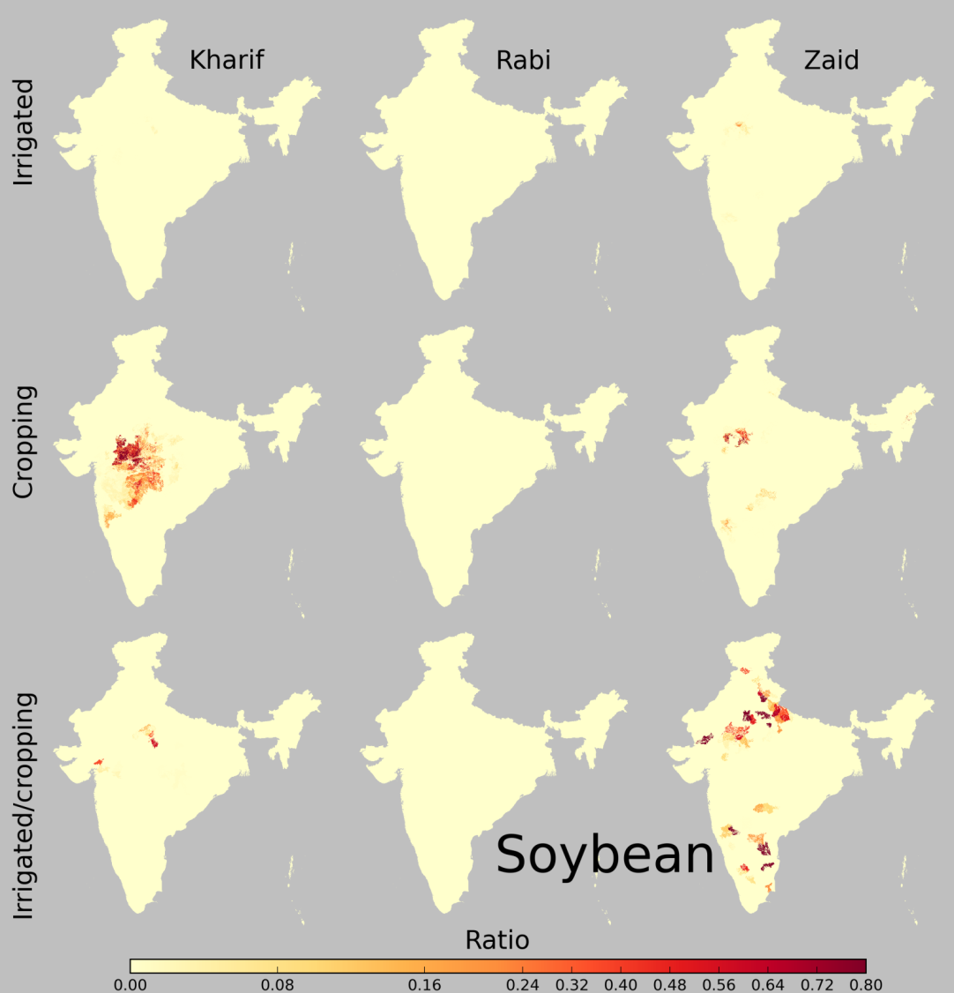
Results
Motivation
Methodology
Results
Discussion
20

Slide 21
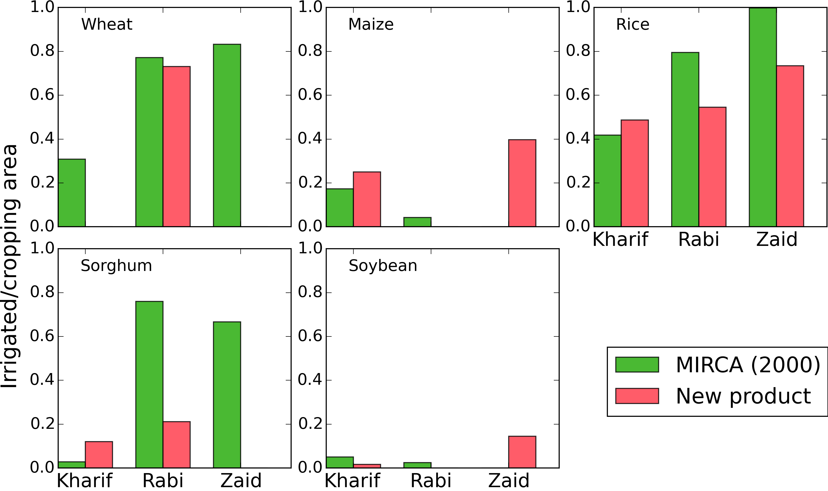
Discussion – Comparison to MIRCA2000
Motivation
Methodology
Results
Discussion
21

Slide 22
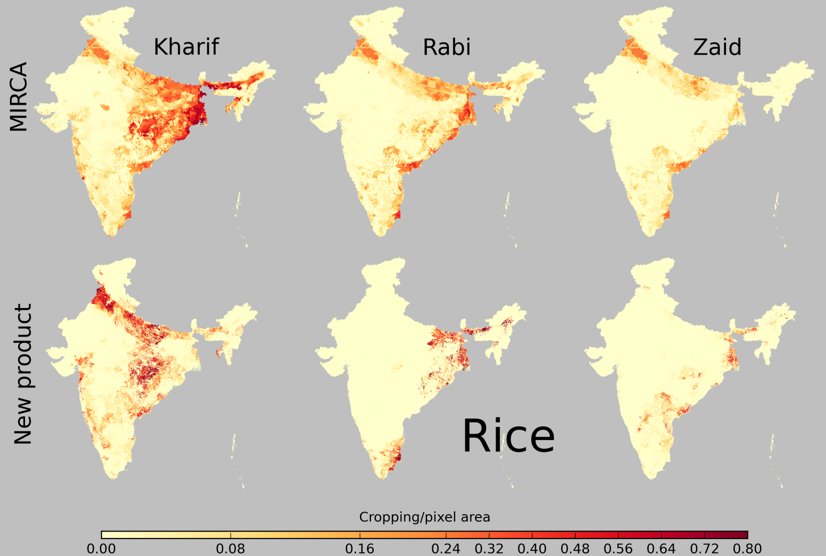
Rice – cropping area – Comparison to MIRCA2000
Motivation
Methodology
Results
Discussion
22

Slide 23
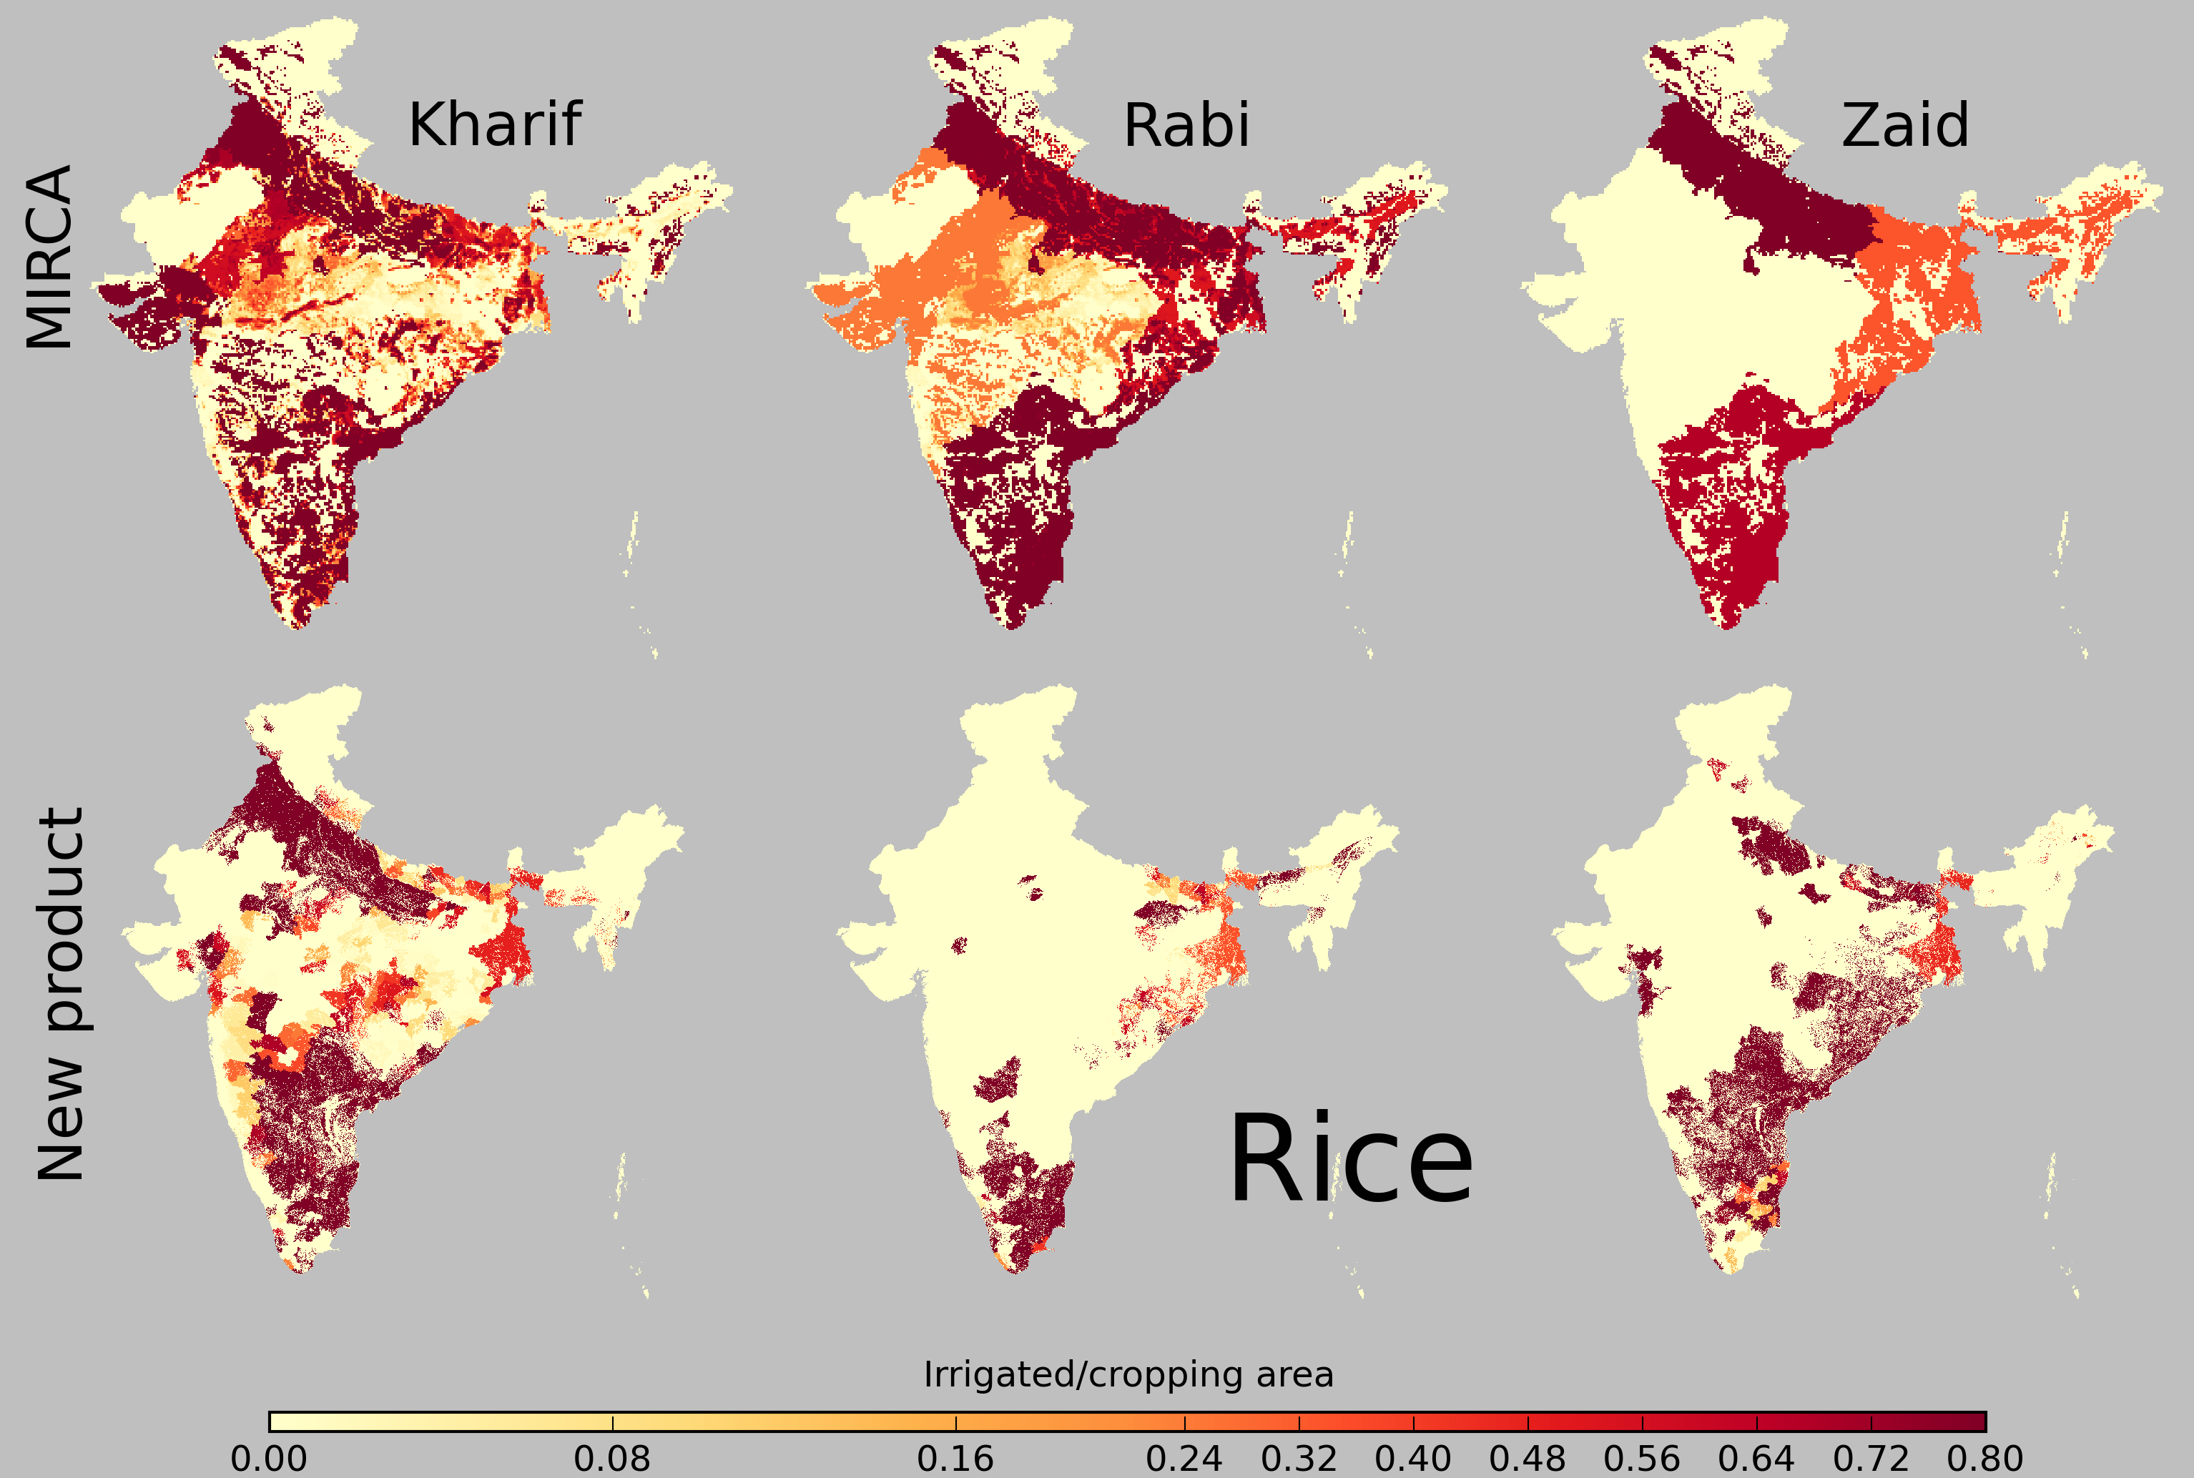
Rice – irrigated fraction – Comparison to MIRCA2000
Motivation
Methodology
Results
Discussion
23

Slide 24
Conclusions
Consideration of data for seasonal crop distribution is required
for multiple cropping regions like India
The growing period differs a lot across regions, crop type and
irrigated versus rainfed crops
Remote sensing based products offer an opportunity to
maintain the observed seasonality of active vegetation in the
map products at high resolution
Thank you !!!
Motivation
Methodology
Results
Discussion
24

Slide 25
Slides for discussion
Motivation
Methodology
Results
Discussion
XX

Slide 26
Objective of the GEOSHARE pilot study:
Develop dataset on monthly growing area of irrigated and rainfed crops in India based on fusion of national data
 | New data set | MIRCA2000
Crop growing areas | NIC (2014) seasonal, per district, irrigated + rainfed crops, 2005 | Monfreda et al. (2008) annual, district - state, 2000
Crop calendar | state level, agrometeoro-logical advisories | 4 agroclimatic zones, FAO
Cropland extent | NIC (2014), NRSC (2014) seasonal, per district, 2005 + seasonal remote sensing based data (56 m) | Ramankutty et al. (2010) annual, per district, 2000 + annual remote sensing based data (1 km)
Motivation
Methodology
Results
Discussion
XX

Slide 27
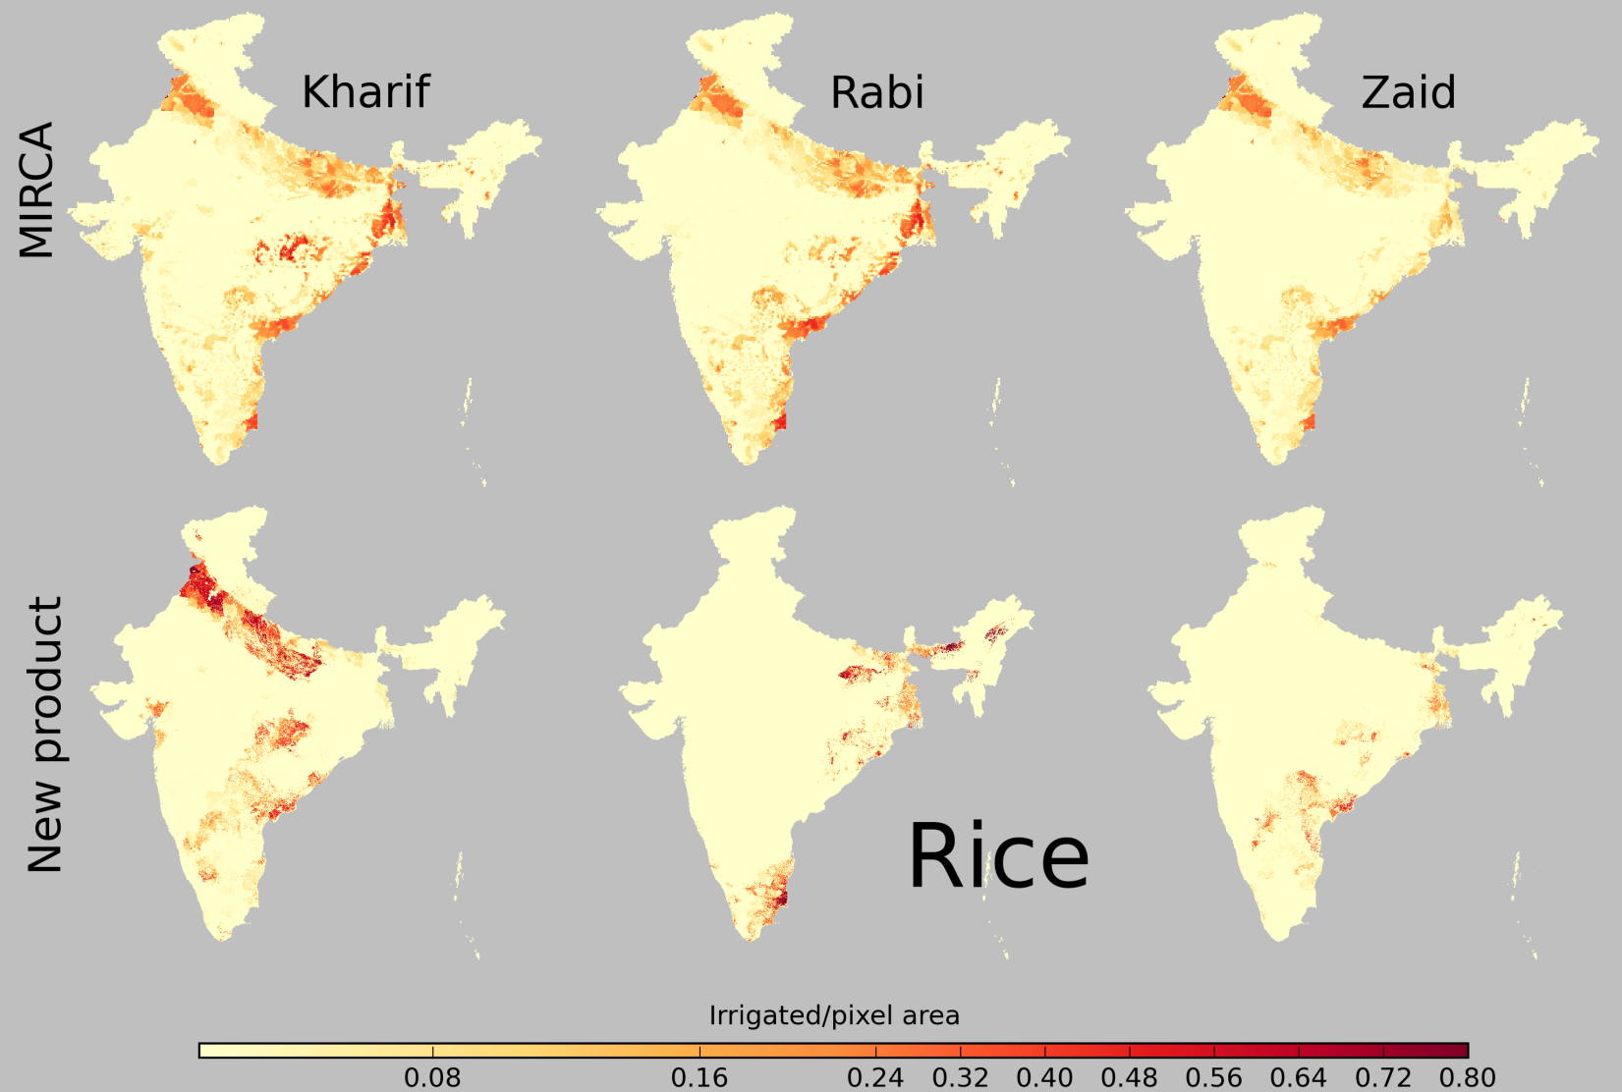
Rice – irrigated area – Comparison to MIRCA2000
Motivation
Methodology
Results
Discussion
XX

