Slide 1
Metadata and DRInet
Jake Carlson
Purdue University Libraries
November 5, 2009

Slide 2
Overview
What content will be in DRInet?
How will this content be accessed and used?
What metadata will be needed to enable access and use of data?

Slide 3
Metadata Work
Inventorying the data - identifying what's available
Indentifying the audiences and use cases – what will be done with the data by whom
Developing a structure for the organization, description and discovery of the data
Prototyping the structure
Template of interfacing with the information

Slide 4
Content types in DRInet
Data
Static
Dynamic ?
Data Derived Products
Indices
Visualizations
Tools
Output
Other - Stories / Narratives, Photographs?, Maps?

Slide 5
Data – obtained
Climate Data - Dev
Climate reference network
Airport Data
Purdue Automated Stations (Meso-nets)
Co-op networks (Daily stations)
Community Collaborative Rain, Hail & Snow Network (CoCoRahs)
IN Precipitation Data - GS
St. Joseph Watershed HIS Data - Indrajeet
Historical Time Series Data for Precipitation and Temperature Average - Dev

Slide 6
Data - potential
Medical data (Ex. Instances of asthma or Instances of heat stroke)
Federal Disaster Declarations (Difficult to find)
Remote Sensing data (held at Purdue by Larry Bale?)
Economic data
Public Health data
Insurance data
Crop data
Air Quality
Soil Moisture – (Phil Owens in Agronomy?)

Slide 7
Data Derived Products - Indices
Palmer Index
Standardized Precipitation Index (SPI)
Reclamation index
Surface Water Index
KBBI - risk of forest fire
JDI - GS
Most indexes use some combination of rainfall and temperature data as their basic information

Slide 8
Data Derived Products - Visualizations
What information about the data will be needed to enable visualizations?
How will DRInet users interact with visualizations? How will the visualizations be used?
What will DRInet users need to know in order to understand and make use of visualizations?
Will DRInet users be able to download a visualization?

Slide 9
Data Derived Products - Tools
What information will DRInet users need to understand and make use of the tools?
Will DRInet users be able to download the outputs?

Slide 10
Other Content Types
What information will DRInet users need to understand and make use of these content types?
What connections are needed between data and other content types?

Slide 11
DRInet Audiences
Researchers
Climatologists
Hydrologists
Agronomists, etc.
State and Local Governments
Planners
Emergency Response Personnel
Other Professionals
Farmers, Economists, Medical Personnel, etc.
General Public

Slide 12
Use Cases - potential
Identification that droughts are occurring and with what severity
Ascertain / Describe impacts of drought (including economic, medical, etc.)
Identify the extent of drought (including historical comparisons)
Identify areas vulnerable to drought

Slide 13
Assumptions about Metadata
Functions of Metadata in DRInet:
Discovery
Description
Relationships
Dissemination
Less is More
Use existing standards whenever possible, but recognize the need for flexibility to address local needs

Slide 14
Assumed Functionality
Discovery - searching and browsing
Access points: search box, browse list, map interface, others?
Description – providing enough information about the content that DRInet users can understand what it is and how it could be used.
Relationships – identifying how a data set or other content fits into DRInet as a whole.
Dissemination – allowing DRInet metadata to be harvested and displayed in union catalogs

Slide 15
Metadata Issues
Data are coming from multiple sources:
“In-house” – Water Quality Data (Indrajeet), Precipitation & Stream Flow (GS)
“Close Connection” – Climate Data from iClimate (Dev)
“Far Connection” – Colleagues who donate data to DRInet
“No Connection” – Data taken from the Internet / Gov Sources
Data may have metadata already attached to it.
Need to capture as much “native” metadata as possible.
The nature, amount and quality of the metadata will differ between (and may be even within) data sets.

Slide 16
Metadata Issues
We cannot fill in the gaps ourselves
If metadata / information about the data is missing we cannot expend too much time / effort to track it down. (We should however provide contact information to the data steward in the metadata when possible)
The need to achieve a balance between:
metadata usable by experts and lay people
the depth of the metadata vs. the resources and effort needed to produce it
the use of standards vs. local needs

Slide 17
Key Elements
Unique Identifier
Dates
Location / Coverage
Information about Methodology / Documentation
Method used to collect information
Notes / Deviations / Errors
Variables
Keywords – Controlled and/or User Driven?
Contact Information

Slide 18
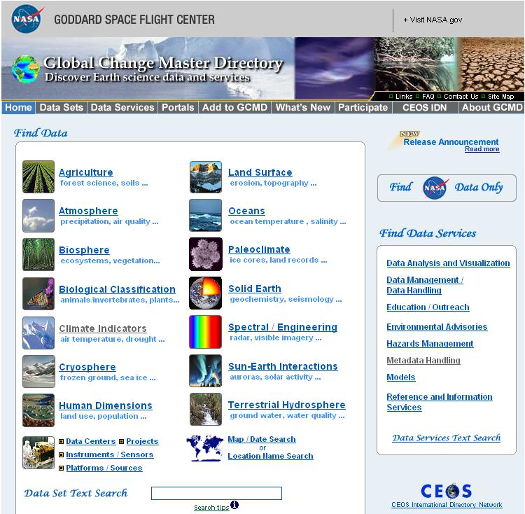
Possible Model for DRInet?
http://gcmd.gsfc.nasa.gov/

Slide 19
Directory Interchange Format
Required Elements:
Entry ID
Entry Title
Parameters (Science Keywords)
ISO Topic Category
Data Center
Summary
Metadata_Name
Metadata_Version

Slide 20
Directory Interchange Format
Highly Recommended Elements:
Data Set Citation
Personnel
Instrument
Platform
Temporal Coverage
Paleo-Temporal Coverage
Spatial Coverage
Location
Data Resolution
Project
Quality
Access Constraints
Use Constraints
Distribution
Data Set Language
Data Set Progress
Related URL
DIF Revision History

Slide 21
Directory Interchange Format
Recommended Elements:
Keyword (Ancillary Keyword)
Originating Center
Multimedia Sample
References (Publications)
Parent DIF
IDN Node
DIF Creation Date
Last DIF Revision Date
Future DIF Review Date
Privacy Status

Slide 22
Questions for future discussion
Will others be allowed to submit data / content to DRInet? If so what will the submission process entail?
What rights will we need to have over the data and how will we secure these rights?
What will people be allowed to do with the data? Do we need to have a “terms of use” document?

Slide 23
Questions for future discussion
Who will update and maintain the data and metadata? When and how will these updates occur?
How could / should content in DRInet be archived and preserved?

Slide 24
Thank you!
Jake Carlson
Purdue University Libraries

