Slide 1
MultiSpec: A Desktop & Online Geospatial Image Data Processing Tool
2017 AGU Fall Meeting
December 13, 2017
Larry L. Biehl, Wei-Kang Hsu, Abdur Rahman M. Maud, Tsung Tai Yeh
Rosen Center for Advanced Computing
Purdue University

Slide 2
MultiSpec: What is it?
Freeware for interactively analyzing RS image data:
Multispectral/hyperspectral geospatial image data from satellite and aircraft sensors
Landsat 8 (10 multispectral bands)
AVIRIS (>200 multispectral bands)
Biomedical images
Can read many image formats (tiff, hdf5, hdf4, netcdf, jpeg2000, lan, jpeg, …)
Available as:
MacOS and Windows OS desktop application (first available in early ’90s)
Online ‘tool’ within a web browser (mygeohub.org/resources/multispec)

Slide 3
MultiSpec Purpose
Technology Transfer: provide ability for other researchers to try new techniques without having to program the algorithms
Teaching: Students use in remote sensing courses
Research: Students use in research
Not meant to replace capabilities of commercially available remote sensing packages
Freeware solution for students to easily use on their own computers to augment commercial packages and to provide basics of handling RS data

Slide 4
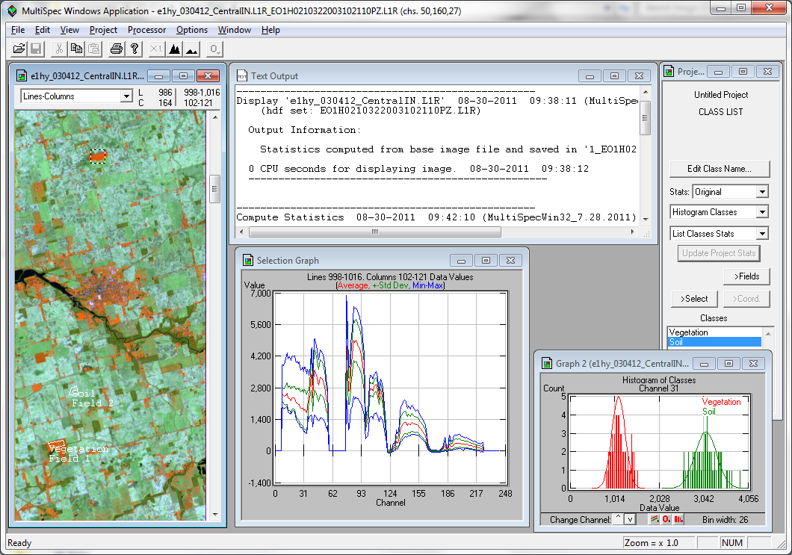
Sample MultiSpec Window (Windows Version)
Application Menu
Output
Window
Coordinate
View
Project
Window
Image
Window
Histogram Plot
Graph Window

Slide 5
Some MultiSpec Analysis Features
Import Data: BIL, BSQ, BIP band interleave formats; 8-, 16- & 32-bit signed/unsigned integer, 32- & 64-bit real data types; shape files as overlays
Histogram & Display Images
Cluster: Single Pass or ISODATA algorithms [unsupervised]
Define Classes: Rectangular, Polygonal, Clusters, Mask [supervised]
Feature Definition: Subsets, or Optimal Subspaces
Statistics Enhancement: Via Labeled & Unlabeled; LOOC (leave one out covariance)
Classification:
Spectral [Quadratic Likelihood, Mahalanobis, Fisher Linear Discriminant, Minimum Distance, Correlation, Matched Filter, Parallel Piped]
Spectral-Spatial [ECHO]
Results Display: Thematic Image & Tabular
Utility Functions: Graph Spectra, Scatter Diagrams, Principal Components, Ratios, Add/Multiply Bands, Mosaic, Change Geometry, Visualization aids)

Slide 6
MultiSpec: Display, Cluster, PC, Reformat

Slide 7
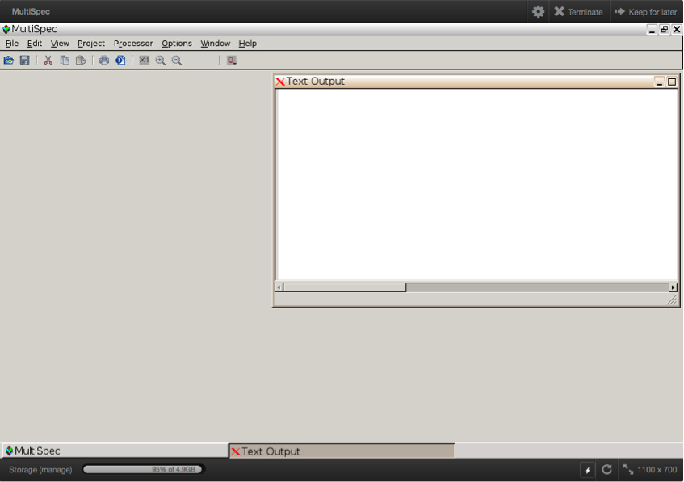
Open MultiSpec Online
mygeohub.org/resources/multispec
Several tutorials available
will need to log in when Launch Tool selected
all text output goes in Text Output window
File, Edit, View, Project, Processor Options, Window menu bar controls the processing of the image

Slide 8
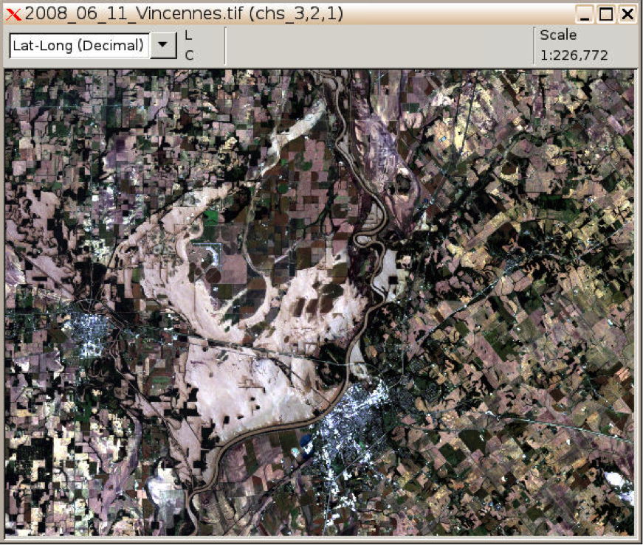
Display and Inspect Image
- Use File->Open Image
- Select image file
total_camp/2008_06_11Vincennes.tif
- Set Display Specifications (dialog)
channels 3, 2, 1 as red, green, blue
select OK
- Image like the right will be displayed
- Use +/- magnifiers to zoom in/out
(in tool bar)

Slide 9
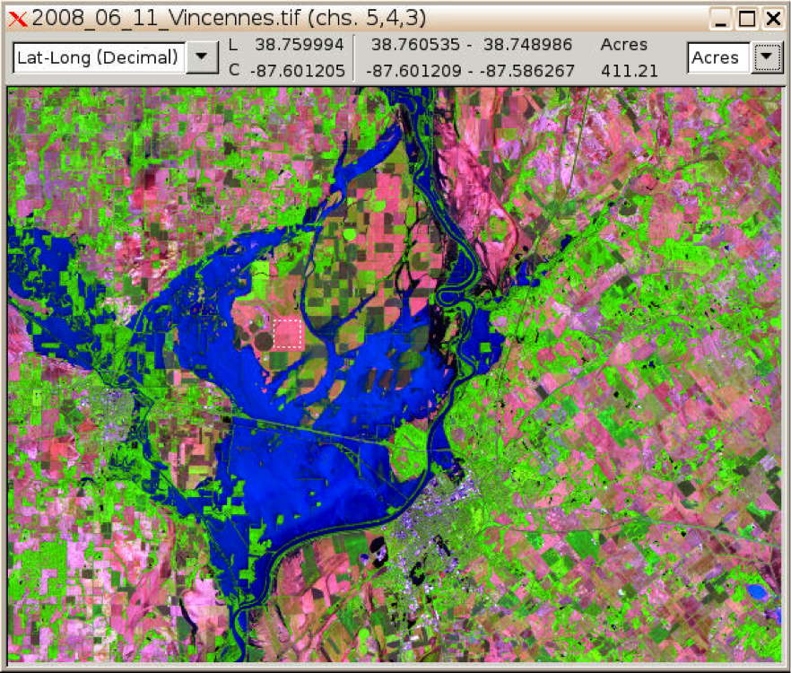
Display different channel combination
Landsat 5 channels 5, 4, 3 displayed as red, green, blue
middle infrared, near infrared, red wavelength bands
Water (flooded area) in the scene is readily visible as dark blue
Note latitude/longitude of cursor location & selected area in coordinate bar
Also area of selection (in acres)

Slide 10
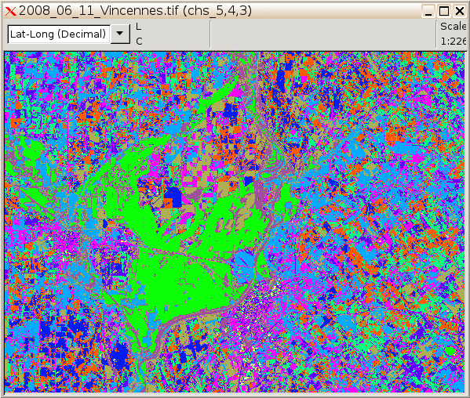
Unsupervised Classification (cluster)
Select Processor->Cluster
Select ISODATA (use defaults)
- select OK
Select Cluster mask file
Select Image window overlay
- select OK
Overlay will be generated in iterative fashion on top of image
- Data in 7 channels in image are grouped into 10 different classes represented by 10 difference colors

Slide 11
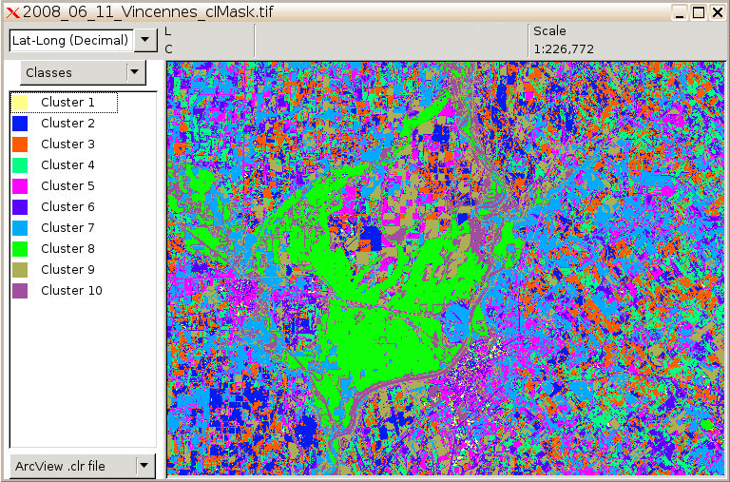
Display cluster mask file
File->Open Image
Select ‘Recently Used’ then 2008_06_11_Vincennes_clMask.tif
Use defaults for Thematic Display specifications
Can double click on the class name in legend to change name
Can double click on the color chip in legend to change color
Blink the colors in image by selecting class in legend & press/release shift key
Hold ctl key down & press/release shift key for ‘reverse blinking’

Slide 12
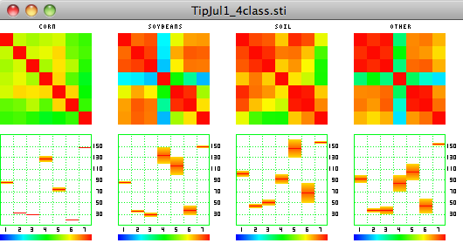
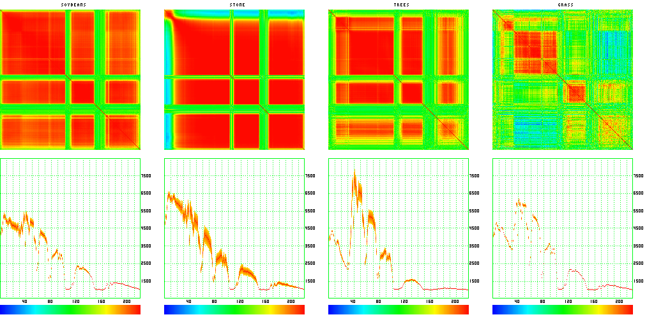
Statistics Image Processor
From Landsat 5 image
From AVIRIS Hyperspectral Image

Slide 13
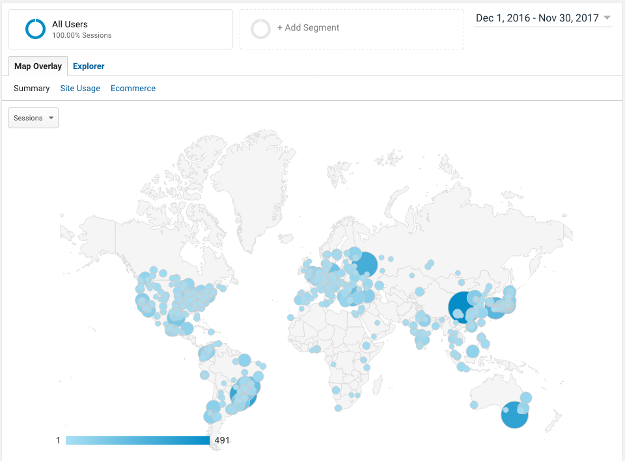
MultiSpec Users / Testimonials
11K downloads during last 12 months
Xiuping Jia: I have been using MultiSpec for teaching for many years. Now I like to download current version. Thanks a lot for providing the software. Very helpful. (8/7/2016)
Konstantinos Papatheodorou: MultiSpec has proven to be a valuable tool for me and my students, both in teaching and in research activities. Thank you so much for it. (10/6/2016)
Russell McKane: … Thanks for providing such a fantastic tool for practically teaching kids about the EMS with real outcomes. (3/3/2017)

Slide 14
MultiSpec Documentation & Tutorials
General (intro to advanced)
Reference Manual: 193 page pdf file
Tutorials: engineering.purdue.edu/~biehl/MultiSpec/tutorials.html (accessed 3,000 times past year)
K-12 level exercises
View imagery, unsupervised & supervised classification, land cover change (AmericaView minigrant)
americaview.org/program-areas/education/land-cover-lessons/
Flood analysis
americaview.org/program-areas/education/land-cover-lessons/
eros.usgs.gov/educational-activities
Urban growth
eros.usgs.gov/educational-activities
Land cover classification
www.globe.gov/do-globe/globe-teachers-guide/biosphere
Greek & Hungarian versions of tutorials provided by users

Slide 15
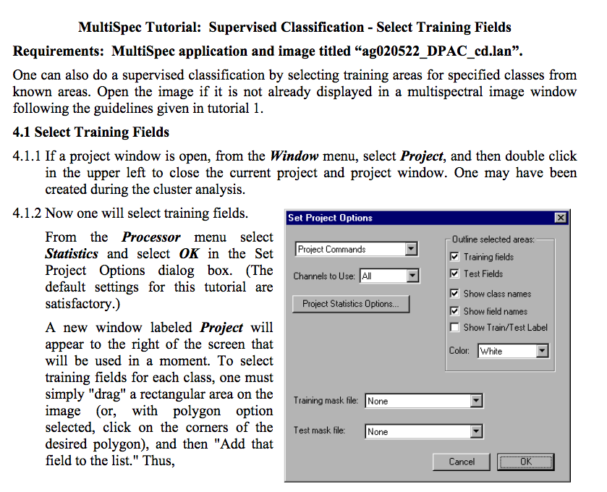
MultiSpec Tutorials
Display & Inspection
Image Enhancement
Unsupervised classification
Supervised classification
Combine separate image files
Overlay shape files
Select areas & Coordinate view
Create Vegetation Indices Images
Handling HDF & netCDF files
Visualize Growing Degree Day Images (other image file type)

Slide 16
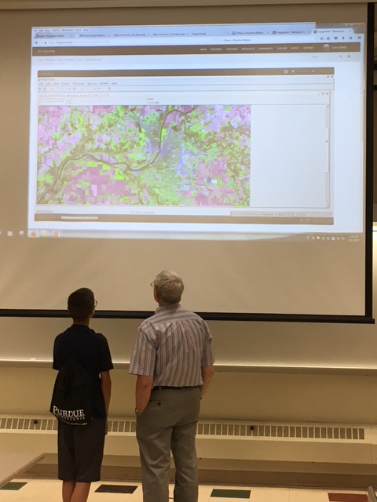
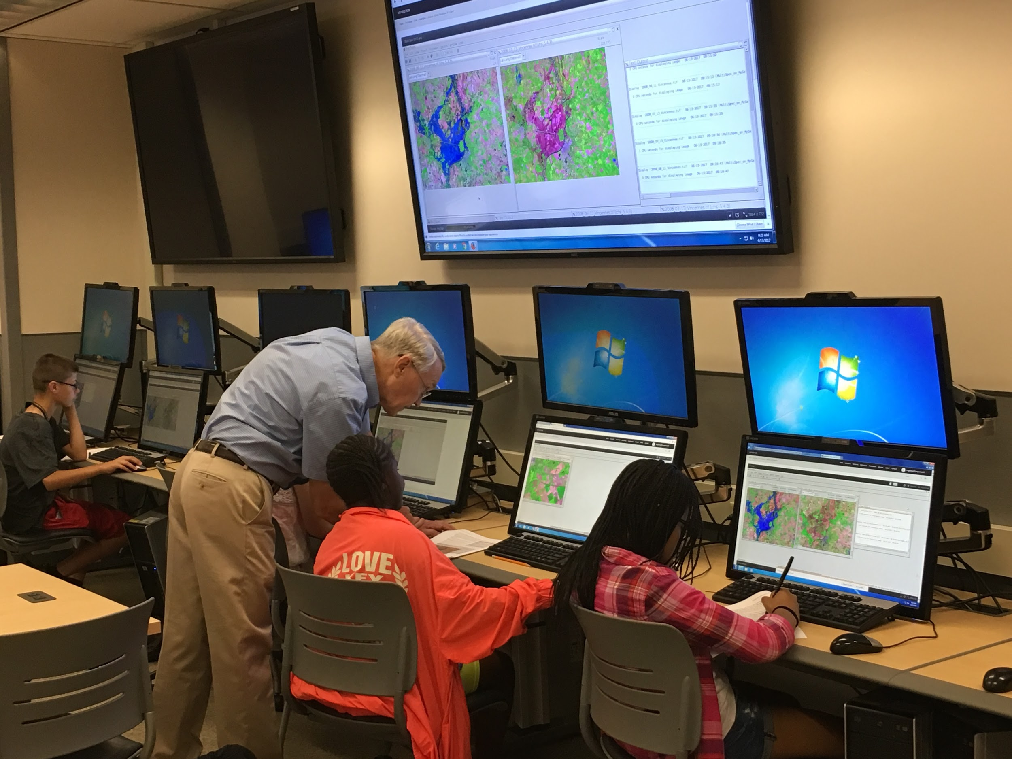
MultiSpec: How it has been used
Middle & high school students at summer (TOTAL) camp at Purdue during 2016 & 2017 in active learning session.

Slide 17
Questions
Animation created from geotiff image file with 365 channels representing accumulated corn growing degree days for each day of the year
Award
ACI-1261727

