Slide 1
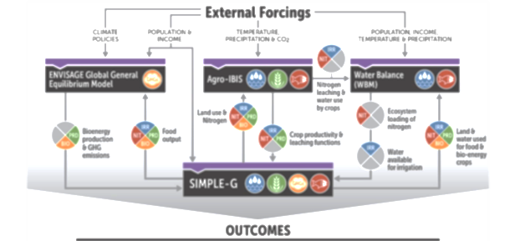
Global–Local–Global Water Quality solutions towards reducing Gulf hypoxia
Synergistic response of nitrogen removal by rivers following field-margin management
    Shan Zuidema, Wil Wollheim, Richard Lammers (UNH)
    Chris Kucharik (UW-Madison)
1)
      Using coupled models to evaluate trade-offs and synergies of multiple interventions to reduce nutrient export by 45%-60% and mitigate bottom-level hypoxia.
2)
Notes:
Start by looking at two efforts that are focused on understanding solutions for reducing GOM hypoxia to the Task Force’s goals. First uses a brand new coupling between AgroIBIS and WBM to look at synergies that exist within the natural system that may simplify the HTF tasks. Second looks at the economic tradeoffs inherent with several key interventions using an established coupling between AgroIBIS and SIMPLE-G. Here we focus on a small subset of the dozens of interventions identified as necessary to meet the HTF goals. Our longer-term goal is to build off this work to couple at minimum the three models to better understand the consequences of an optimized system when meeting the HTF goals.

Slide 2
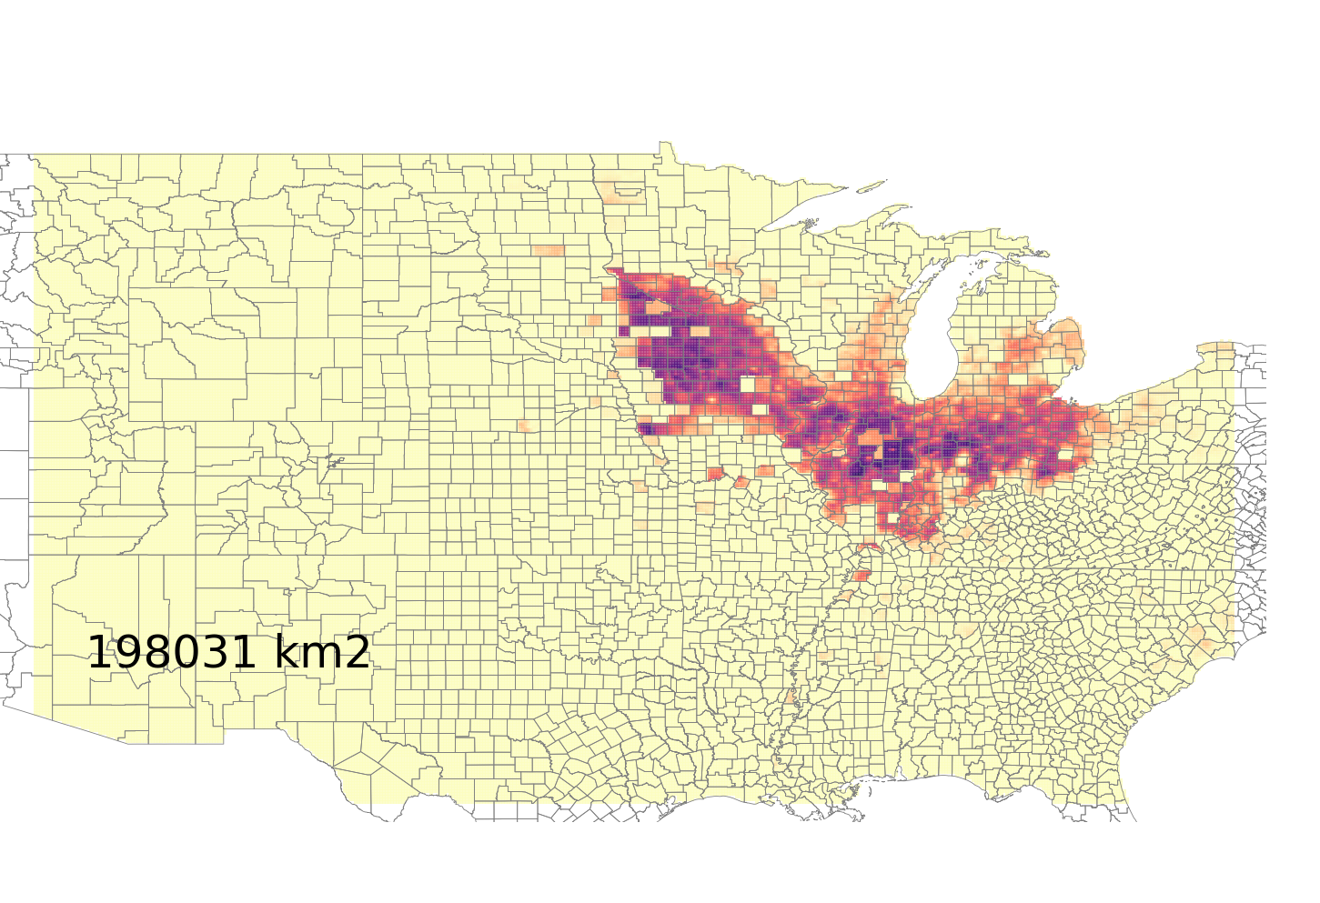
How does converting drained cropland to restored wetlands affect riverine denitrification and export?
Drained rotated maize soy
Wetland restoration considered a key intervention, with high capacity ^{[1]}.
Often included in multi-lever efforts ^{[2,3,4]}
We use dynamic, process-based models.
Assumptions:
1) Only convert rainfed, tile-drained, maize/soy
2) Wetlands treat all upland runoff up to an area 22 times greater than their area^{[2,3]}
3) Wetlands act as natural wetlands
Convert 0.2% to 50%
(small fraction of potential)
[1] Horvath et al. (2017), [2] Christianson et al. (2013) [3] Marshall et al. 2018 [4] Liu et al. (2018)
Notes:
In this first effort, we’re looking at a single intervention, namely the restoration of a small fraction of cropland (selecting rainfed, tile-drained maize and soy under rotation) to wetlands. This intervention gets a lot of attention, may have many synergistic benefits (i.e. habitat restoration, aesthetics), and maximizes the natural ability of the landscape to process excess anthropogenic nitrogen. For these reasons, wetland restoration has been included in many efforts. Our immediate science question is however about how the river is affected by removing nitrogen in the landscape: denitrification in the rivers is the most effective when at low concentrations, and at lower flows, so restoring wetlands is expected to increase the efficiency of the rivers. However, since the loading itself declines, the absolute amount of removal declines, and it is unclear whether we should expect the role of rivers it increase or decrease in mitigating export. We could have picked any intervention. Because we are implementing a single intervention, even if at a physically plausible, but economically and politically un-realistic magnitude, we do NOT expect to meet the HTF goals. Instead – we have an immediate science question, and a new model coupling to test.

Slide 3
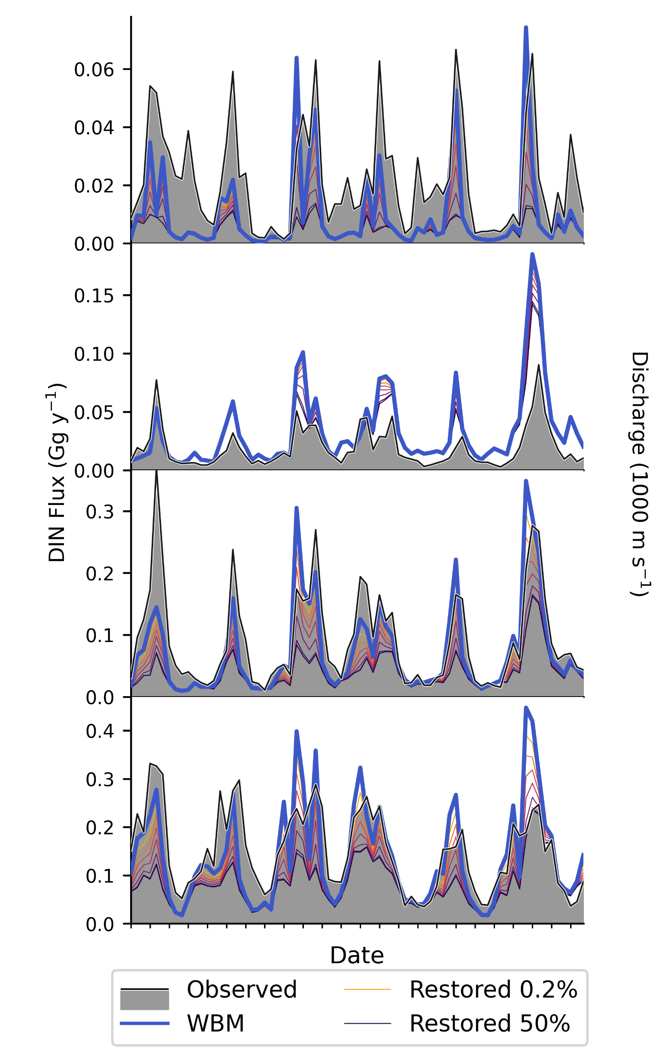
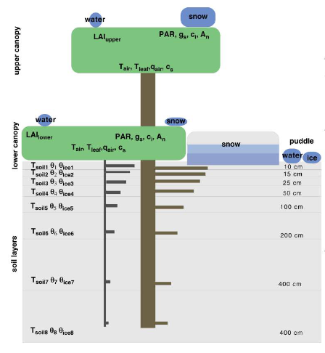
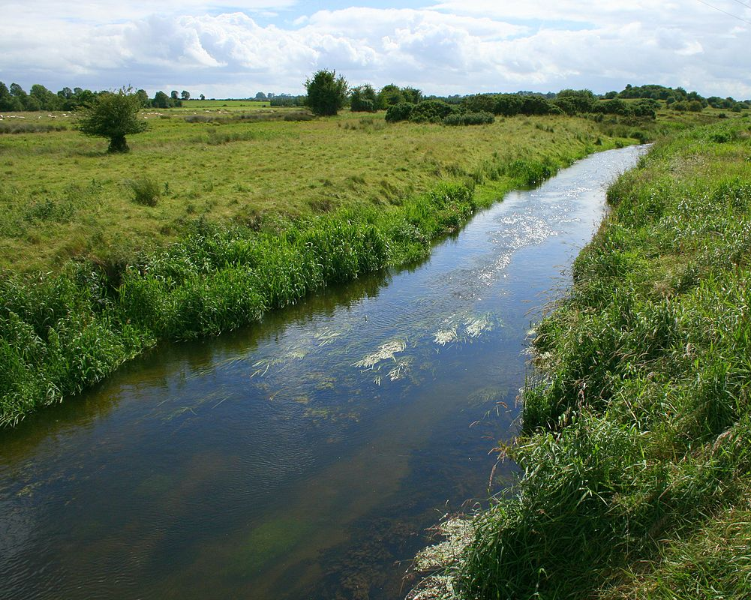
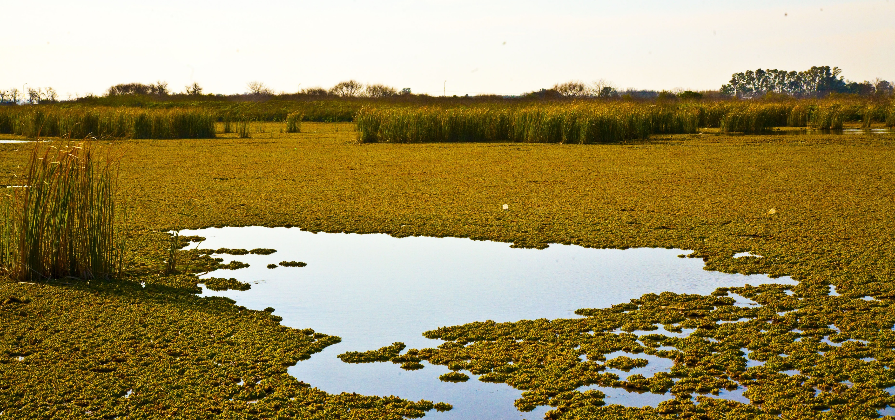
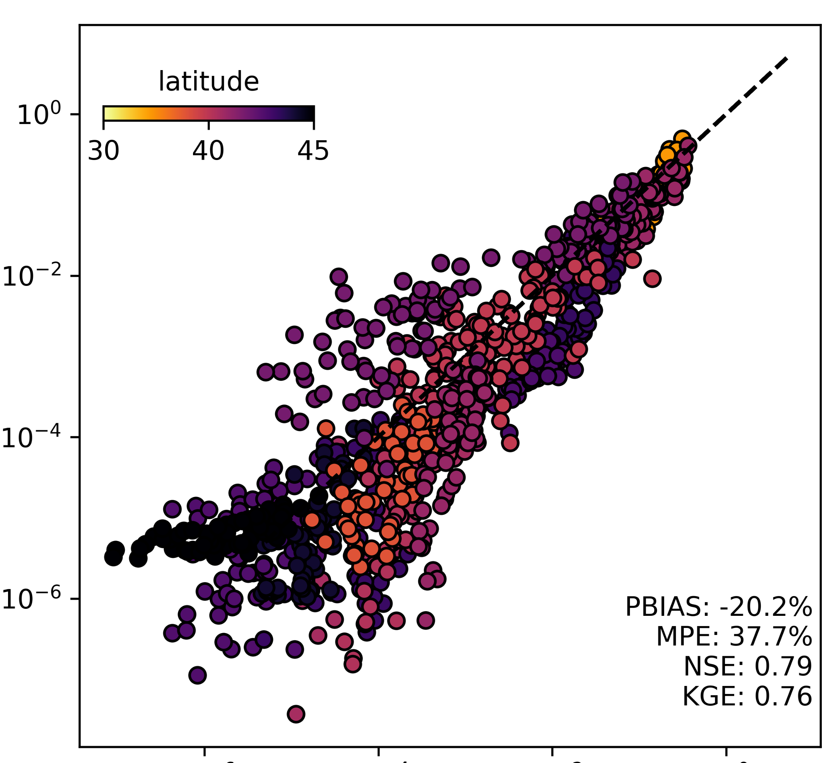
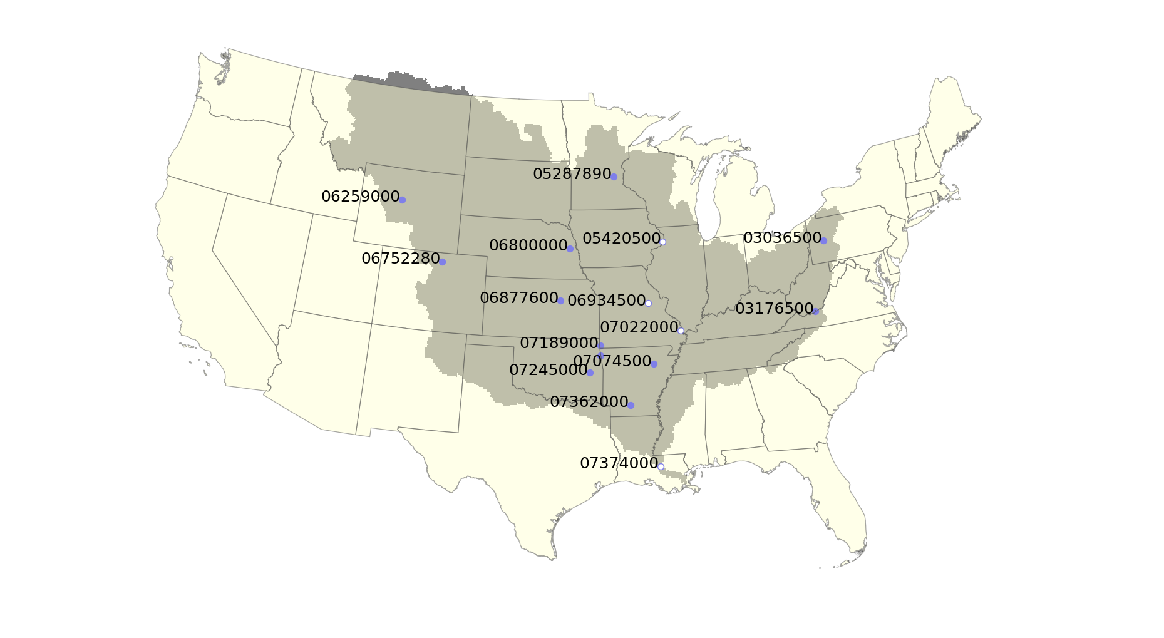

AgroIBIS provides loading, WBM wetland and in-stream denitrification
a)
b)
Kucharik et al. (2003), Wollheim et al. 2008. 2014
WBM
Agro-IBIS
Snowpack
ET
c)
N Leachate
Tile Drain
SW Pool
WETLANDS
Surface
Shallow
Groundwater
Detention Pool
Recharge
Baseflow
River
d)
5-minute
WWTP (wastewater treatment)
This Photo by Unknown Author is licensed under CC BY-SA
DIN Flux
Compared to LOADEST at 16 stations
mod
obs
AgroIBIS-WBM
Notes:
Even recent efforts such as that in Marshall et al 2018, assume a constant rate of nitrogen retention. Its not that simple as some dynamics, like runoff during the cold season, limits the capacity of these systems to process nitrogen. We have implemented a fully dynamic representation of wetland uptake in the landscape in WBM that operates at a daily time-scale. AgroIBIS is a cutting edge agroecosystem model that provides daily estimates of nitrogen leaching from soil, which WBM ingests, processes through the riparian fringe (including wetlands), and routes downstream. Currently, with minimal calibration, we exhibit a strong correspondence (NSE and KGE greater than 0.7) with observed nitrogen fluxes across the basin. Currently, the model slightly underpredicts flux at 16 stations across the basin, and slightly underpredicts basin export. Rectifying these biases may be important for better optimizing solutions; however, are not considered problematic for understanding the effect that interventions would have on in-stream denitrification.

Slide 4
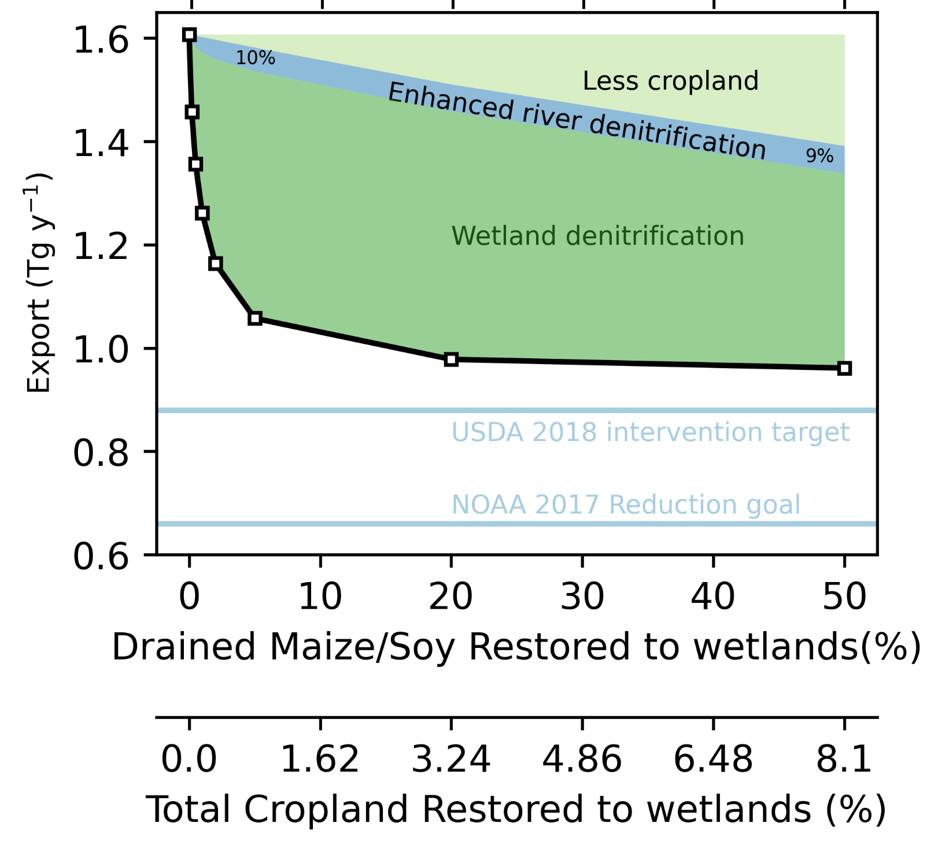
Wetland restoration is most efficient at low rates of conversion
Source-limited as landscape shifts from ag to wetland
Peak enhanced riverine denitrification
Restoration alone did not reduce export to target goals.
Multiple levers are as necessary: 4Rs, channel restoration
Wetlands are efficient at USDA’s conversion rate
Enhanced removal from the river network (neglected in previous studies), accounted for about 10% of the total reduction in export.
Will synergistic riverine removal increase as interventions are layered? Or will the benefit be asymptotic?
How do treatment wetlands fit into multi-lever analyses …
USDA
USDA Marshall et al. 2018, EPA Horvath et al. (2017), NOAA Scavia et al. 2017
Notes:
Remaining issue is that the USDA report suggests that about 3.5 times the land taking out of production needs to be kept as a buffer to the wetland. So the actual wetland area that I’m simulating may be 4 times too high.

Slide 5
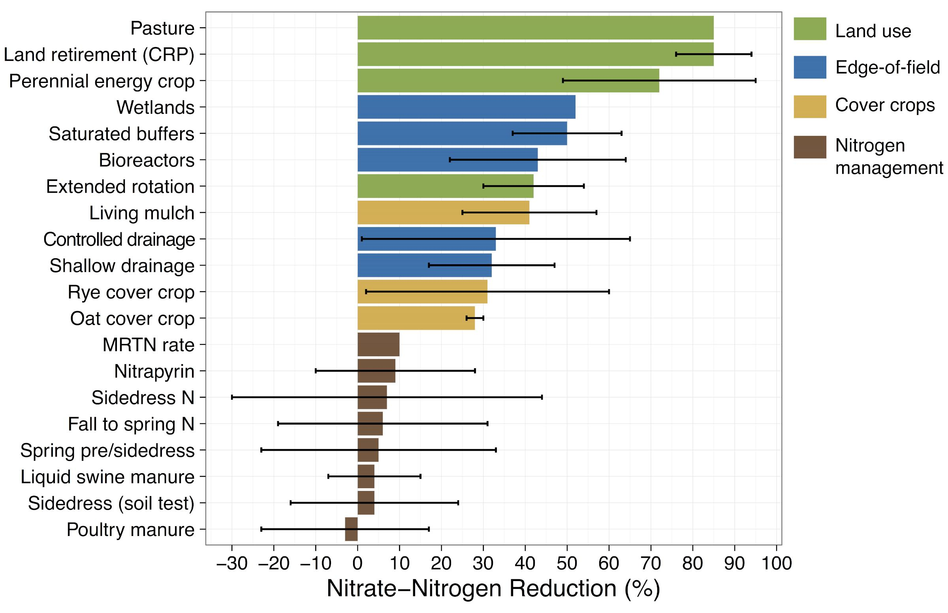
Using Multi-scale Analysis to Inform Nutrient Pollution Management
Jing Liu¹, Thomas Hertel¹, Laura Bowling¹, Sadia Jame¹, Christopher Kucharik², Uris Baldos¹ and Navin Ramankutty³
¹Purdue, ²UW-Madison, ³UBC
Iowa Nutrient Reduction Strategy (Dec., 2017)

Slide 6
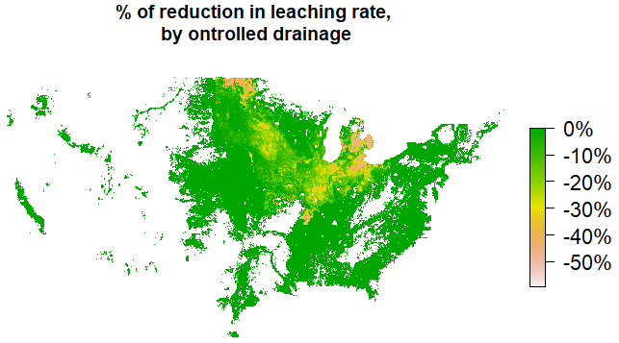
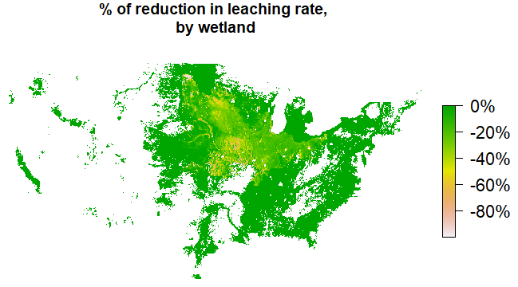
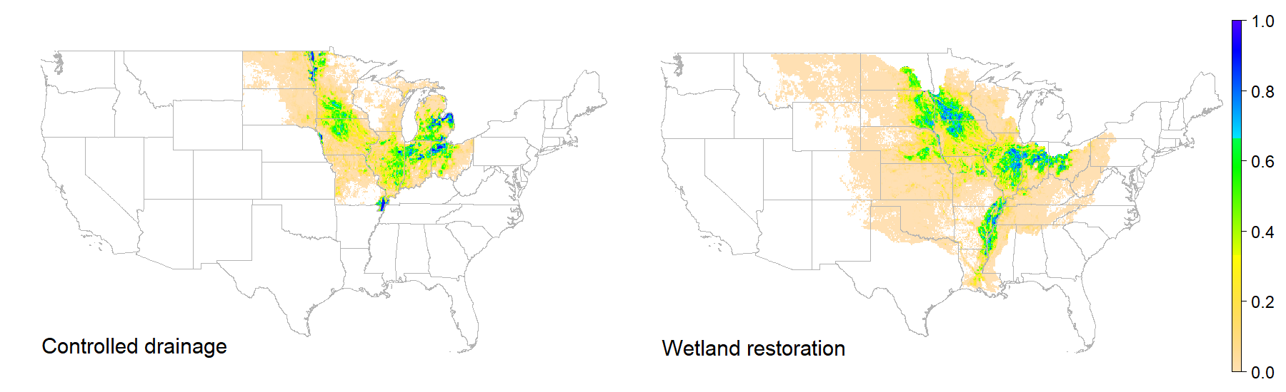
Compare different leaching reduction strategies
Policy A: $1/kg leaching charge (~100% N fertilizer tax)
Policy B: 10% increase in productivity of N fertilizer
Policy C: Controlled drainage
Policy D: Wetland restoration
Combined Policies: A+B, A+B+C, A+B+D
Interested in
Total mitigation
Spatial pattern of leaching reduction
Optimal strategy at local and state level
Targeting
Spatial spillover effect
Nitrate removal rate considers:
Feasibility of practices
Extent of treatment (e.g. restore wetland only at tile-drained area)
Tile-drained runoff
Seasonality of denitrification rates
Fraction of controlled drainage and wetland (per grid-cell)

Slide 7
Compare different leaching reduction strategies
Policy A: $1/kg leaching charge (~100% N fertilizer tax)
Policy B: 10% increase in productivity of N fertilizer
Policy C: Controlled drainage
Policy D: Wetland restoration
Combined Policies: A+B, A+B+C, A+B+D
Interested in
Total mitigation
Spatial pattern of leaching reduction
Optimal strategy at local and state level
Targeting
Spatial spillover effect
Nitrate removal rate considers:
Feasibility of practices
Drainage volume
Seasonality of denitrification rates
Fraction of controlled drainage and wetland (per grid-cell)

Slide 10
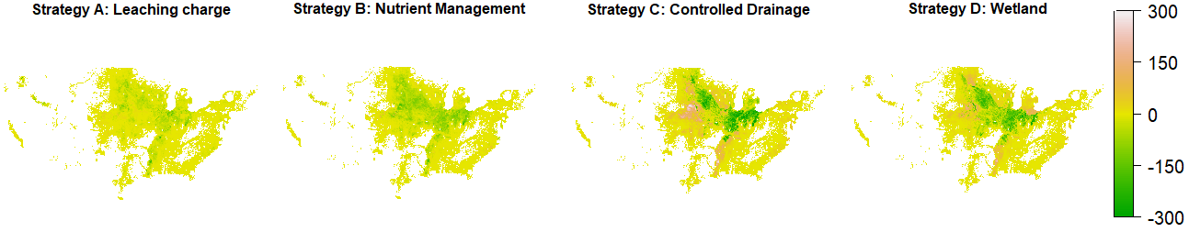
Change in N leaching (tons)

Slide 11
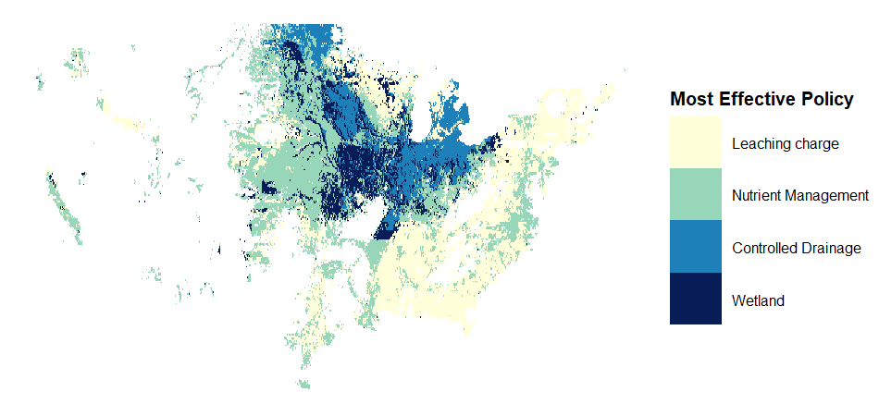
Most effective leaching reduction policy varies by location and by state

Slide 12
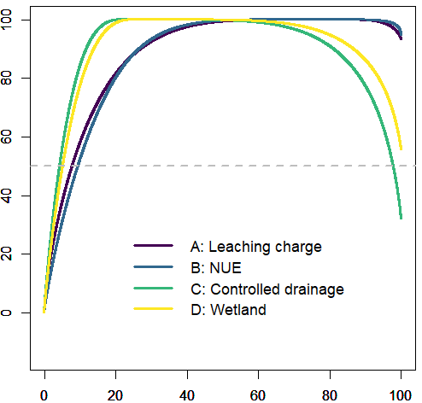
50% mitigation comes from 10% grid cells
Summary
Wetland is most the effective single practice, but none by itself is sufficient to achieve the 45% reduction goal
Most effective policy varies by location and by state
Spatial patterns of N leaching reduction differ
Leaching outcome is highly spatially concentrated
Controlled drainage and wetland have strong spatial spillovers
Other interesting leaching reduction strategies?
Leaching mitigation accumulation
Grid accumulation

Slide 13
Christianson, L., Tyndall, J., & Helmers, M. (2013). Financial comparison of seven nitrate reduction strategies for Midwestern agricultural drainage. Water Resources and Economics, 2–3, 30–56. https://doi.org/10.1016/j.wre.2013.09.001
Horvath, E. K., Christensen, J. R., Mehaffey, M. H., & Neale, A. C. (2017). Building a potential wetland restoration indicator for the contiguous United States. Ecological Indicators, 83, 462–473. https://doi.org/10.1016/j.ecolind.2017.07.026
Kucharik, C. J. (2003). Evaluation of a Process-Based Agro-Ecosystem Model (Agro-IBIS) across the U.S. Corn Belt: Simulations of the Interannual Variability in Maize Yield. Earth Interactions, 7(14), 1–33. https://doi.org/10.1175/1087-3562(2003)007<0001:EOAPAM>2.0.CO;2
Liu, J., Hertel, T. W., Bowling, L., Jame, S., Kucharik, C., & Ramankutty, N. (2018). Evaluating Alternative Options for Managing Nitrogen Losses from Corn Production. Purdue Policy Research Institute Policy Briefs, 4(1), 5.
Marshall, E. (2018). Reducing Nutrient Losses From Cropland in the Mississippi/Atchafalaya River Basin: Cost Efficiency and Regional Distribution (Economic Research Report No. ERR-258) (p. 75). Washington, D. C.: US Department of Agiculture, Economic Research Service.
Wollheim, W., Vörösmarty, C. J., Bouwman, A. F., Green, P., Harrison, J., Linder, E., et al. (2008). Global N removal by freshwater aquatic systems using a spatially distributed, within-basin approach. Global Biogeochemical Cycles, 22(2). https://doi.org/10.1029/2007GB002963
Wollheim, W., Harms, T. K., Peterson, B. J., Morkeski, K., Hopkinson, C. S., Stewart, R. J., et al. (2014). Nitrate uptake dynamics of surface transient storage in stream channels and fluvial wetlands. Biogeochemistry, 120(1–3), 239–257. https://doi.org/10.1007/s10533-014-9993-y

