Slide 1
Identifying Sustainability Solutions through Global-Local-Global Analysis of a Coupled Water-Agriculture-Bioenergy System
Thomas Hertel, PI
Purdue University
Stakeholder Advisory Board Meeting December 15, 2020

Slide 2
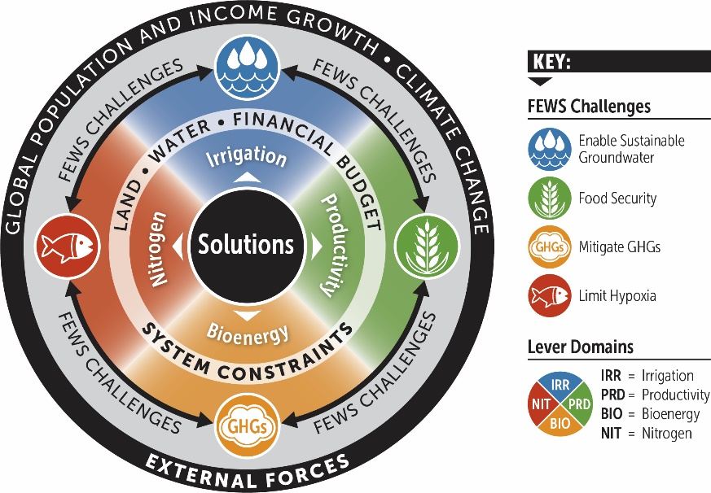
The Project Focuses on Four Interrelated Challenges
Four primary outcome domains
Water quantity
Water quality
Food production
Energy and GHG emissions

Slide 3
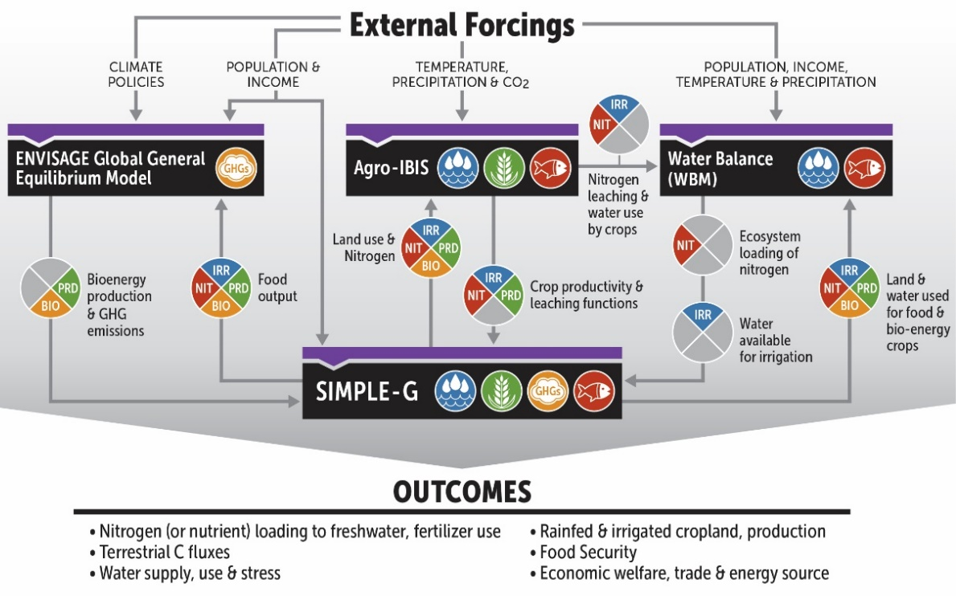
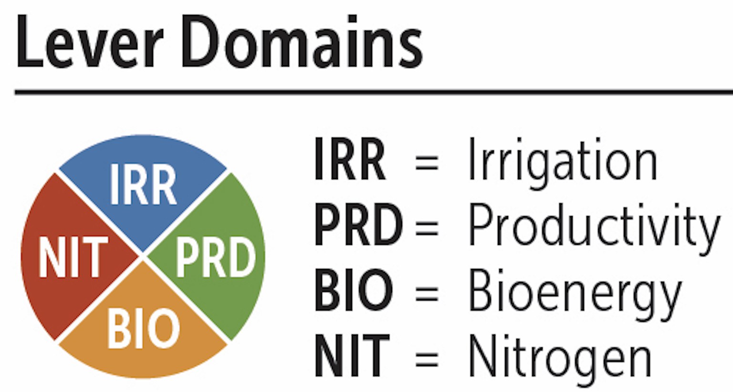
Our Analytical Framework

Slide 4
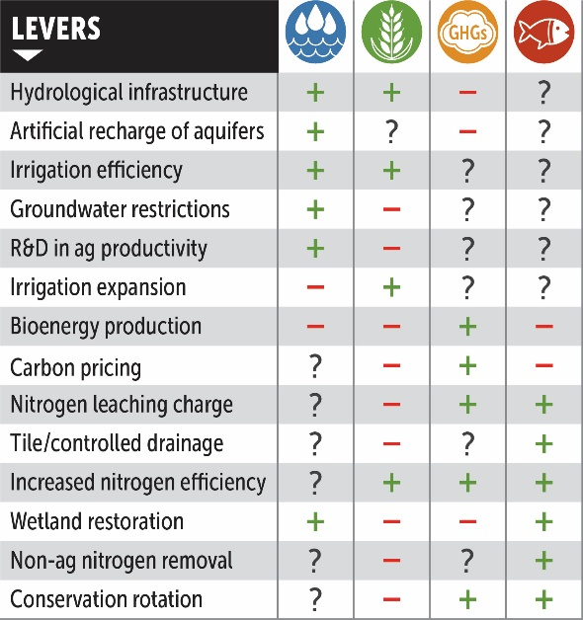
A focus on levers available to decision makers
Single lever analysis at first
Multi-lever analysis to follow

