Slide 1
GLG Analysis of Coupled Systems Impact of US Renewable Fuel Standards
Science Advisory Board Meeting December 15, 2020

Slide 2
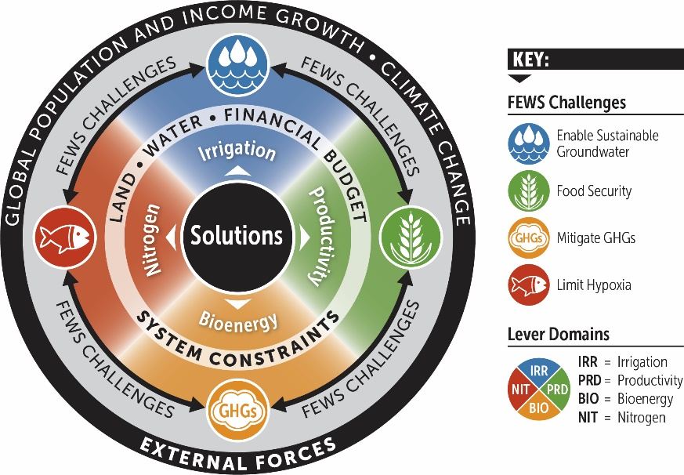
Motivation: RFS2 Targets Bioenergy at Expense of Other Outcomes
What would the impacts of relaxing RFS2 be across FEWS domains?
RFS2 mandates biobased energy production but is not optimized for emissions reductions
Hypoxia in Gulf of Mexico may not be solvable with RFS2 status quo (Donner & Kucharik, 2008)
Future population and income growth will add further stress
Can revised liquid renewable fuel mandates ease short-term stress on nutrient management and food prices?

Slide 3
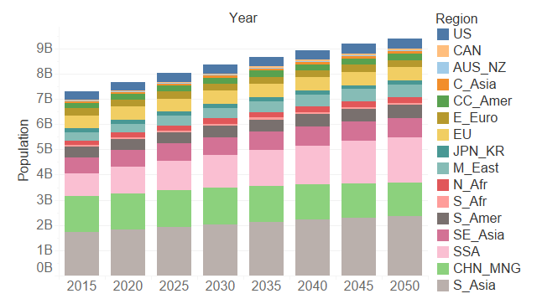
Experimental Design: SIMPLE-G-US Corn/Soy Model
Reductions in exogenous bioenergy demand from 2020 to 2050
SIMPLE-G-US-CS models RFS2 as an exogenous demand for biomass
Experimental design:
11 levels of demand, 0% (full repeal) to 100% (status quo) at 10% intervals
5-year intervals from 2020 to 2050
Regional population, income, total factor productivity follow SSP2 trajectory
Non-US bioenergy demand follows IEA World Energy Outlook projections

Slide 4
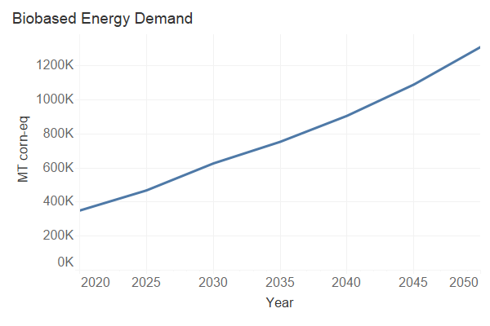
Experimental Design: Caveats
Reductions in exogenous bioenergy demand from 2020 to 2050
Demand reduction resulting from relaxation of RFS2 would not be total
Ethanol as anti-knocking agent in gasoline fuel blends
Consequently, analysis is more descriptive than predictive
Possible narrative for more aggressive demand shocks:
Rapid and high uptake of electric vehicles displacing internal combustion

Slide 5
Results: Interactive Demo
Reductions in exogenous bioenergy demand from 2020 to 2050
Demand reduction resulting from relaxation of RFS2 would not be total
Ethanol as anti-knocking agent in gasoline fuel blends
Consequently, analysis is more descriptive than predictive
Possible narrative for more aggressive demand shocks:
Rapid and high uptake of electric vehicles displacing internal combustion

Slide 6
Conclusions and Discussion
What additional analysis would increase impact?
If linked, ENVISAGE could produce estimates of GHG emissions impacts
Can we do a better job noting what demand decrease would actually result from relaxing RFS2 targets?

