Slide 1
Reimagining the US Agricultural System for Environmental Sustainability
Richard Lammers, University of New Hampshire
David Johnson, Purdue University
Stakeholder Advisory Board Meeting December 15, 2020

Slide 2
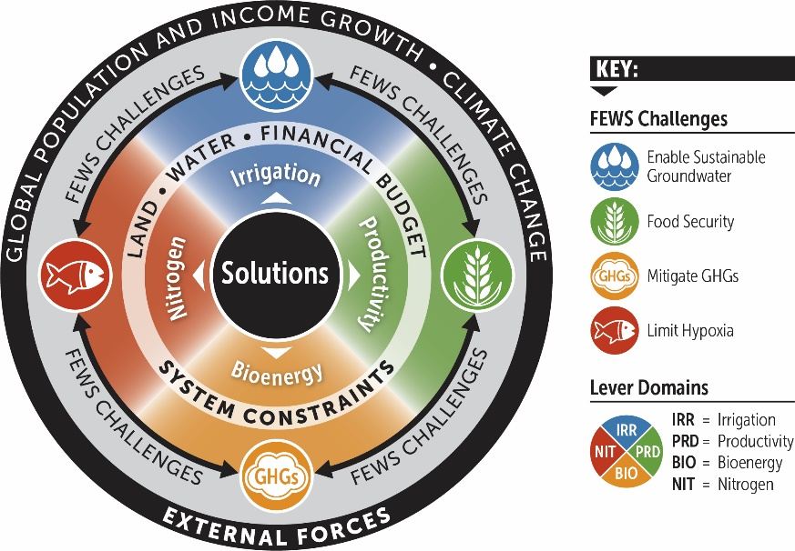
The Project Focuses on Four Interrelated Challenges
How can varied stakeholders balance solutions across domains?
Four primary outcome domains
Water quantity
Water quality
Food production
Energy and GHG emissions

Slide 3
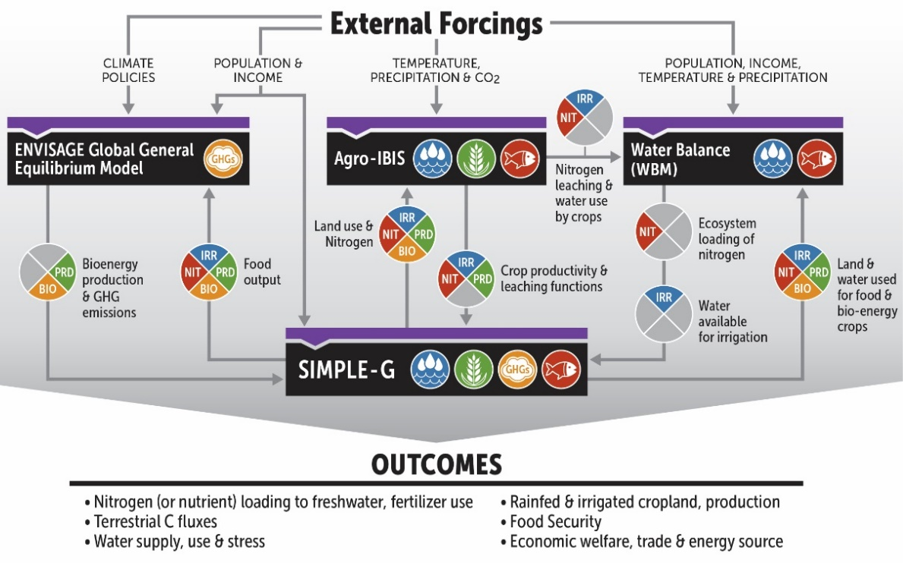
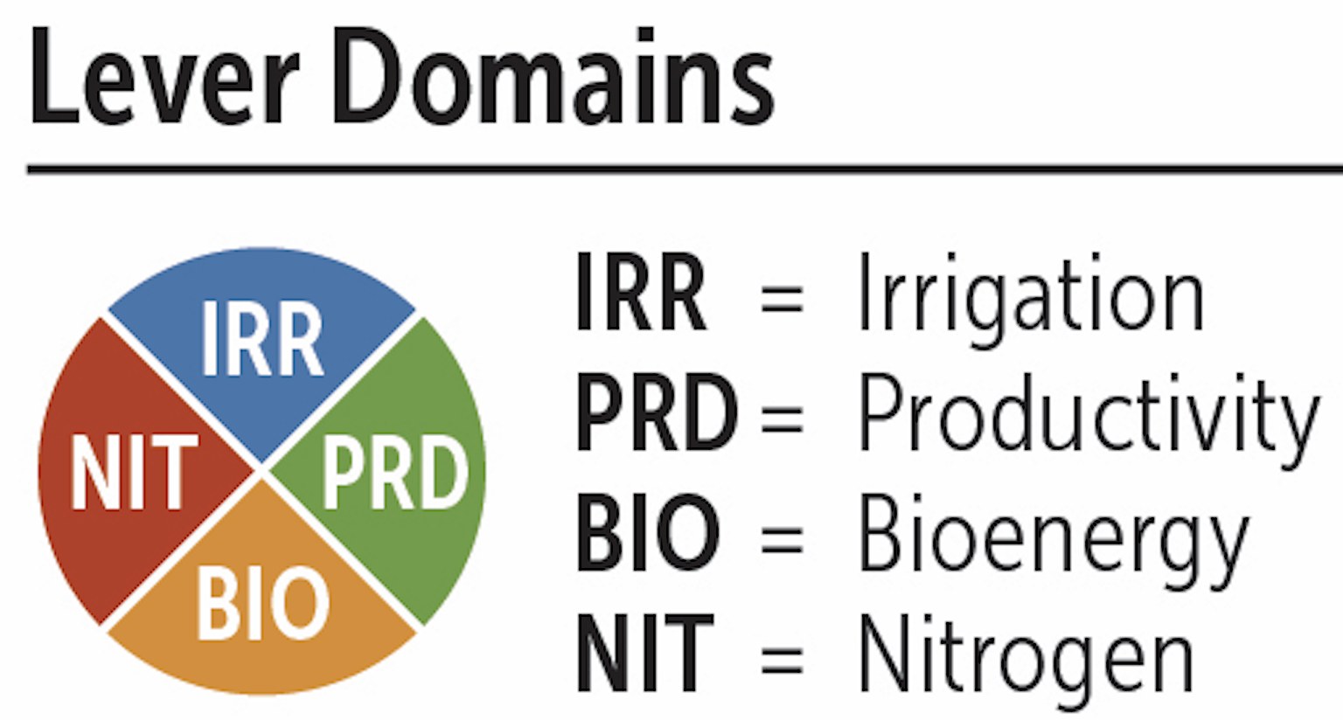
Method for Multi-lever Understanding - Model Coupling
21 “pieces of pie”
Coupled models and information passing between them
Necessary first step

Slide 4
Method for Multi-lever Understanding - Model Coupling
In-progress analyses
Most papers use only one or two of the four models
Example 1:
Nutrient Management: Nitrogen removal and field-margin management paper
One-way coupling
(Agro-IBIS to WBM)
Two lever domains
(IRR, NIT)

Slide 5
Method for Multi-lever Understanding - Model Coupling
In-progress analyses
Most papers use only one or two of the four models
Example 2:
Nutrient Management: Policy Interventions and Spillovers
One-way coupling
(Agro-IBIS to SIMPLE-G)
Two lever domains
(IRR, NIT)

Slide 6
Method for Multi-lever Understanding - Model Coupling
In-progress analyses
Most papers use only one or two of the four models
Example 3:
Water Scarcity paper
Two-way coupling
(WBM, SIMPLE-G)
Two lever domains
(IRR, PRD)

Slide 7
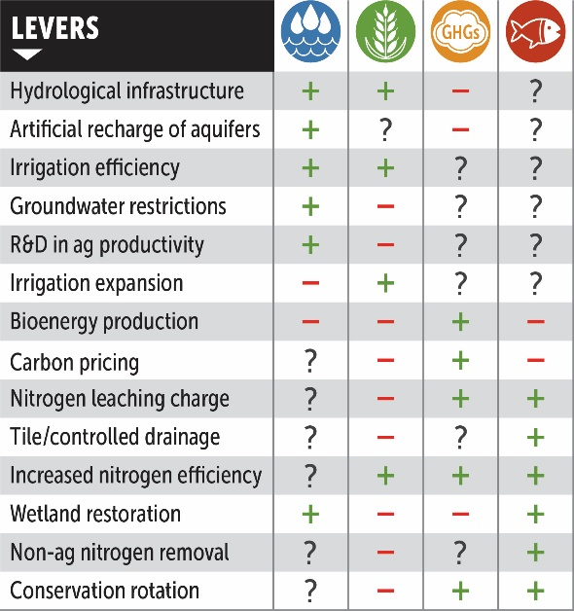
Why do we need multi-lever modeling?
Current set of six papers ( ) cover 9 of 13 policy levers

Slide 8
Why do we need multi-lever modeling?
Current set of six papers ( ) cover 9 of 13 policy levers
Deep connections between systems under study
Complex Feedbacks
Collisions or interference
Unified and
harmonized
comparisons
between
levers

Slide 9
We need to start thinking about the next steps: How effective are multiple levers across the FEWS Challenges?
Example:
Join efforts from several papers
Nutrient management: Natural Solutions (Shan)
Nutrient management: Policy Interventions and Spillovers (Jing)
Water Scarcity: Impacts and Solutions (Iman & Danielle)

Slide 10
We need to start thinking about the next steps: How effective are multiple levers across the FEWS Challenges?
Example:
Join efforts from several papers
Nutrient management: Natural Solutions (Shan)
Nutrient management: Policy Interventions and Spillovers (Jing)
Water Scarcity: Impacts and Solutions (Iman & Danielle)

Slide 11
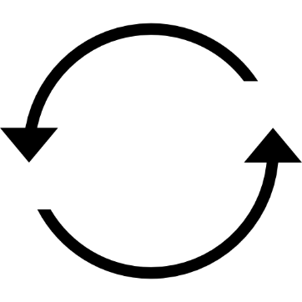
We need to start thinking about the next steps: How effective are multiple levers across the FEWS Challenges?
Example:
Join efforts from several papers
Nutrient management: Natural Solutions (Shan)
Nutrient management: Policy Interventions and Spillovers (Jing)
Water Scarcity: Impacts and Solutions (Iman & Danielle)
Model Framework
Agro-IBIS
SIMPLE-G
WBM

Slide 12
What do we need from the SAB?
Identify
Research questions to ask
Policy-relevance
How best to build on the existing sub-projects
New connections
Leveraging ENVISAGE/Climate policy
Guidance on best directions to go
Set priorities
Model Framework
ENVISAGE
Agro-IBIS
SIMPLE-G
WBM
Notes:
RFS - Renewable Fuel Standard

