Slide 1
Water Scarcity: Impacts and Solutions
Danielle Grogan & WBM Team
Iman Haqiqi & SIMPLE-g Team
December 2020

Slide 2
Goal:
To project the situation and the impacts of future groundwater scarcity on:
Local agricultural production and land use
Global food system
Water resources
Applications
Stress scenarios:
Long-lasting droughts in key agricultural production areas
Heat stress (e.g., RCP 8.5 climate change to 2050)
Global changes in income, diets, technology
Pandemic
Market-driven adaptation & policy scenarios:
Increasing irrigation efficiency
Switching between irrigated and rainfed crop production
Changing the spatial distribution of production to move away from stressed aquifers
Notes:
What to expect to see?

Slide 3
There are technical challenges in measuring the impacts and evaluating the solutions

Slide 4
Challenges for economists
Economic models have been criticized for narrow disciplinary perspective and simplified assumptions on:
water availability (environmental supply)
plants water requirements (agronomic demand)
Economic models fail to capture the critical hydrological dynamics including:
The interactions between surface water and groundwater
The impacts of upstream decisions on downstream water availability

Slide 5
Challenges for hydrologists
Hydrological models have been criticized for simplified assumptions on:
Decisions about irrigation efficiency (technology)
Decisions about irrigation and rainfed extension
Decisions about irrigation intensity (economic vs agronomic optimum)

Slide 6
Therefore, the results of disciplinary studies are biased images of the relationships between water management decisions and water resources

Slide 7
Suggested approach: Linking the best of both worlds
SIMPLE-g
is an economic model of land use and agricultural markets,
can model the social system responses to environmental changes
WBM
is a macro-scale hydrological model,
can model the water system responses to weather and agricultural changes
Solution to the problems outlined in earlier slides:
Link these models together so that neither the biophysical nor the economics are ignored!
Notes:
We suggest a fully coupled framework that
gets the decisions right and
gets the hydrology right and
gets their interaction right
Appropriate geographical scale and resolution,

Slide 8
Linking the biophysical and economic components of agricultural production
METHODS:
weather
Precipitation
Temperature
…
Irrigation extent
Water
Groundwater
Decisions
Surface water
Evapotranspiration
…
…
Irrigation extent
Rainfed extent
Irrigation technology
...
…
Environment
Groundwater supply
Surface water supply
Agronomic water demand
Irrigation efficiency
WBM
SIMPLE-g
input
output
input
output

Slide 9
I. Haqiqi, D. S. Grogan, M. Bahalou, T. W. Hertel, J. Liu, U. L. C. Baldos

Slide 10
Income 2020: % change in GDP
Some examples
-8%
-5%
+2%
-7%
-9%
-6%
-9%
Water Stress:
% change in surface water available for irrigated agriculture
Heat Stress:
% change in crop yields for rainfed agriculture

Slide 11
Agricultural trade can act as a buffer….

Slide 12
Preliminary results: pandemic + heat stress+ water stress one-way link: WBM to SIMPLE-g

Slide 13
Conclude: We have built a tool that includes feedbacks between the biophysical and the economic components of agriculture. Advantages: We can evaluate stresses and policies that target one part of the system and understand how the other side of the system will respond, leading to more realistic model predictions of the success or failure of sustainability policy.
weather
Precipitation
Temperature
…
Irrigation extent
Water
Groundwater
Decisions
Surface water
Evapotranspiration
…
…
Irrigation extent
Rainfed extent
Irrigation technology
...
…
Environment
Groundwater supply
Surface water supply
Agronomic water demand
Irrigation efficiency
WBM
SIMPLE-g
input
output
input
output

Slide 14
Applications for the fully coupled approach
Stress scenarios:
Long-lasting droughts in key agricultural production areas
Heat stress (e.g., RCP 8.5 climate change to 2050)
Global changes in income, diets, technology
Pandemic
Market-driven adaptation & policy scenarios:
Increasing irrigation efficiency
Switching between irrigated and rainfed crop production
Changing the spatial distribution of production to move away from stressed aquifers
What other scenarios would be valuable to look at using this modeling tool?

Slide 15
Thanks!

Slide 16
Other slides

Slide 17
Workplan & project design
This is where we are looking for input from you!
Method development
Translating WBM output to SIMPLE-G input
Translating SIMPLE-G output to WBM input
Develop data passing protocol via GeoHub
Status: complete!
B) Validate & evaluate both the individual model runs, and the coupled model system
WBM: Improve spatial variability in irrigation technology representation & use Shan’s best parameters for the Mississippi basin
SIMPLE-G: Validate irrigation changes
Status: ongoing
C) Use coupled system model to evaluate both:
Future changes in agricultural land use due to climate change impacts, and
Possible policy scenarios in response to expected changes
Status: planned

Slide 18
Methods to pass information
How to convert change in groundwater table from WBM to groundwater supply in SIMPLE-G?
How to convert “irrigation equipment” in SIMPLE-G to “irrigation efficiency” in WBM?

Slide 19
Income per capita
Population
Per Capita
Demand
Food Consumption
Food Security
DEMAND
Crop Demand
Food Prices
Biofuels
Domestic Market
Global Market
Crop Supply
Investments in Ag. R&D
Input Demand
Land,
Nitrogen,
Groundwater,
Surface Water,
Other Inputs
Grid_1
Input Prices Grid_1
Grid_1 Market
Input Supply
Productivity and yields
……
SUPPLY
Input Demand
Land,
Nitrogen,
Groundwater,
Surface Water,
Other Inputs
Grid_k
Input Prices Grid_k
Grid_k Market
Temp, Precip & CO₂
Input Supply

Slide 20
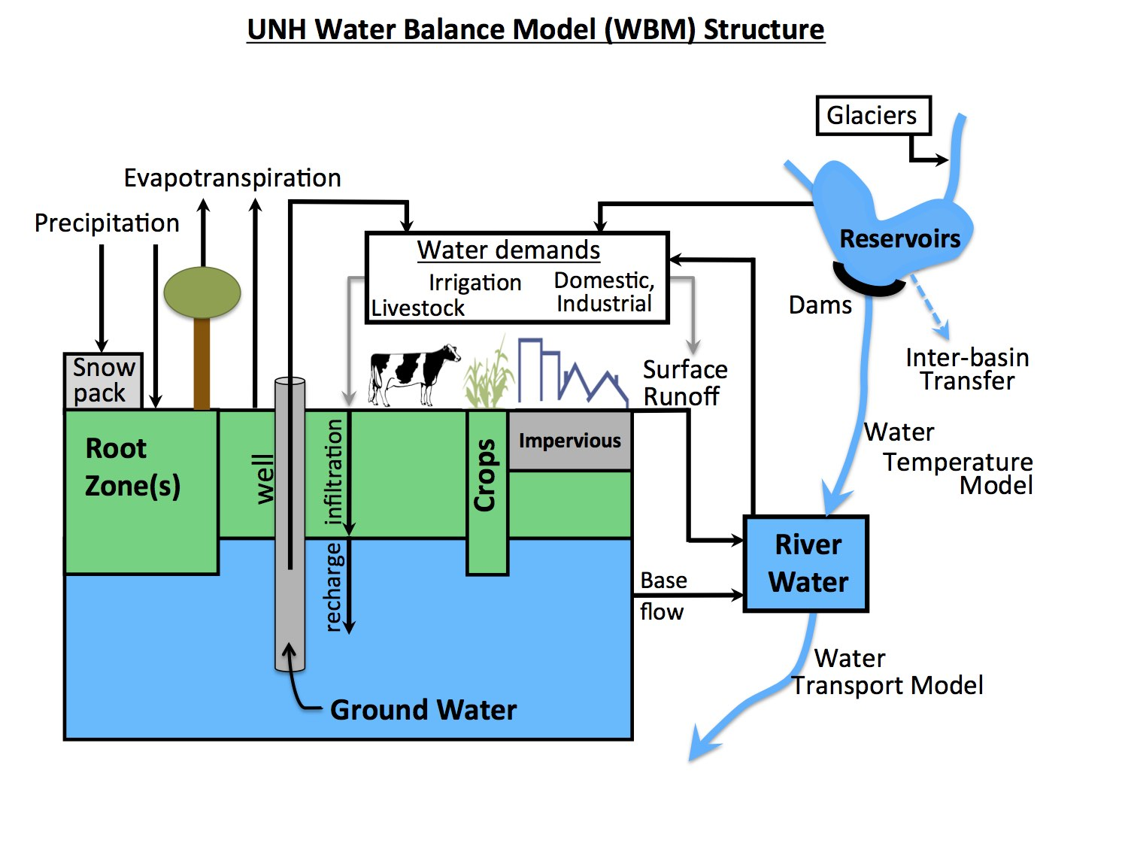
WBM
The Water Balance Model is a process-based hydrologic model that simulates surface water and groundwater, as well as crop water biophysical requirements and use.
Global 5 minute grid cells of land cover, crop composition, soils, and other biophysical characteristics

Slide 21
REDUNDANT?
weather
Precipitation
Temperature
…
Irrigation extent
Water
Groundwater
Decisions
Surface water
Evapotranspiration
…
…
Irrigation extent
Rainfed extent
Irrigation technology
...
…
Environment
Groundwater supply
Surface water supply
Agronomic water demand
Yield gaps
Irrigation efficiency
WBM
SIMPLE-g
input
output
input
output
Yields
Yields of irrigated crops
Yields of rainfed crops

Slide 22
SIMPLE-G
Agricultural Supply
A global-to-local-to-global approach in the Food-Energy-Water systems
Trade-off and synergies
Global food security goals
Local sustainability goals
Domestic and International Trade
Agricultural Productivity
Climate Change
Outcomes*
Ag.Output
Ag. Land Use
Local Environmental Constraints
Water Use
Nitrogen
Land Use
Ag. Prices
Undernutrition
GLOBAL FORCES
Land Use Emission
Population
Income
Agricultural Demand
Bioenergy
Diets
Notes:
a Simplified International Model of agricultural Prices Land use and the Environment (Hertel and Baldos 2016; Baldos and Hertel 2013)
Multi-scale: Local prices as well as national and global prices
Grids are 5 arc-min (10 km), 30 arc-min (50 km), 750meter
Demand for crops, livestock, processed food

Slide 23
Connecting WBM with SIMPLEg through functional forms
1. Groundwater depth change (WBM output) to energy expense (SIMPLEg input)
2. Irrigation equipment change (SIMPLEg output) to irrigation efficiency change (WBM input)
drip
pivot
gravity

Slide 24
Connecting WBM with SIMPLEg through direct grid-level changes in shared model concepts.
Change in irrigated area
Change in rainfed area
SIMPLEg → WBM
SIMPLEg → WBM
% change
% change

Slide 25
Examples of WBM inputs: weather, changes 2010-2015
Precipitation (mm)
Air temperature (C)

Slide 26
Examples of WBM baseline (W0) outputs: Agronomic irrigation requirement, 2010-2015
ET of rainfed crops (mm)
Irrigation requirement (mm)

Slide 27
Examples of WBM baseline (W0) outputs: water supply, 2010-2015
Reservoir storage (m3)
Groundwater head (m)

Slide 28
1- Groundwater head in WBM to groundwater supply in SIMPLE-g
In economics, water supply represents the marginal (incremental) costs of providing more water.
At this stage, we looked at USDA Census of Irrigation to find a relationship between groundwater head and total pumping costs by state.

Slide 29
2- Changes in agronomic water requirement AFWATER: (water productivity)
In hot years, more water is required to produce a given amount of crop output.
In other words, the same amount of water will produce less crop output in hot years than normal years.

Slide 30
Progress so far:
W0:
WBM run 2010-2015
S1W0:
SIMPLE run based on WBM (W0) outputs
W1S1:
WBM run based on SIMPLE (S1)
S2W1:
SIMPLE run based on WBM (W1)

Slide 31
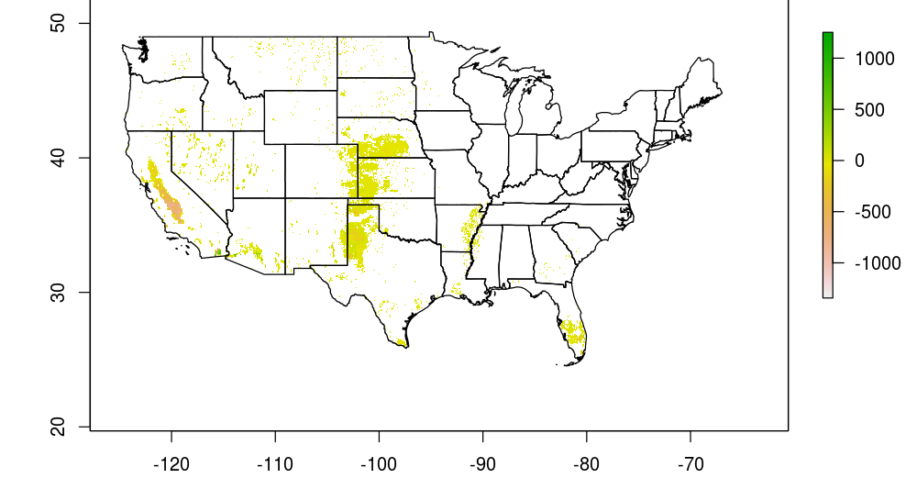
WBM (W1S1) simulation: Change in groundwater irrigation due to cropland and irrigation efficiency changes from SIMPLE-G
mm/Year
Preliminary: this result will likely change as we develop the best model parameterizations

