Slide 1
US Climate Policy Revisited:
The Role of Non-CO₂ Greenhouse Gas Emissions
Maksym Chepeliev and Dominique van der Mensbrugghe
Center for Global Trade Analysis, Purdue University
INFEWS Advisory Board Meeting
December 15, 2020

Slide 2
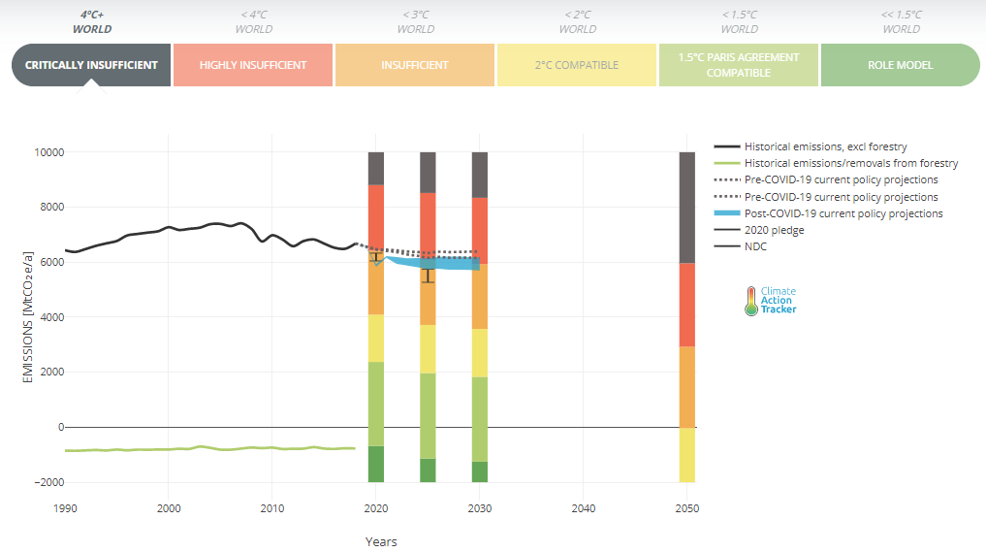
1. U.S. climate mitigation policy: Where do we go next?
Trump Administration has pulled out of the Paris Agreement and relaxed environmental regulations
  Even under initial Paris pledge U.S. contribution was considered insufficient
Much more stringent reductions are needed in line with 2ºC mitigation effort
COVID-19 pandemic will lower emissions by 10%-11% in 2020 (rel. 2019)
Biden Administration has ambitious climate plans
  Carbon free electricity by 2035
  Net zero emissions by 2050
US climate mitigation pledges and emission targets
Source: Climate Action Tracker.
  What are the implications of such ambitious policies for agriculture practices?
  (crop production, crop prices, land rents)

Slide 3
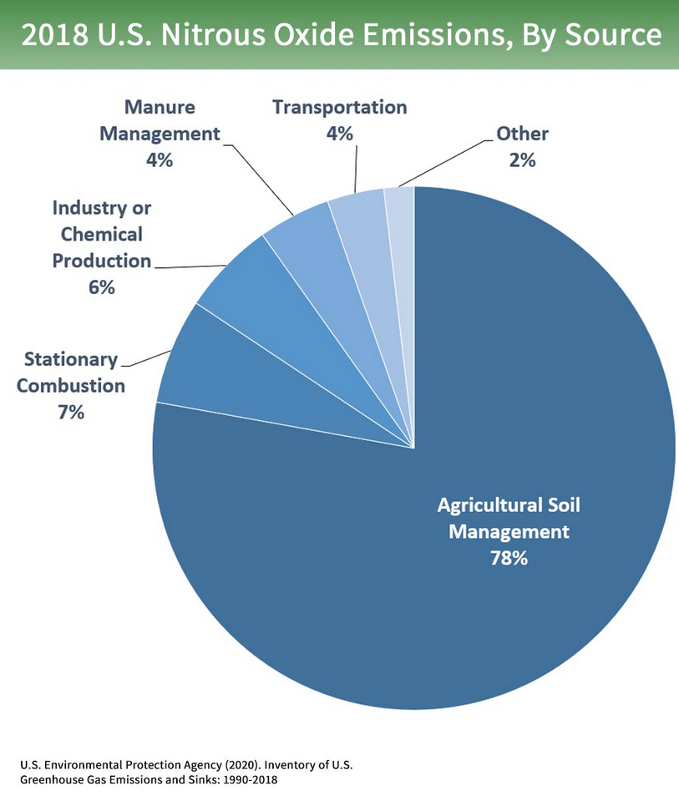
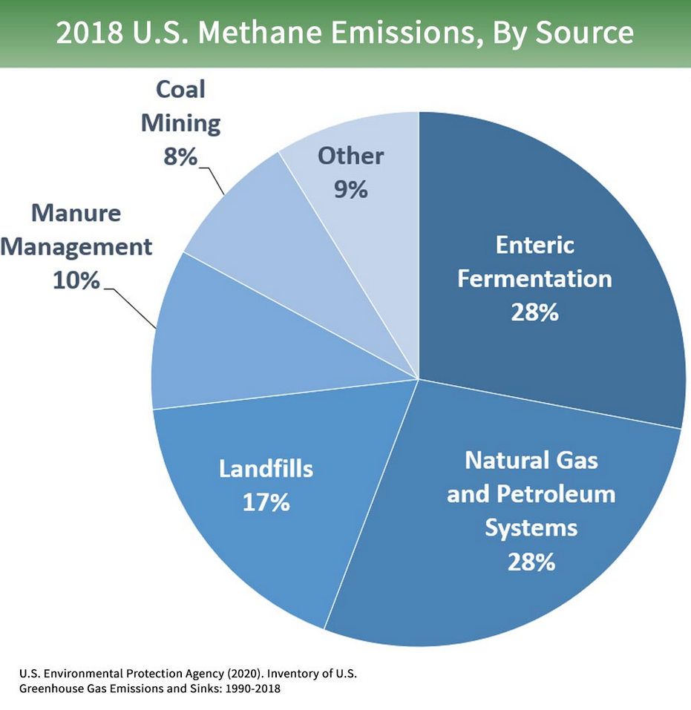
2. Multi-gas mitigation options
Wide variety of instruments could be used to meet mitigation targets:
  Subsidies to clean energy; energy efficiency investments; imposing technical regulations; introducing feebates – some could be attractive to policy makers.
  Most studies strongly argue that carbon taxation is the most efficient way to reduce emissions.
  Multi-gas mitigation options prove to be cheaper than CO₂-based mitigation only, but put more pressure on agriculture (e.g. N₂O emissions from soil management).
Non-CO₂ gasses accounted for 20% of the aggregate US GHG emissions in 2018.
Source: Van Vuuren et al. (2006).

Slide 4



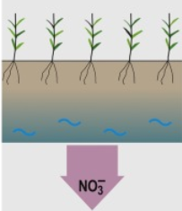
3. Global-to-local linkages of the climate mitigation policies
Global dynamic CGE assessment
Gridded-level analyses
Macro, demographic and environmental drivers of future changes (SSP framework)
Water scarcity assessment
Inputs to the stress scenarios
RFS policy impacts
GHG taxes; changes in drivers
Global climate policies
U.S. mitigation efforts
Nitrate leaching solutions
N₂O taxes
Refined mitigation options
Modes of international climate cooperation
Preliminary ENVISAGE-based assessment for the US:
  $40/tCO₂ tax -> multi-gas mitigation.
  CO₂ only mitigation reaching same carbon budget.
Global dynamic CGE (ENVISAGE)
assessment
Changes in income
Crop production
Crop prices
Food demand
Land rents…
14% cheaper

Slide 5
Thank you!

