Slide 1
Global Land Use Spillovers from US Land Conservation Policies
Preliminary work
INFEWS Stakeholder Advisory Board Meeting
12/15/2020
Uris Baldos, Srabashi Ray, Tom Hertel

Slide 2
Background
Feedback from last SAB meeting: “What is the global impact of domestic set aside of land for nature?”
Here we explore impacts of land leaving US Conservation Reserve program
Focus on crop production, land use and land use change emissions
Need feedback from the advisory board
Is there interest for this?
How to improve on this preliminary output?
Who is interested in this type of work?

Slide 3
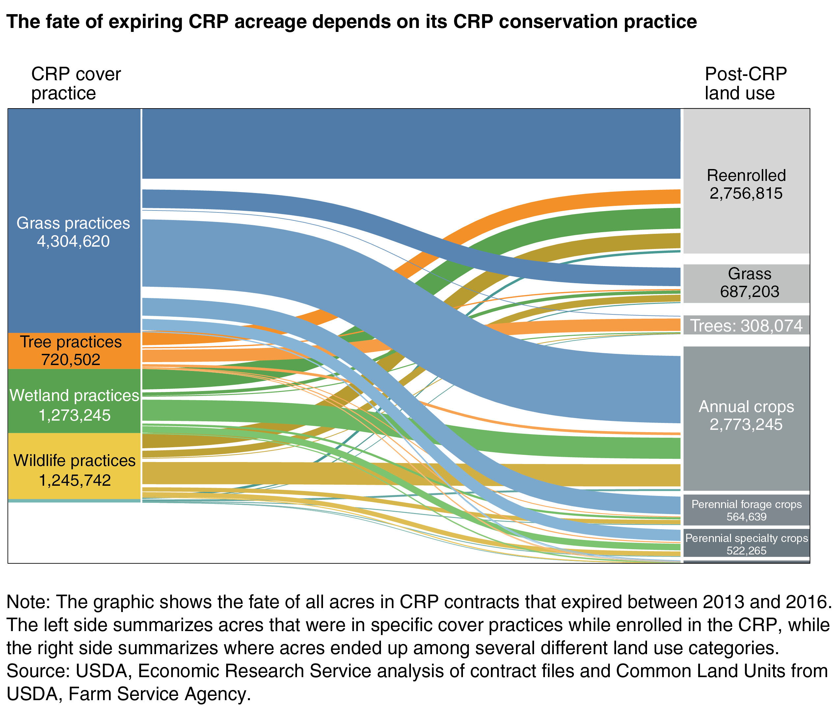
Background
Around 79% of CRP lands enter crop production
Source: https://www.fsa.usda.gov
The Fate of Land in Expiring Conservation Reserve Program Contracts, 2013-16 , by Daniel Bigelow, Roger Claassen, Daniel Hellerstein, Vince Breneman, Ryan Williams, and Chengxia You, ERS, January 2020

Slide 4
Research Question
What are the impacts of land leaving US Conservation Reserve program?
Crop production
Land use (cropland, pasture, managed forests)
Land use change emissions

Slide 5
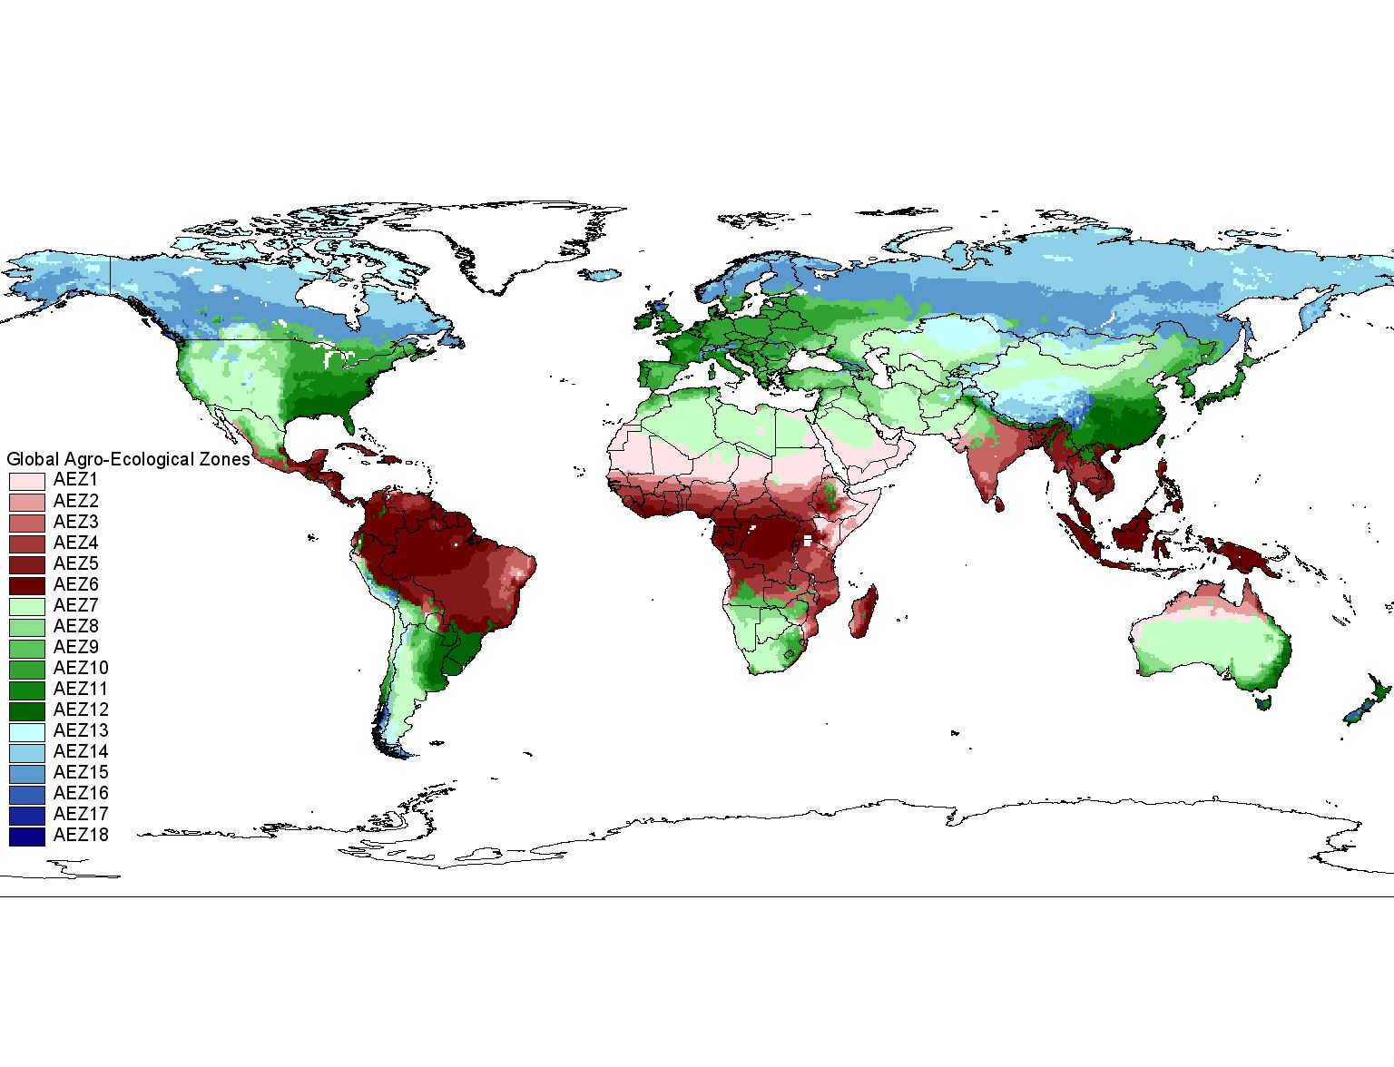
Models and Data
GTAP-AEZ model (Base Data Y2007)
Multiregion, multisector, computable general equilibrium model
Indirect land use change emissions from GTAP-AEZ EF model (Plevin et al, 2014)
Above- and below-ground carbon fluxes from changes in land use change

Slide 6
Preliminary Results
Output growth in US crop sectors results in decline in crop output in RoW

Slide 7
Preliminary Results
Decline in crop output in RoW leads to less cropland use

Slide 8
Preliminary Results
Land leaving Crop sector moves to Managed Forestry and Livestock Sectors

Slide 9
Feedback from the advisory board
Is there interest for this?
How to improve on this preliminary output?
More environmental and economic metrics (Non-CO2 emissions, GDP, trade balance)
Ideas for integrating with other INFEWS applications
Who is interested in this type of work?
Decision makers
Outlets for papers
Audience for outreach

