Slide 1
The impact of agricultural water use on streamflow and yields
Photo credit: NASA
Tara J. Troy, Xiao Zhu, and Xiuyuan Li
Department of Civil Engineering
University of Victoria
British Columbia, Canada

Slide 2
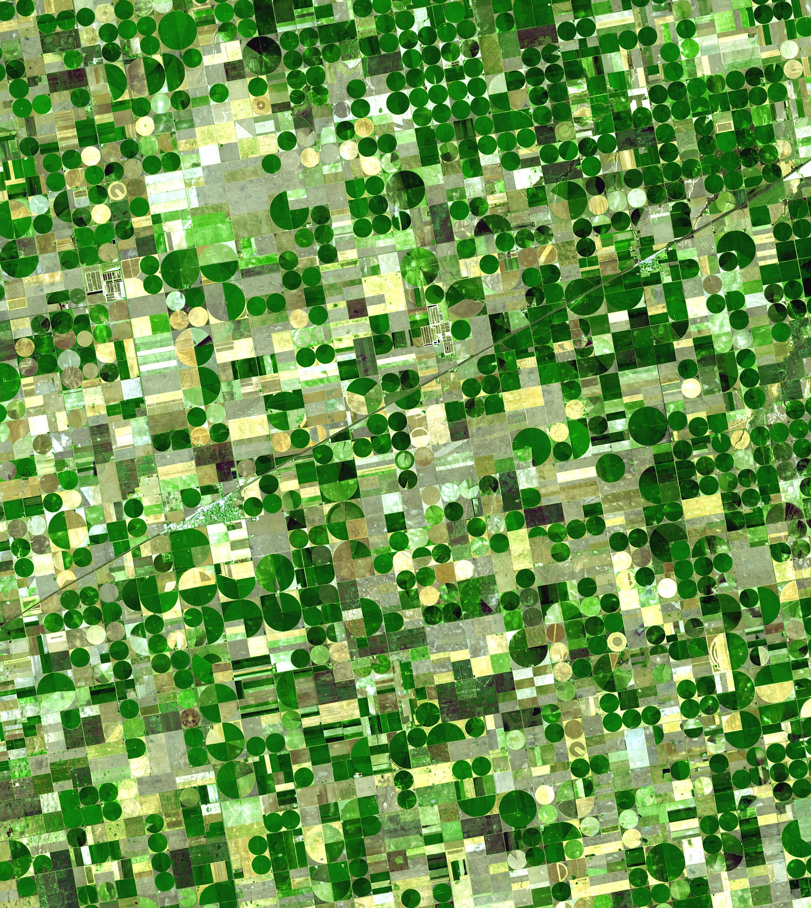
Research motivation
Irrigation improves yields: 34% for wheat and 22% for maize globally (Wang et al, 2021)
Agriculture is the largest consumptive use of water, globally and in the US
Climate change will impact both water resources and agriculture. Irrigated water demands are projected to increase (Wada et al, 2013)
Photo source: USDA

Slide 3
Groundwater & irrigated ag: Who consumes it?
Marston et al., PNAS, 2015

Slide 4
How does agricultural water use impact streamflow?

Slide 5
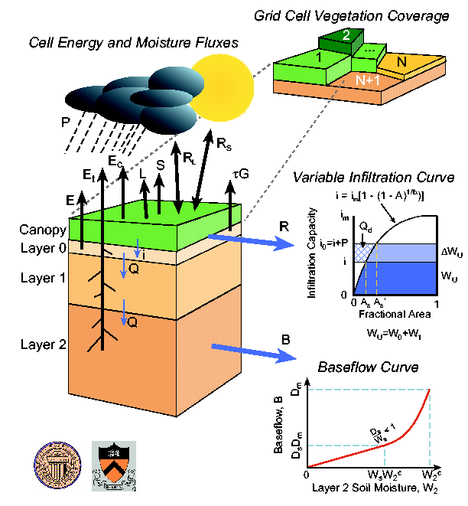
Agricultural impacts on streamflow: Modeling framework
P, T, Wind
Meteorological data
Reference Crop ET
Crop water demands =
f(ET, PET, kc)
Vegetation and soil data
Surface water withdrawals
VIC Land Surface Model
Runoff,
Baseflow
Simplified streamflow routing model
Notes:
Crop water demands - did a VIC run with only short and tall reference crops. Then looked at difference in actual and potential ET

Slide 6
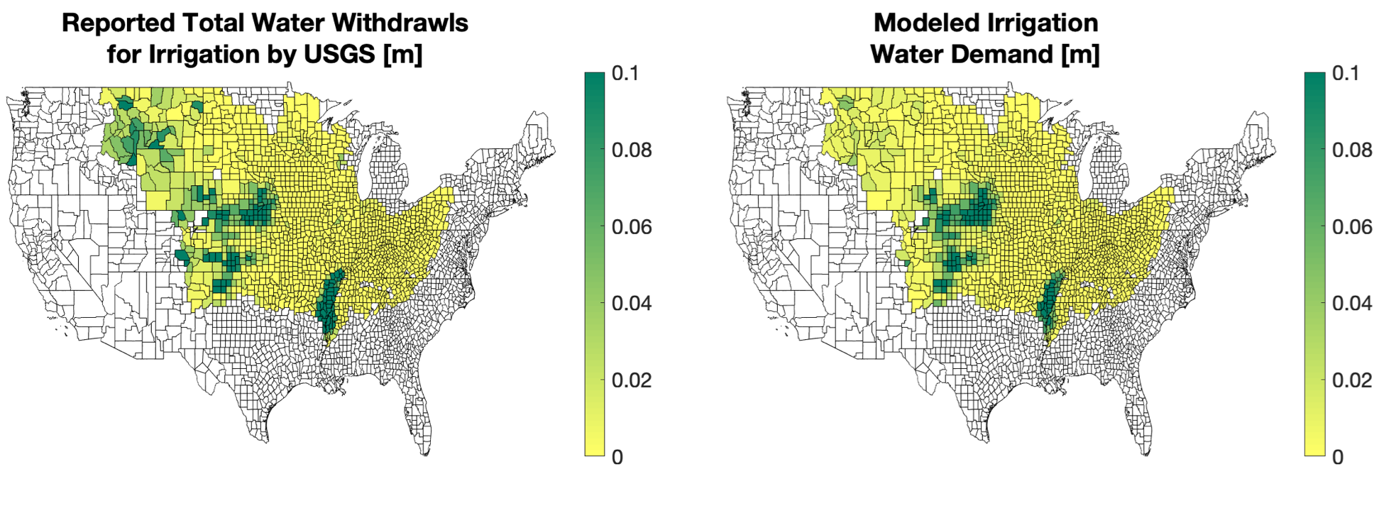
Validation: Irrigation Water Demand (blue water)
Zhu and Troy, in preparation

Slide 7
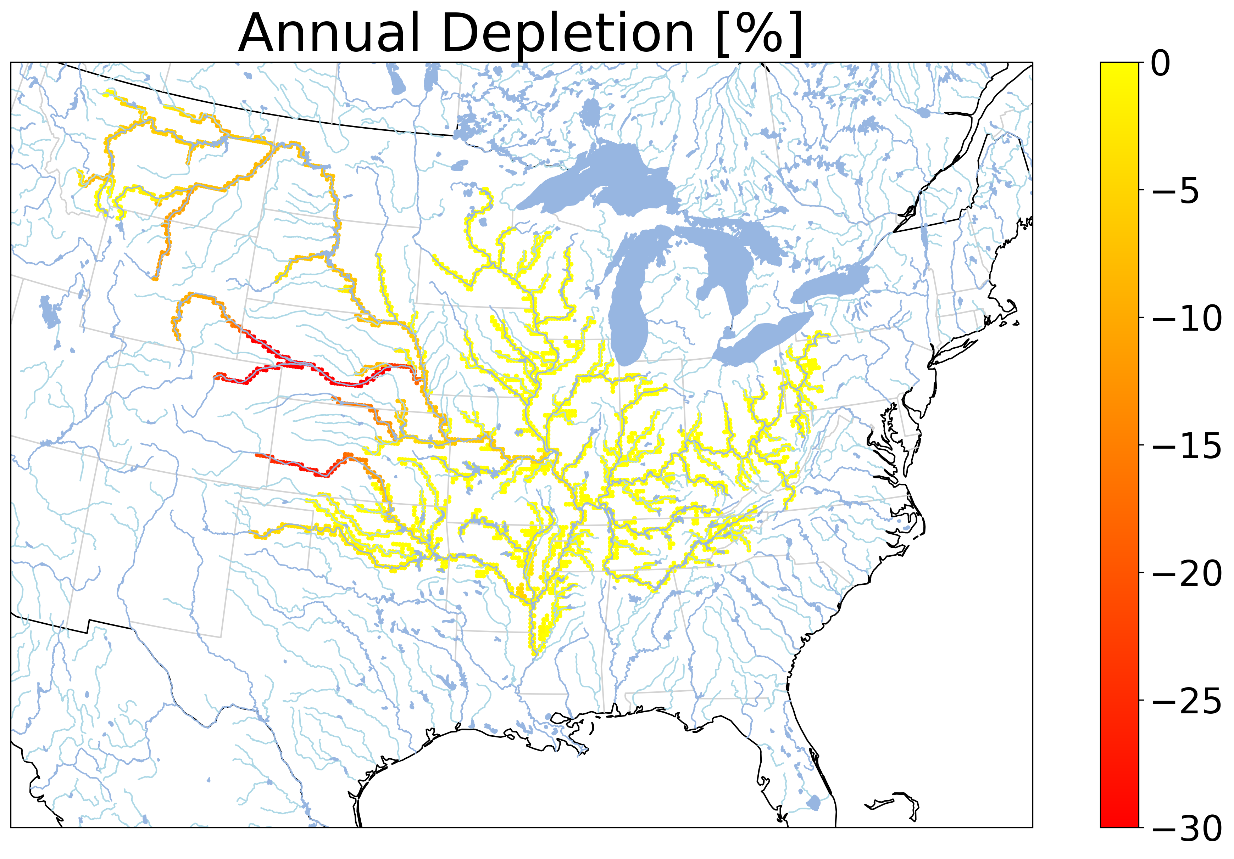
Streamflow decreases due to irrigation surface water use
Zhu and Troy, in preparation

Slide 8
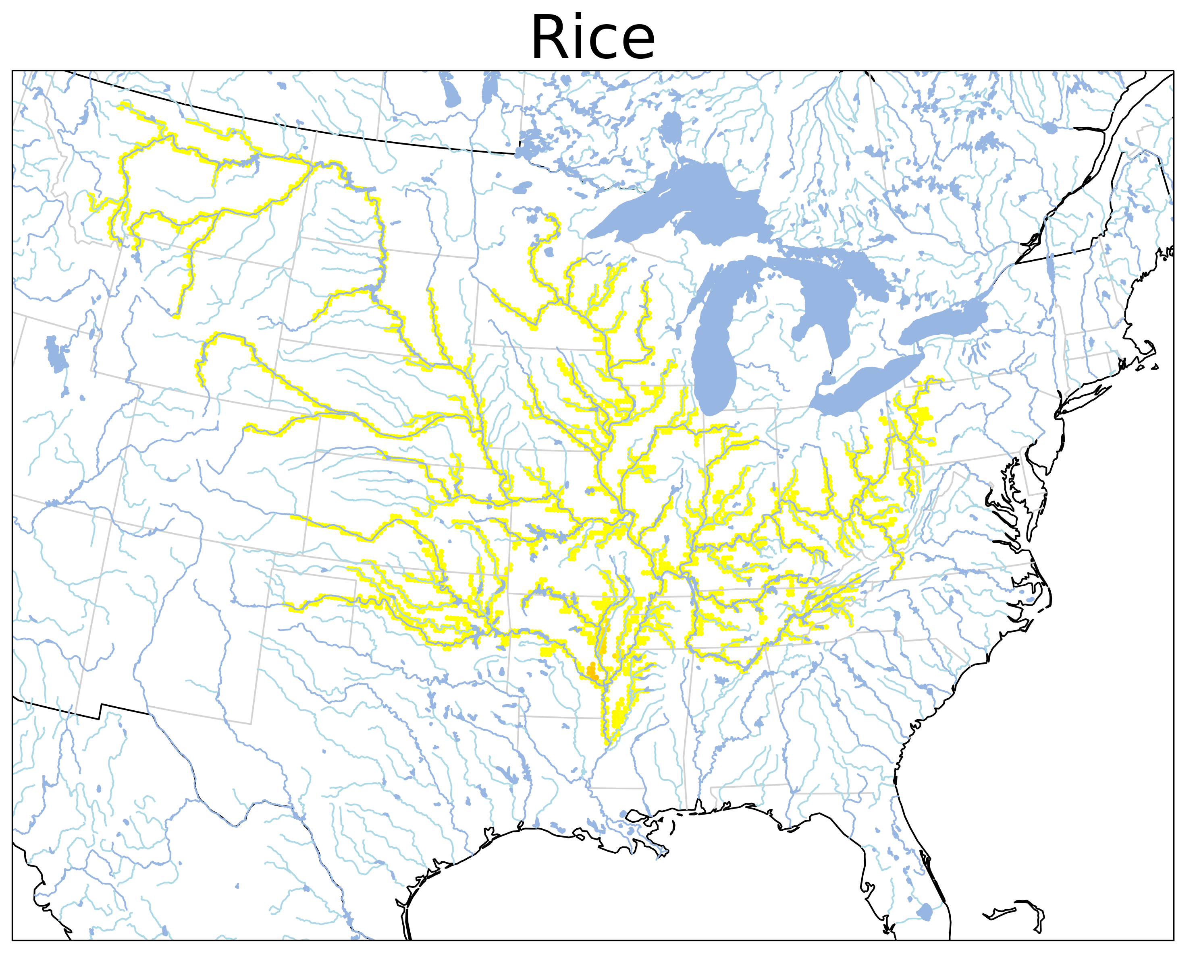
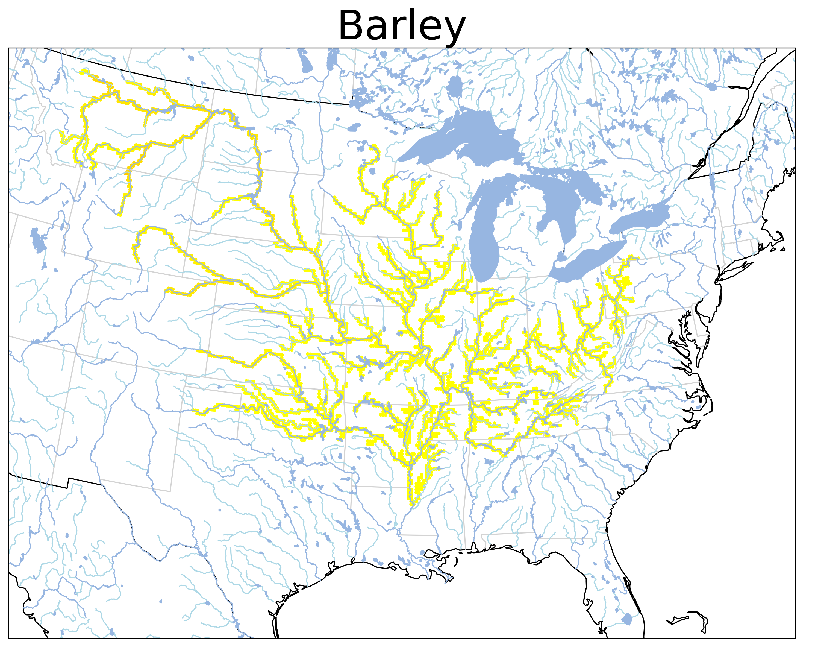
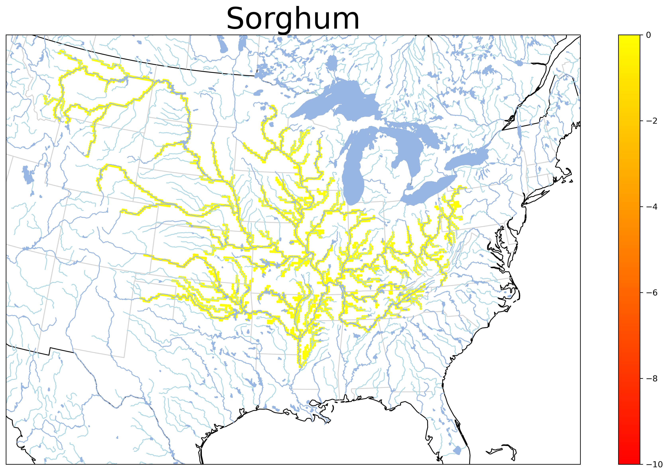
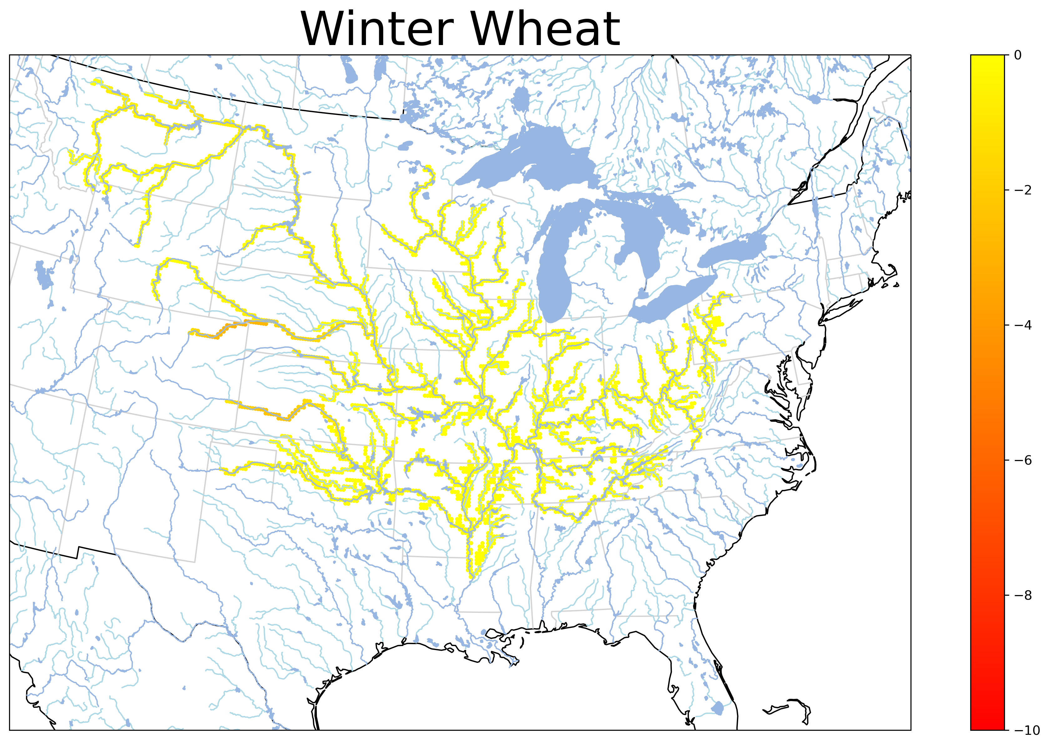
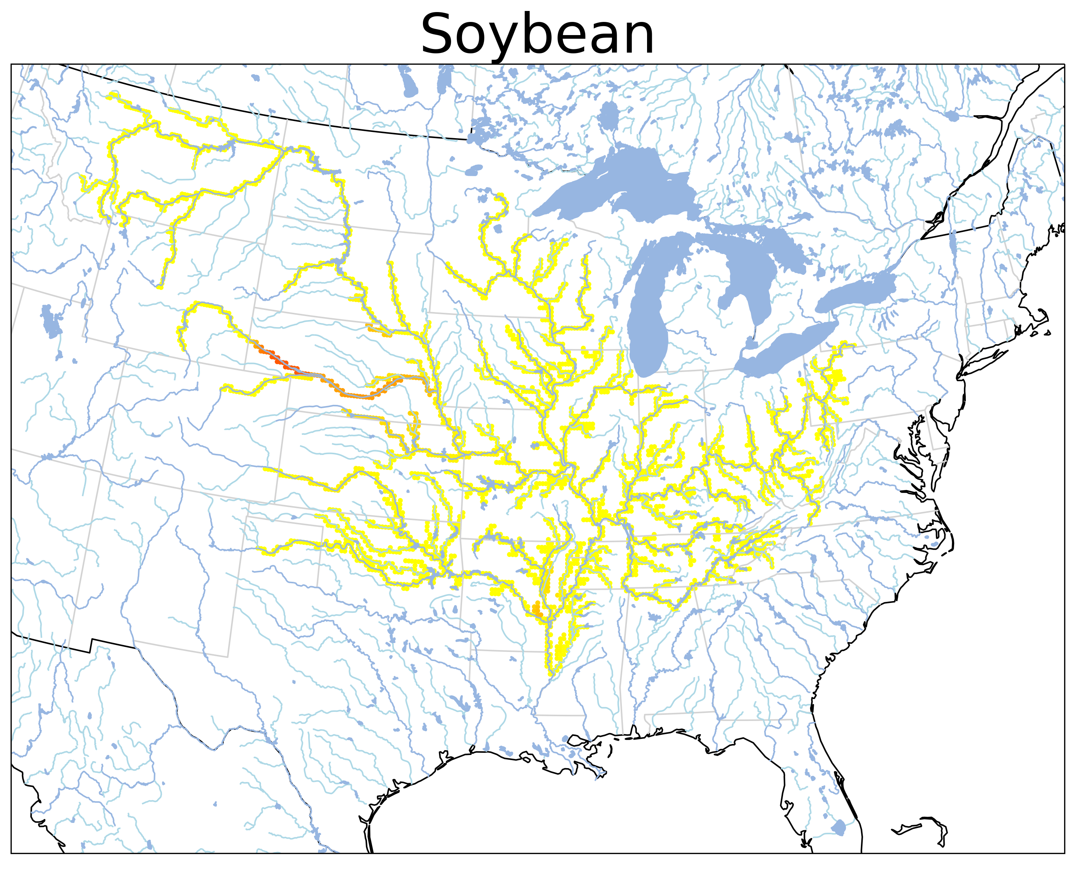
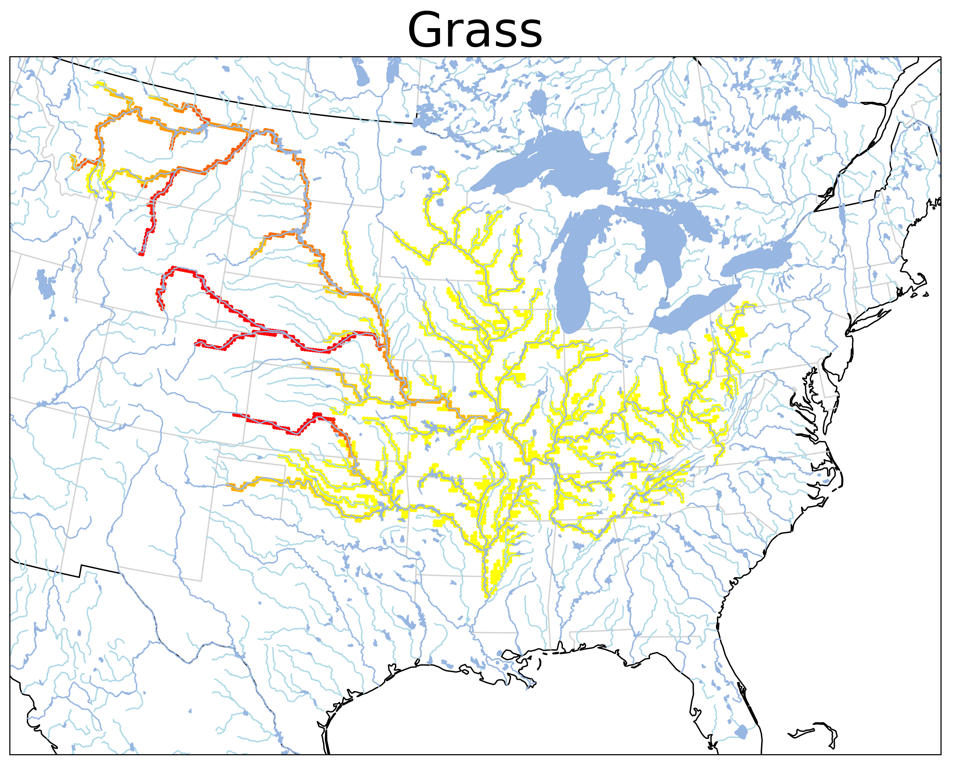
Relative Importance of Crop Type
% Depletion in Annual Q
0
10
Zhu and Troy, in preparation

Slide 9
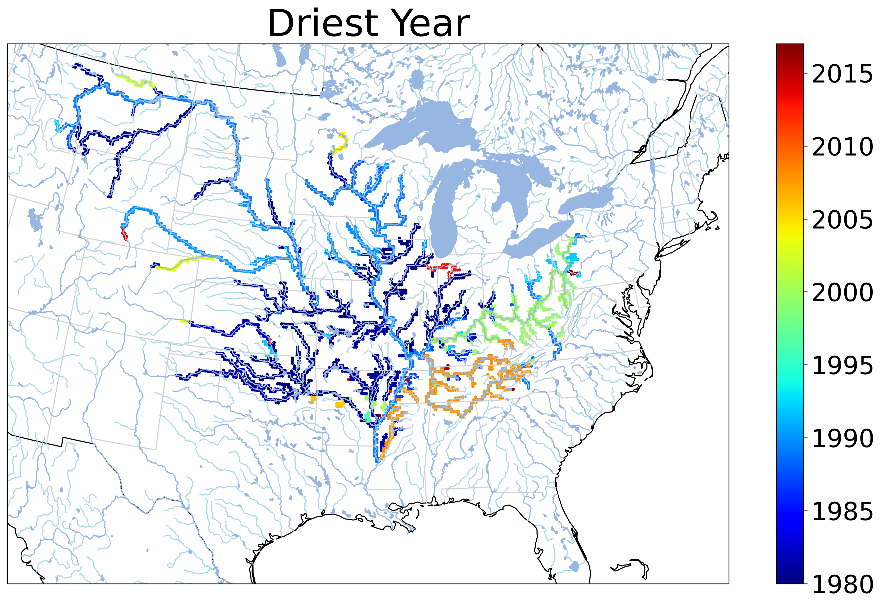
Role of Irrigation During Drought
Driest Year
Zhu and Troy, in preparation

Slide 10
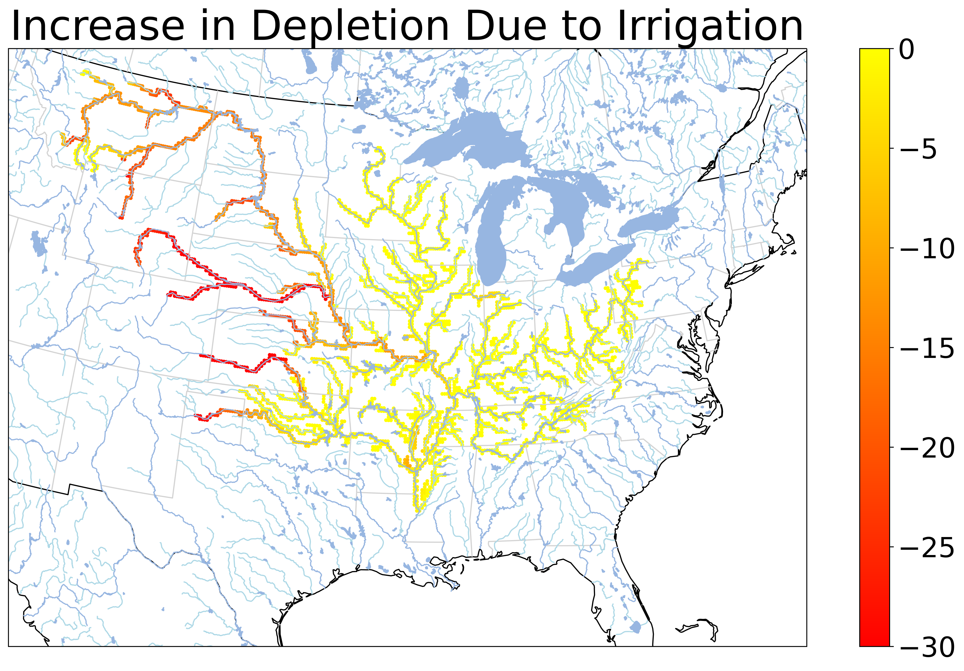
Role of Irrigation During Drought
% Increase in Depletion Due to Irrigation
Driest Year
Zhu and Troy, in preparation

Slide 11
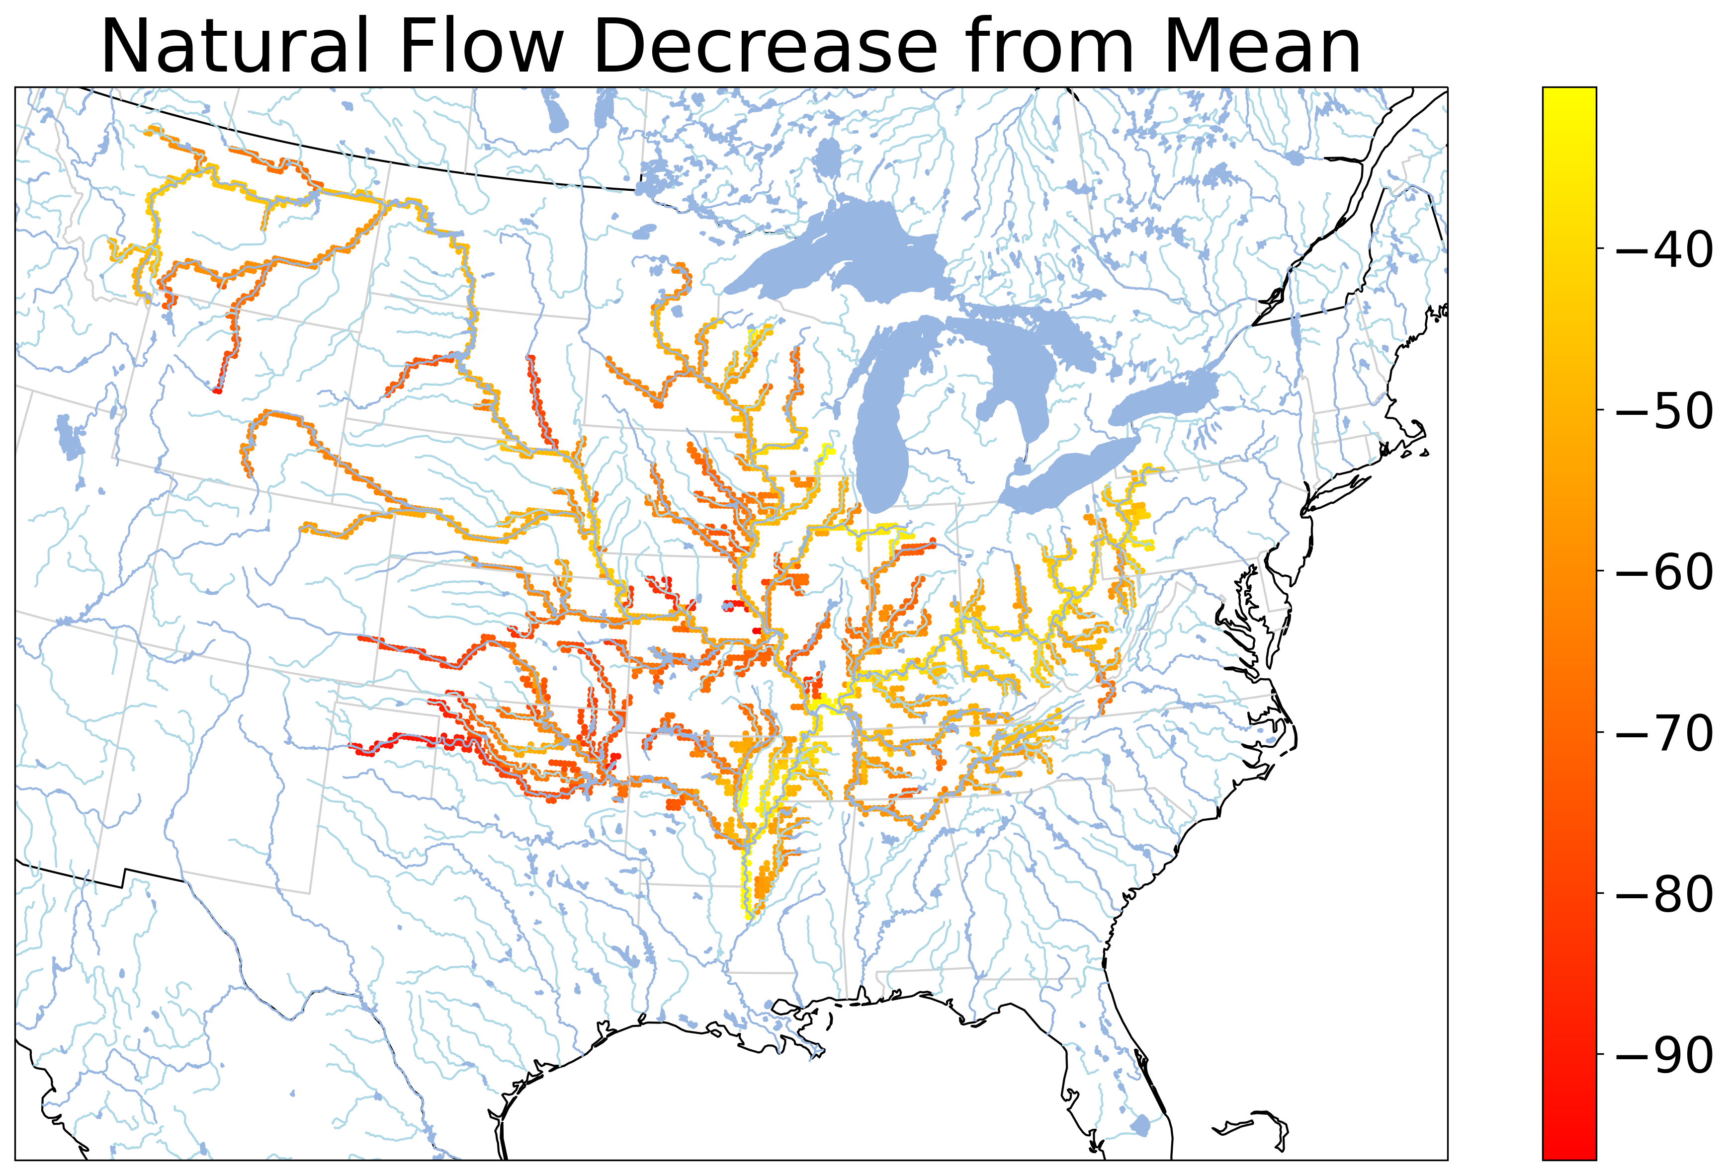
Role of Climate During Drought
% Decrease in Naturalized Flow Compared to Mean
% Decrease in Streamflow Due to Irrigation
Note different scales!
Zhu and Troy, in preparation

Slide 12
How does irrigation improve crop yields?

Slide 13
USDA Yield Data
Estimates of county-level yields for 1970 until last harvest
Includes estimates of rainfed and irrigated yields for many counties west of the Mississippi
Li and Troy, ERL, 2018

Slide 14
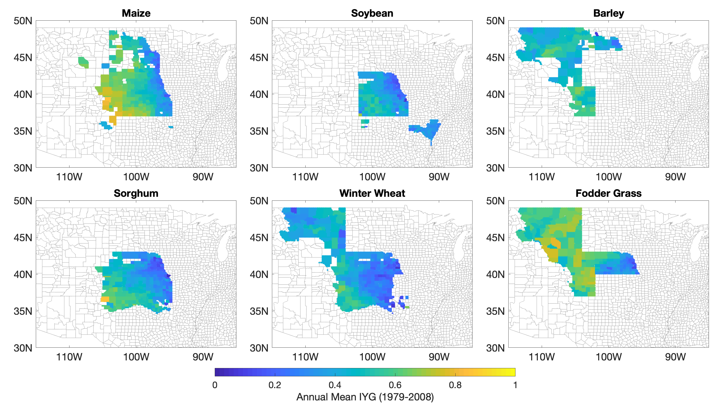
Mean Irrigated Yield Gains
$$IYG=\frac{Y_{i}−Y_{r}}{Y_{i}}$$
Yi: Irrigated Yield
Yr: Rainfed Yield
Li and Troy, ERL, 2018

Slide 15
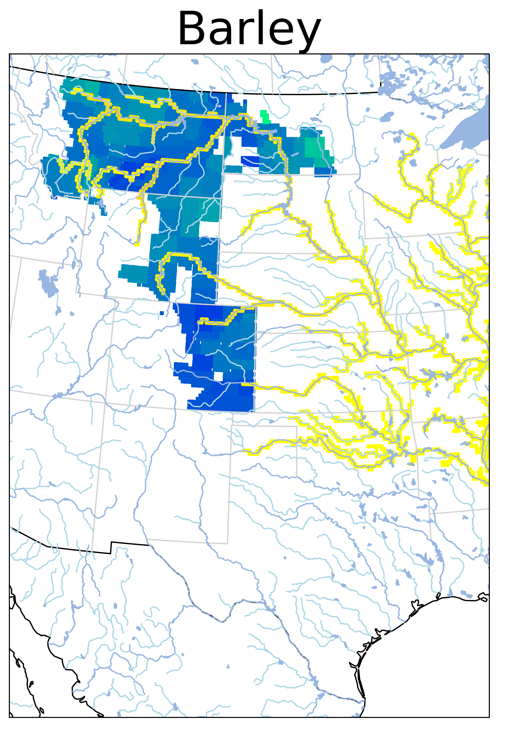
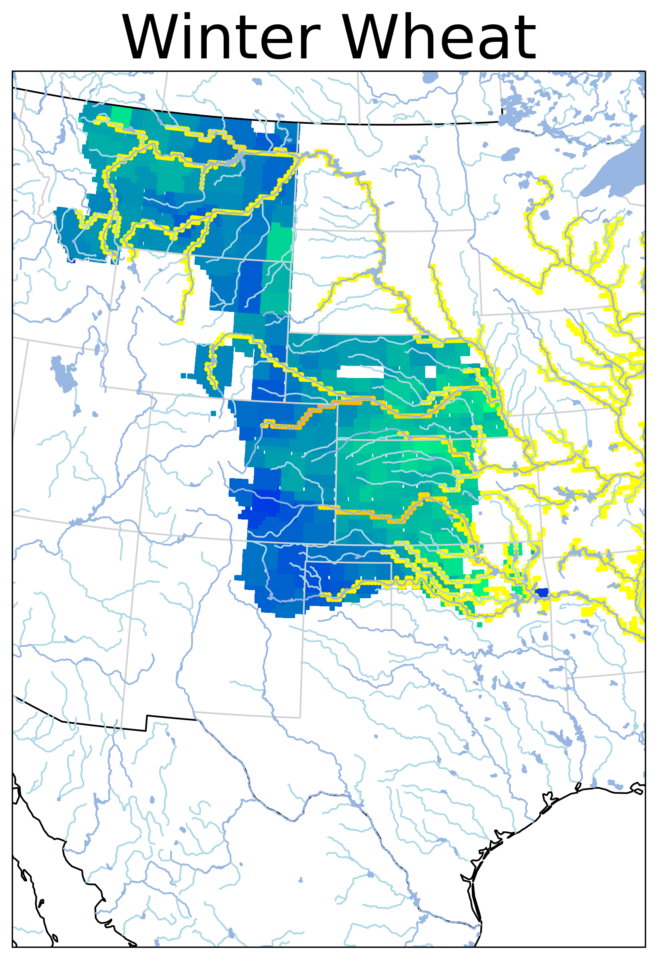
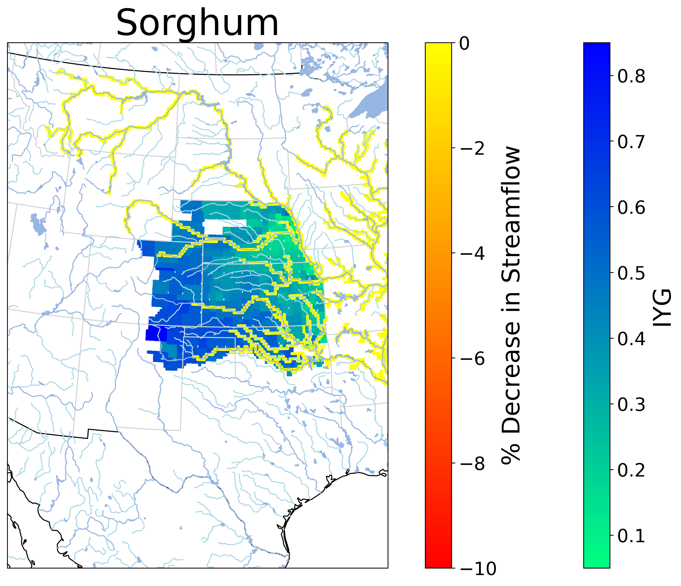
IYG and stream depletion
$$IYG=\frac{Y_{i}−Y_{r}}{Y_{i}}$$
Zhu, Li and Troy, in preparation

Slide 16
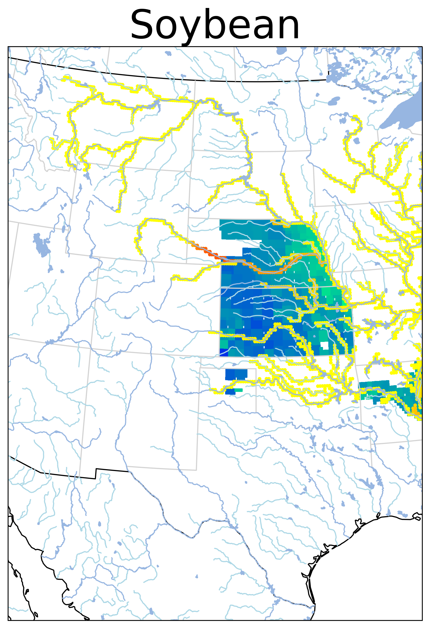
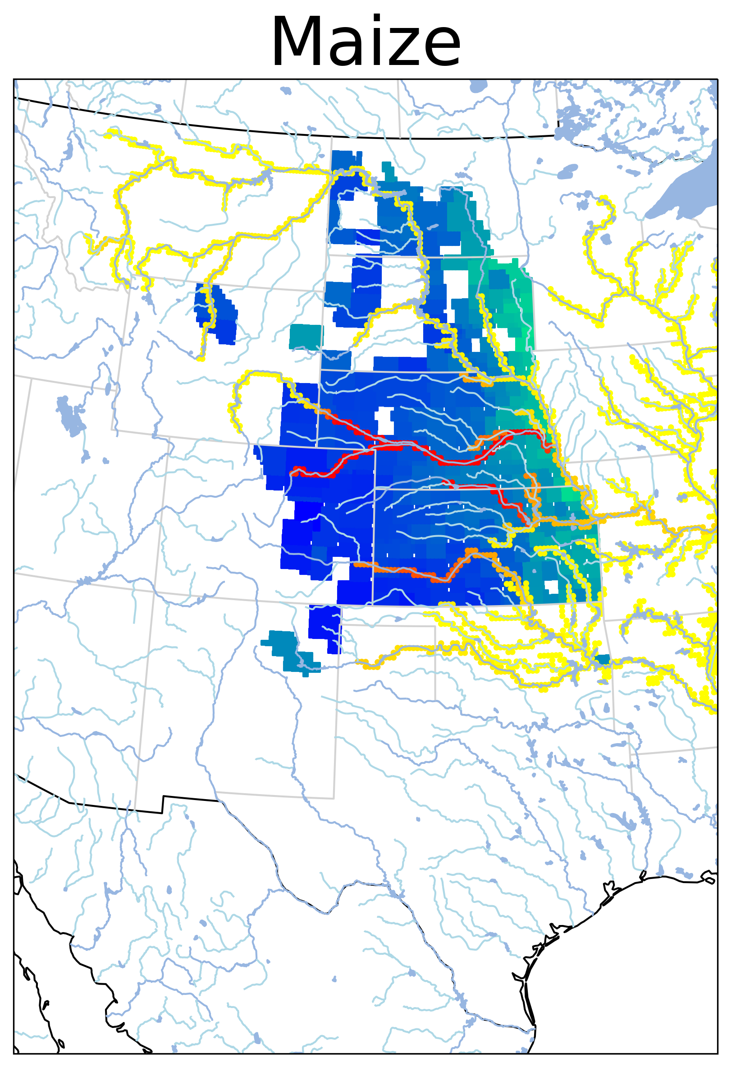
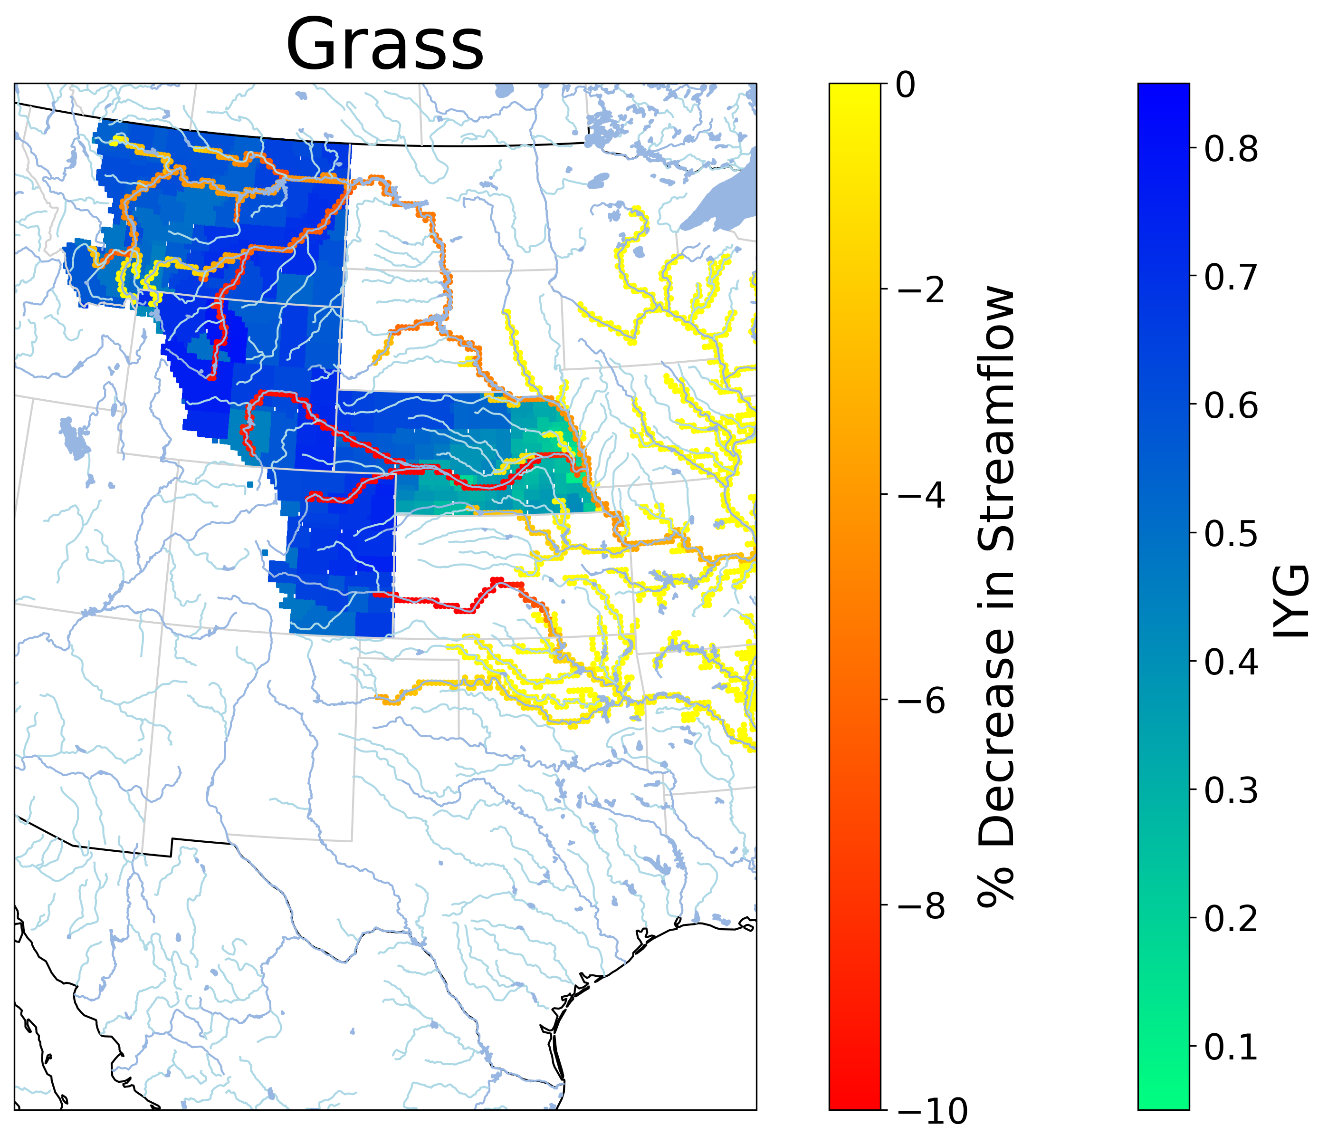
IYG and stream depletion
$$IYG=\frac{Y_{i}−Y_{r}}{Y_{i}}$$
Zhu, Li and Troy, in preparation

Slide 17
Open research questions
What is the “optimal” balance of agricultural water use to ensure sustainable water resources and food production under climate change? What is the role of infrastructure, broadly defined, in this? What does the feasible solution space look like?
How do we reconcile the wide range of spatial scales, from a farm up to global, in ensuring a sustainable future? Is the system sufficiently resilient to shocks, particularly if they become more frequent?
How would the answer to the questions above change if we factor in water quality and groundwater?

